Slide 1
What is NetLogo
Multi-agent programmable modeling environment
Well suited for modeling complex systems evolving over time
Hundreds or thousands of independent agents operating concurrently
Exploring the connection between the micro-level behavior of individuals and the macro-level patterns that emerge from the interaction of many individuals
UH-DMML

Slide 2
What is NetLogo
Easy-to-use application development environment
Opening simulations and playing with them
Creating custom models: quickly testing hypotheses about self-organized systems
Models library: large collection of pre-written simulations in natural and social sciences that can be used and modified
Simple scripting language & User-friendly graphical interface
UH-DMML

Slide 3
What is NetLogo
History
LOGO (Papert & Minsky, 1967)
Theory of education based on Piaget’s constructionism (“hands-on” creation and test of concepts)
Simple language derived from LISP
Turtle graphics and exploration of “microworlds”
StarLogo (Resnick, 1991), MacStarLogo, StarLogoT
Agent-based simulation language
Exploring the behavior of decentralized systems through concurrent programming of 100s of turtles
UH-DMML

Slide 4
What is NetLogo
History
NetLogo (Wilensky, 1999)
Further extending StarLogo (continuous turtle coordinates, cross-platform, networking, etc.)
Most popular today (growing cooperative library of models)
UH-DMML

Slide 5
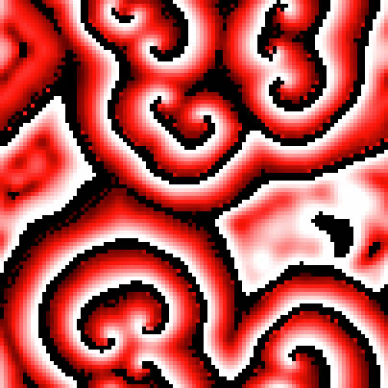
What is NetLogo
World of NetLogo
NetLogo is a 2-D world made of 4 kinds of agents:
patches – make up the background or “landscape”
turtles – move around on top of the patches
observer – oversees everything going on in the world
links – agents that connect two turtles
patch-only models
UH-DMML

Slide 6
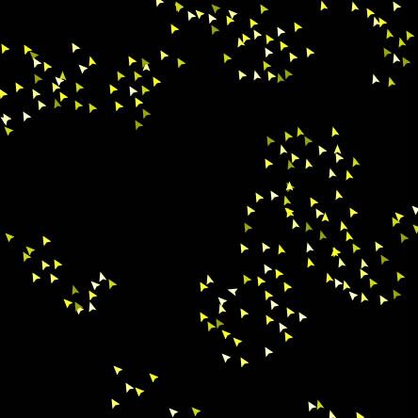
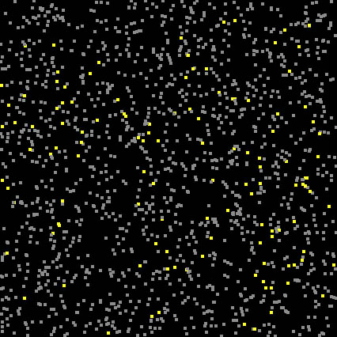
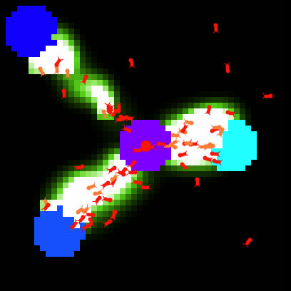
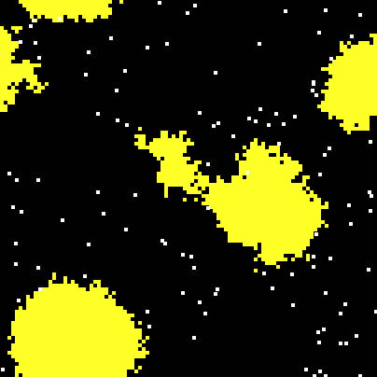
What is NetLogo
turtle-only models
turtle & patch models
UH-DMML

Slide 7
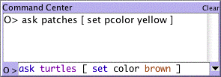
Graphic Interface
Controls
Allow to run and control the flow of execution
buttons
command center
Buttons - initialize, start, stop, step through the model
“once” buttons execute one action (one piece of code)
“forever” buttons repeat the same action (the same piece of code) until pressed again
Command center – ask observer, patches or turtles to execute specific commands “on the fly”
UH-DMML

Slide 8
What is NetLogo
Settings
Allow to modify parameters
sliders
switches
choosers
sliders – adjust a quantity from min to max by an increment
initial-number-sheep = 82
switches – set a Boolean variable (true/false)
show-energy? = false
UH-DMML

Slide 9
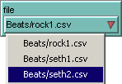
What is NetLogo
Settings
choosers – select a value from a list
file = “Beats/seth2.csv”
UH-DMML

Slide 10
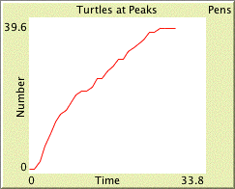
What is NetLogo
Views
output text areas – log text info
monitors
Plots
output text areas
graphics window
monitors – display the current value of variables
plots – display the history of a variable’s value
UH-DMML

Slide 11
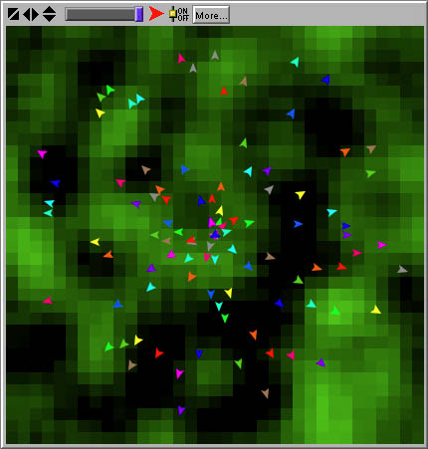
What is NetLogo
Views
output text areas – log text info
graphics window
UH-DMML

Slide 12
Programming Concepts
Agents -- carry out their own activity, all imultaneously.
patches
turtles
observer
links
Patches
don’t move, form a 2-D wrap-around grid
have integer coordinates (pxcor, pycor)
Turtles
move on top of the patches, not necessarily in their center
have decimal coordinates (xcor, ycor) and orientation (heading)
UH-DMML

Slide 13
Programming Concepts
Observer
can create new turtles
can have read/write access to all the agents and variables
Links
Links do not have coordinates.
Every link has two ends, and each end is a turtle
UH-DMML

Slide 14
Programming Concepts
Procedures
Commands
actions for the agents to carry out (“void” functions)
to setup ca crt 10 end
UH-DMML

Slide 15
Programming Concepts
Reporters
report a result value (functions with return type)
to-report absolute-value [ number ]
ifelse number >= 0
[ report number ]
[ report 0 -number ]
end
UH-DMML

Slide 16
Programming Concepts
Primitives
built-in commands or reporters (language keywords)
some have an abbreviated form:
create-turtles → crt
clear-all → ca, etc.
Procedures
custom commands or reporters (user-made)
UH-DMML

Slide 17
Programming Concepts
Variables – places to store values (such as numbers or text)
global variables
turtle & patch variables
local variables
Global variables
only one value for the variable
every agent can access it
Turtle & patch variables
each turtle/patch has its own value for every turtle/patch variable
Local variables
defined and accessible only inside a procedure
scope = narrowest square brackets or procedure itself
UH-DMML

Slide 18
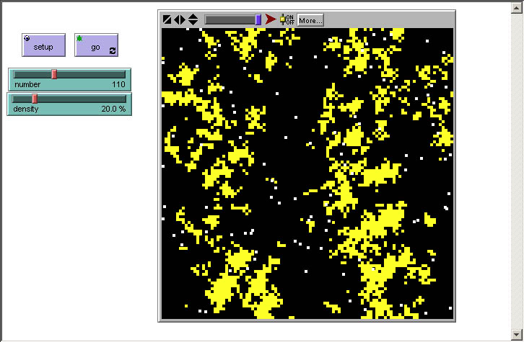
Tutorial
Build Termite Module
Two buttons
Setup → observer, once
Go → turtles, forever
Two sliders
number1 →300
density0 →100%
UH-DMML

Slide 19
Tutorial
Randomly strew yellow wood chips (patches) with given density
to setup-chips
ask patches [ if random-float 100 < density
[ set pcolor yellow ] ]
end
to setup-termites
create-turtles number
ask turtles [ set color white
setxy random-float screen-size-x
random-float screen-size-y ]
end
to setup
ca setup-chips setup-termites
end
UH-DMML

Slide 20
Tutorial
Termites (turtles) follow 3 rules:
1 look around for a wood chip and pick it up
2 look around for a pile of wood chips
3 look around for an empty spot in the pile and drop off the chip
to go ; turtle code
pick-up-chip
find-new-pile
drop-off-chip
end
UH-DMML

Slide 21
Tutorial
Variables – places to store values (such as numbers or text)
global variables
turtle & patch variables
local variables
Global variables
only one value for the variable
every agent can access it
Turtle & patch variables
each turtle/patch has its own value for every turtle/patch variable
Local variables
defined and accessible only inside a procedure
scope = narrowest square brackets or procedure itself
UH-DMML

Slide 22
Tutorial
Variables – places to store values (such as numbers or text)
global variables
turtle & patch variables
local variables
Global variables
only one value for the variable
every agent can access it
Turtle & patch variables
each turtle/patch has its own value for every turtle/patch variable
Local variables
defined and accessible only inside a procedure
scope = narrowest square brackets or procedure itself
UH-DMML

