Slide 1
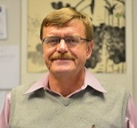
2015 Research Areas and Projects
Data Mining and Machine Learning Group (UH-DMML)
Its research is focusing on:
Spatial Data Mining
Clustering and Anomaly Detection
Classification and Prediction
GIS
2. Current and Planned Projects
Clustering Algorithms with Plug-in Fitness Functions and Other Non-Traditional Clustering Approaches
Analyzing and Doing Useful Things with Bio-aerosol Data quite new
Using Mixture Models for Anomaly Detection and Change Analysis quite new
Interestingness Scoping Algorithms for the Analysis of Spatial and Spatio-temporal Datasets
Taxonomy Generation—Learning Class Hierarchies from Training Data
Understanding, Preventing, and Recovery from Flooding just starting
Educational Data Mining (lead by Nouhad Rizk)
UH-DMML

Slide 2
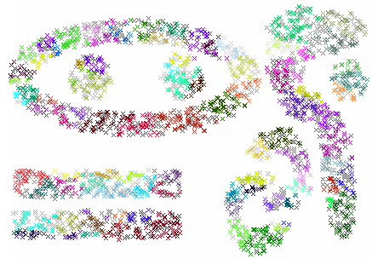
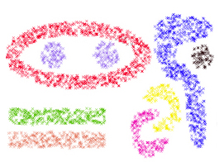
1. Non-Traditional Clustering Algorithms
Clustering Algorithms
With plug-in Fitness Functions
Clustering Polygons and
Trajectories
Mining
Spatio-Temporal
Datasets
MOSAIC STAXAC
Agglomerative
Clustering Algorithms
AVALANCHE
Prototype-based
Clustering
Parallel Computing
Input
Output
CLEVER
Illustration of MOSAIC’s approach
UH-DMML

Slide 3
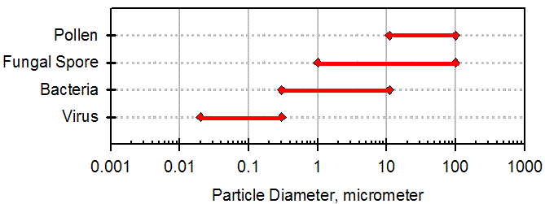
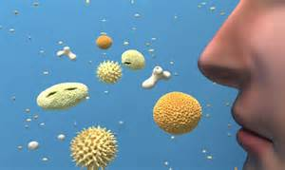
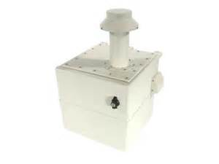
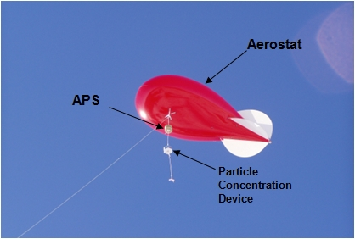
2. Understanding and Doing Useful Things with Bio-areosol Data
Definition: A bioaerosol (short for biological aerosol) is a suspension of airborne particles that contain living organisms or were released from living organisms.^{[1]} These particles are very small and range in size from less than one micrometer (0.00004") to one hundred micrometers (0.004").
Research Questions
Characterization of the Bio-aerosol Composition at a Particular Location
Anomaly Detection and Change Analysis for Bio-aerosols
Understanding Disease Spread
Sensor-based Bio-aerosol Early Warning Systems
…
[1] Wathes, Christopher M.; Cox, C. Barry (1995). Bioaerosols handbook. Chelsea, Mich: Lewis Publishers. ISBN 0-87371-615-9.
UH-DMML

Slide 4
3. Using Mixture Models for Anomaly Detection and Change Analysis
Set of Sensor Reading
Analysis Function₁
Analysis Function₂
Model Fitting
. . .
Probabilistic Model
Analysis Function_{k}
Sensor Modeling Toolbox
The Sensor Modeling Toolbox will be used for the following tasks:
Change analysis and anomaly detection (based on sensor readings)
For creating background models of particular sensors at particular locations
Development of sophisticated threat assessment functions that operate on the top of the toolbox
UH-DMML

Slide 5
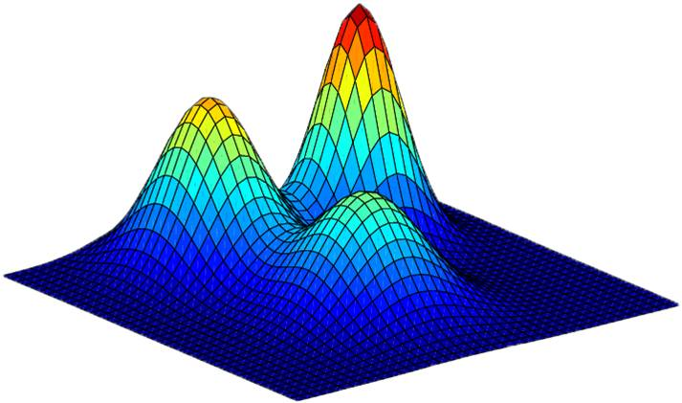
Gaussian Mixture Models
Uses a parametric probability density function represented as a weighted sum of Gaussian component densities
p(x) = $\sum_{k=1}^{K}{Prk}$ * N(x|µ_{k}, ∑_{k})
$Prk$ = Prior probabilities / weights of each component Gaussian.
µ_{k} = Mean of k^{th} Gaussian.
∑_{k} = Covariance Matrix of k^{th} Gaussian.
x = Data point under consideration.
N(x|µ_{k}, ∑_{k}) = Density of x in k^{th} Gaussian
= $\frac{1}{\sqrt{\left(2π\right)d|∑k|}}$ exp$\left(−\frac{1}{2}\left(x−μk\right)T∑k⎻1\left(x−μk\right)\right)$
K = Total number of Gaussian Components.
Model Selection
EM
BIC/Akaike/…
Data Set

Slide 6
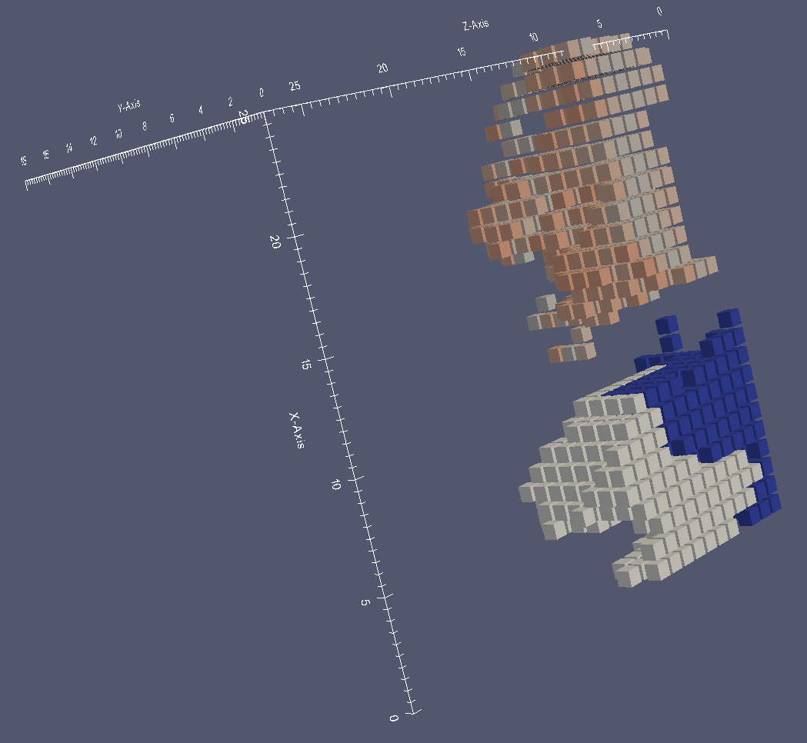
4. Interestingness Hotspot Discovery Framework for Grids
Objective: Find interesting hotspots in 4D grid-based datasets using plugin interestingness functions.
Methodology:
Find hotspots in grid-based spatio-temporal datasets using hotspot discovery algorithms and clustering techniques. Employ plugin interestingness and reward functions to guide the search for “good” hotspots.
Generate cluster summaries
Visualize 4-dimensional spatio-temporal clusters and cluster summaries
Dataset: We are working on a 4-dimensional grid-based air pollution dataset.
Each grid cell overs a 4x4 km area. There are 150,000 4D grid cells.
Grid cells have latitude, longitude, layer (altitude), and time dimensions.
Each grid cell is associated with hourly observations of 132 compounds in the air.
Low variation hotspots
UH-DMML

Slide 7
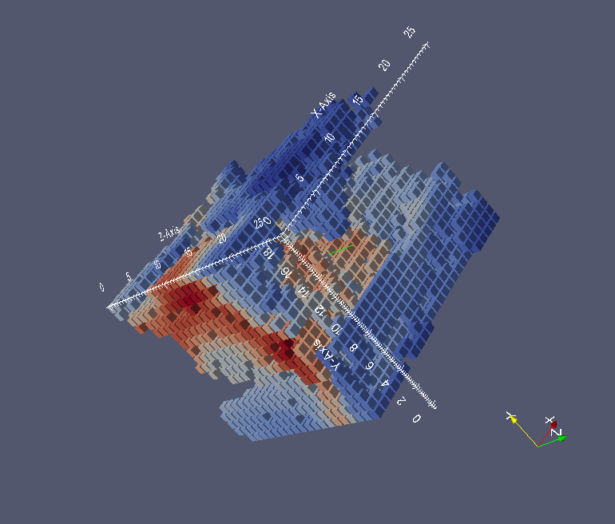
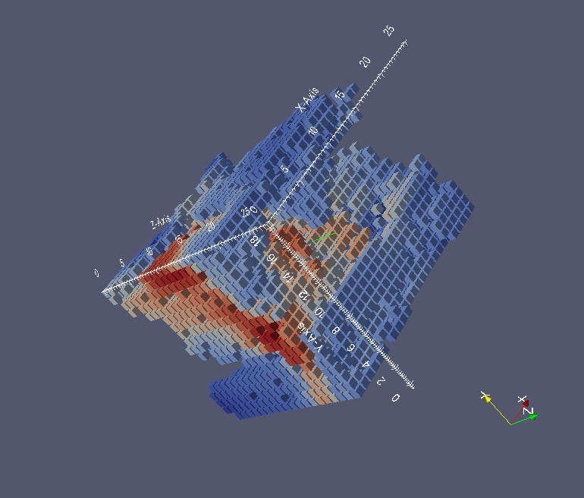
Interestingness Hotspot Discovery Framework for Grids
Problem: Find 4D contiguous regions maximizing a plugin reward function:
Reward(R) = interestingness(R) x size(R)^{β} where
Interestingness(R) = $\left\{\begin{aligned}0, if |correlation\left(R_{v1,v2}\right)|<th \\ |correlation\left(R_{v1,v2}\right)|−th , otherwise\end{aligned}\right\}$
Where 0 < th < 1 is the reward threshold, $correlation\left(R_{v1,v2}\right)$ is the correlation of the 2 variables in the region R.
Currently we are using Ozone and PM2.5 levels as variables.
Ozone
PM2.5
<-Highly Correlated region->
Ozone concentration in the region
PM2.5 concentration in the region
UH-DMML

Slide 8
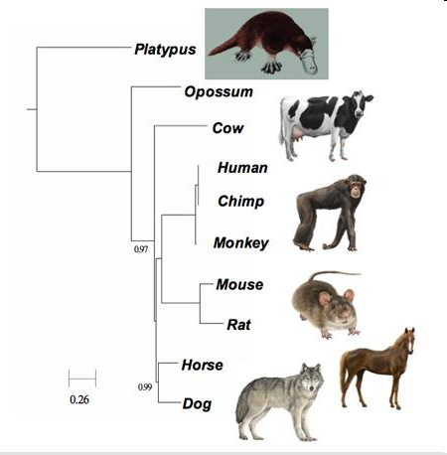
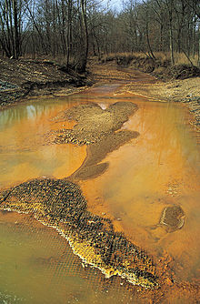
5. Taxonomy Generation
M
Taxonomy Generation
Algorithm
Datasets
UH-DMML

Slide 9
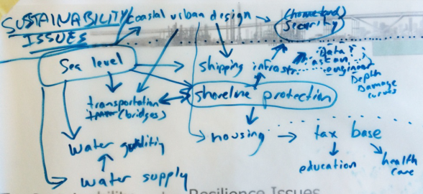
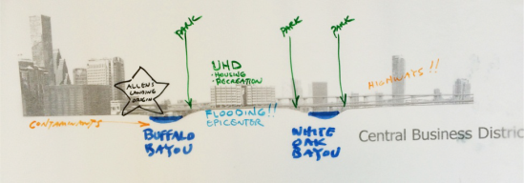
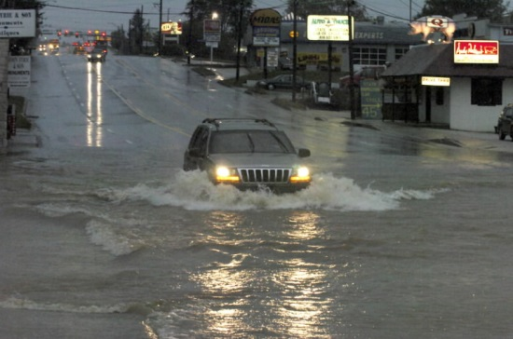
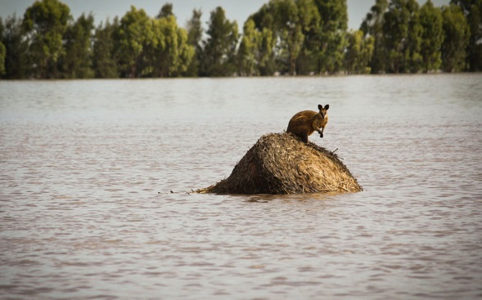
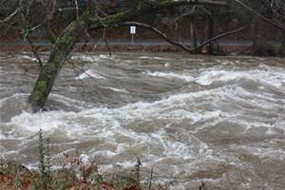
6. Understanding, Preventing, and Recovery from Flooding
Center for Sustainability and Resiliency
UH CeSAR Symp. 7/24/2015
UH-DMML

Slide 10
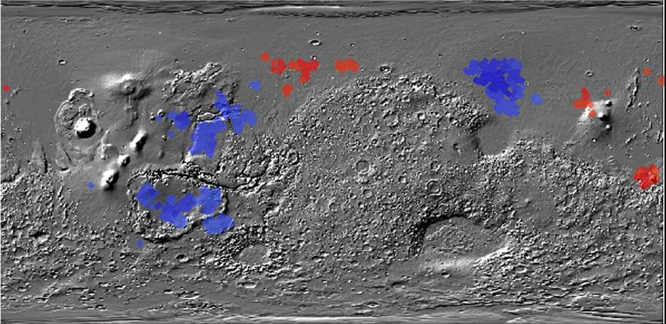
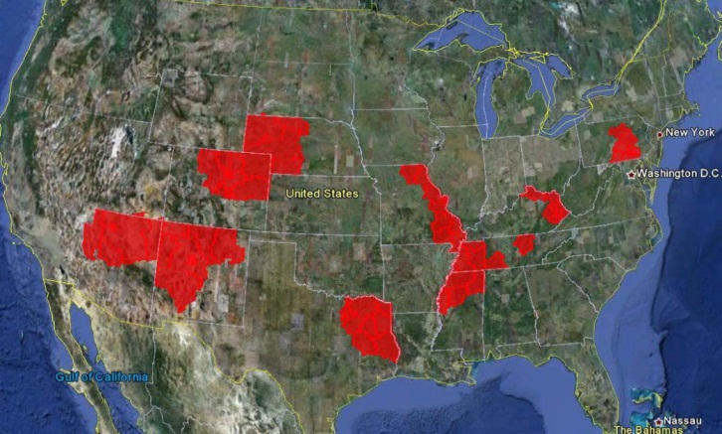
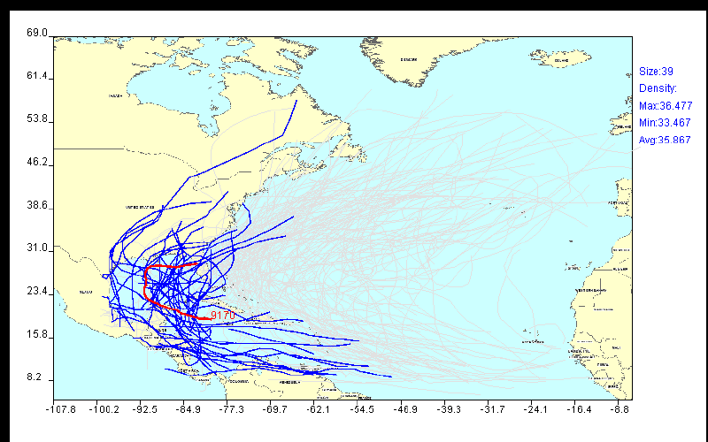
Helping Scientists to Make Sense Out of their Data
Figure 1: Co-location regions involving deep and
shallow ice on Mars
Figure 2: Interestingness hotspots where both income and CTR are high.
Figure 3: Mining hurricane trajectories
UH-DMML

Slide 11
Some UH-DMML Graduates 1
Dr. Wei Ding, Associate Professor, Department of Computer Science, University of Massachusetts, Boston
Christopher T. Ryu, Professor,
Department of Computer Science, California State University, Fullerton
Sharon M. Tuttle, Professor,
Department of Computer Science,
Humboldt State University, Arcata, California
Sujing Wang, Assistant Professor,
Department of Computer Science,
Lamar University, Beaumont, Texas
Christoph F. Eick

Slide 12
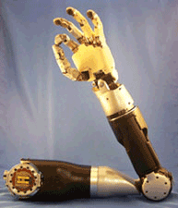
Some UH-DMML Graduates 2
Chun-sheng Chen, PhD Amazon
Chong Wang, MS Haliburton
Justin Thomas MS Section Supervisor at Johns Hopkins University
Applied Physics Laboratory
Mei-kang Wu MS Microsoft, Bellevue, Washington
Jing Wang MS AOL, California
Rachsuda Jiamthapthaksin PhD Faculty, Assumption University, Bangkok, Thailand
Christoph F. Eick

Slide 13
Students in the UH-DMML Research Group
PhD Students: Yongli Zhang, Fatih Akdag, Nguyen Pham, Chong Wang and Paul Amalaman.
Master Students: Puja Anchlia, Riny Hutapea and Rohit Jidagam.
Undergraduate Students: none at the moment
UH-DMML

