Slide 1
Convolutional Neural Networks (CNNs/ConvNets)

Slide 2
What and Why
CNN is a type of neural network model that can extract higher representations of the image.
In classical image classification you define the image features. CNN takes the image’s raw pixel data, trains the model and then extracts the features for better classification.
Regular Neural Nets don’t scale well to full images
Full connectivity is wasteful, and the huge number of parameters would quickly lead to overfitting.

Slide 3
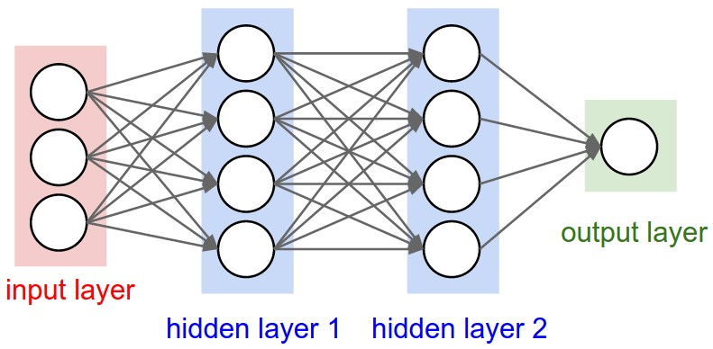
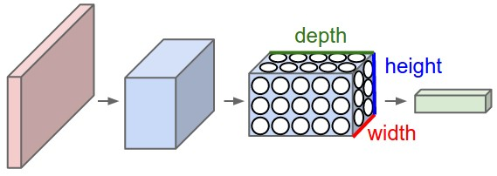
NN vs CNN

Slide 4
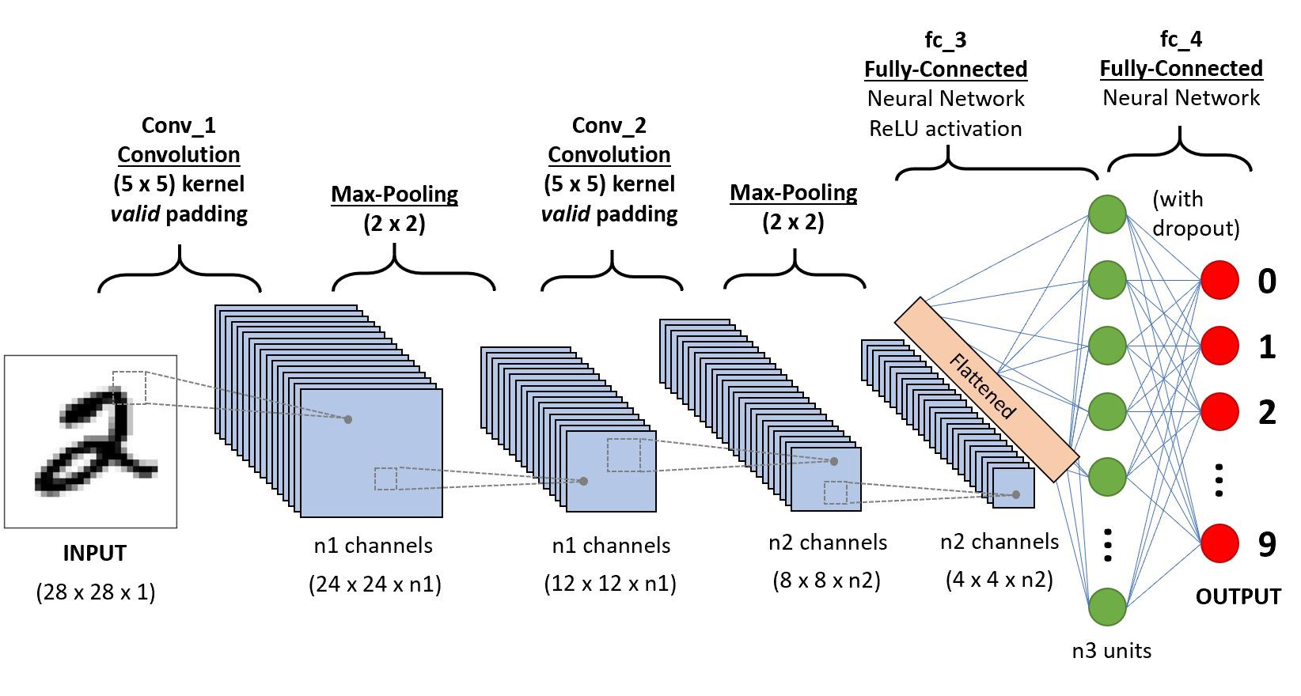
CNN

Slide 5
Layers
Input(2D or 3D input)
Convolutional Layer
(Relu Layer)
Pooling Layer
Fully Connected Layer
Additional Layer liker Dropout Layer

Slide 6
Convolutional Layer
The CONV layer’s parameters consist of a set of learnable filters.
Every filter is small spatially (along width and height) but extends through the full depth of the input.
Each place contains weight
Only uses local connectivity [The spatial extent of this connectivity is a hyperparameter called the receptive field of the neuron (equivalently this is the filter size)]
Layers share parameters

Slide 7
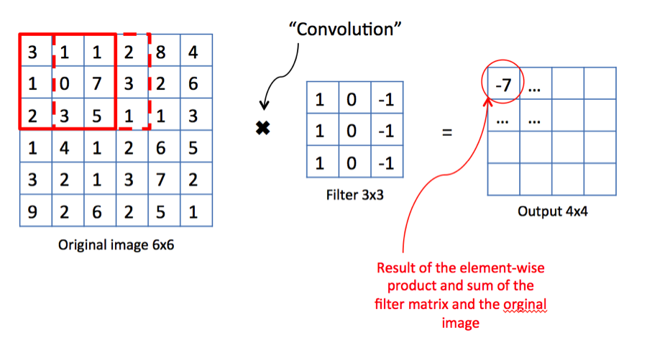
Convolutional Layer

Slide 8
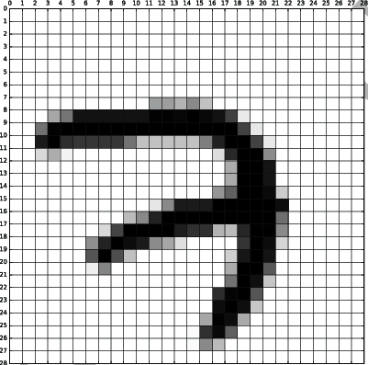
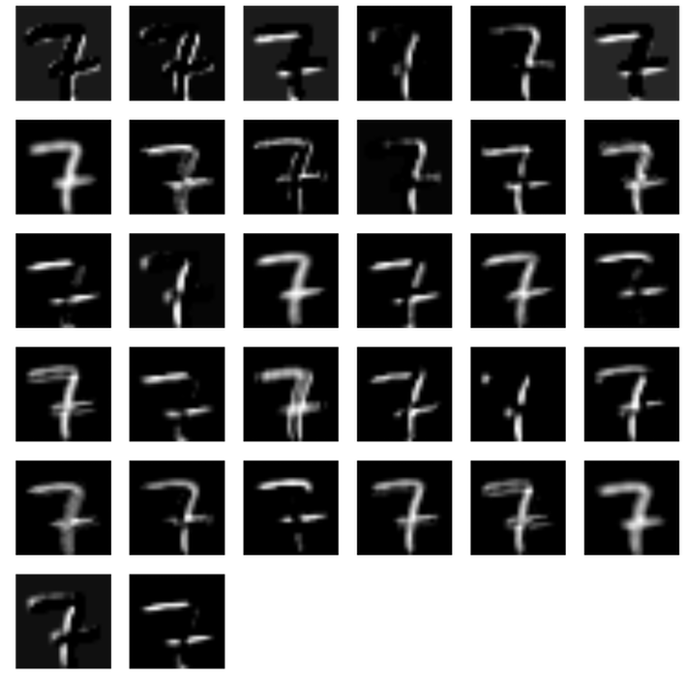
Convolutional Layer

Slide 9
maxPooling Layer
Maxpool layers are used in CNN to replace output with the max summary of the feature maps to reduce the data size and processing time.
Max pooling takes two hyperparameters: stride and size. Stride will determine the pixels that maxpool filters will move. Size will determine how big the value pools in every step.

Slide 10
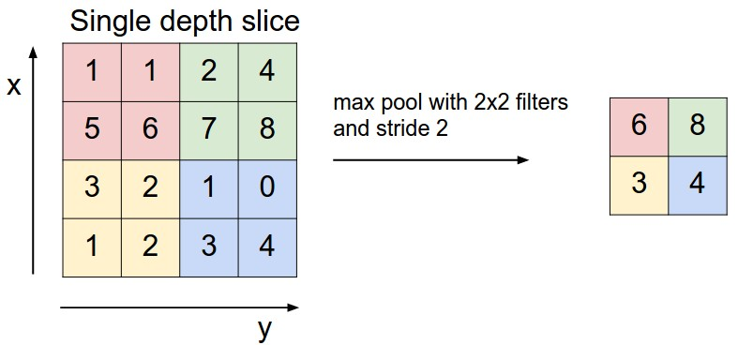
maxPooling Layer

Slide 11
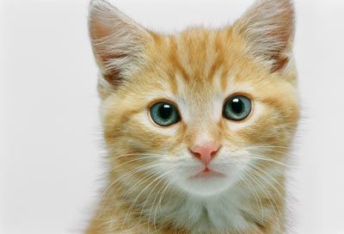
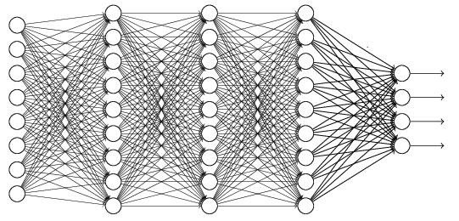
The whole CNN
cat dog ……
Convolution
Max Pooling
Can repeat many times
Fully Connected Feedforward network
Convolution
Max Pooling
Flattened

Slide 12
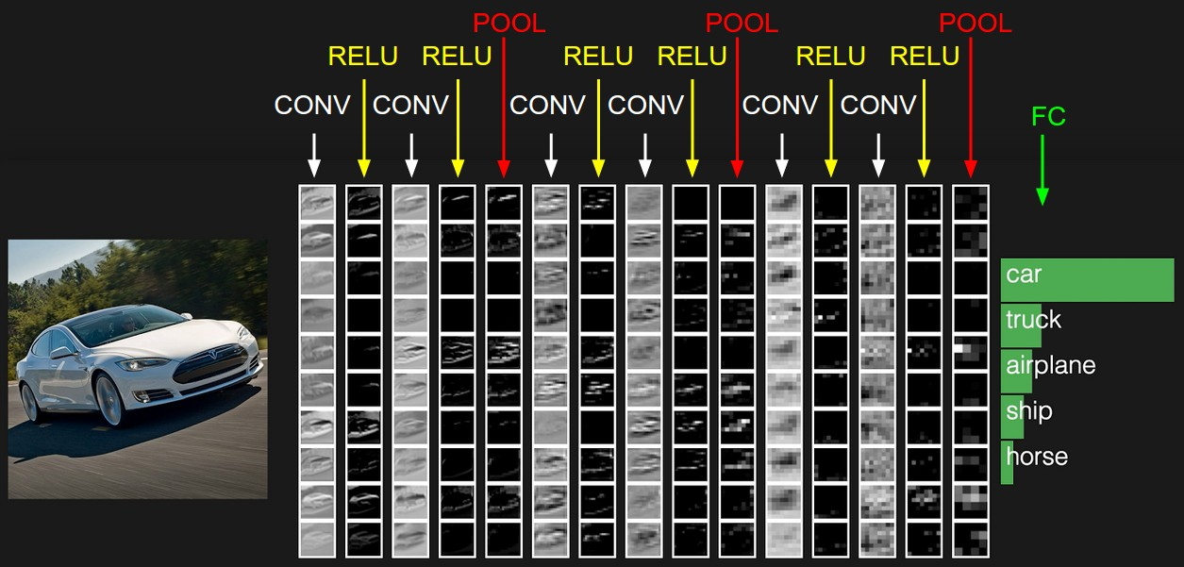
Sample Image

Slide 13
Use of CNN
Image classification (LeNet, InceptionNet, ResNet)
Image segmentation (UNet, FCNN, RCNN)
Image Generation(GAN)

Slide 14
Reference
https://cs231n.github.io/convolutional-networks/?fbclid=IwAR3mPWaxIpos6lS3zDHUrL8C1h9ZrzBMUIk5J4PHRbKRfncqgUBYtJEKATA
http://cs231n.stanford.edu/slides/2018/cs231n_2018_lecture05.pdf

