Slide 1
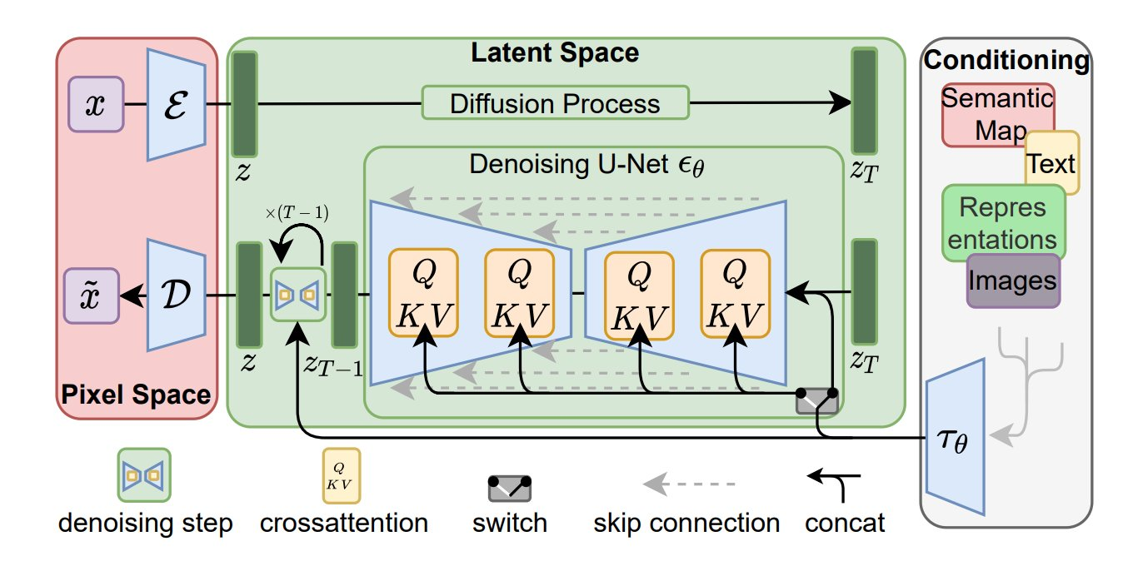
Understanding Diffusion Models
Raunak Sarbajna
April 15, 2024
COSC 4368 – Spring 2024
University of Houston

Slide 2
Topics and Prerequisites
Topics discussed
Latent Diffusion Models (Stable Diffusion)
Math behind diffusion models as defined in the DDPM paper
U-Net
Classifier-Free Guidance
Text – to – Image
Image – to – Image
Prerequisites
Basics of probability and statistics (multivariate gaussian, conditional probability, marginal probability, likelihood, Bayes’ rule).
Basics of PyTorch and neural networks
How convolution layers work

Slide 3
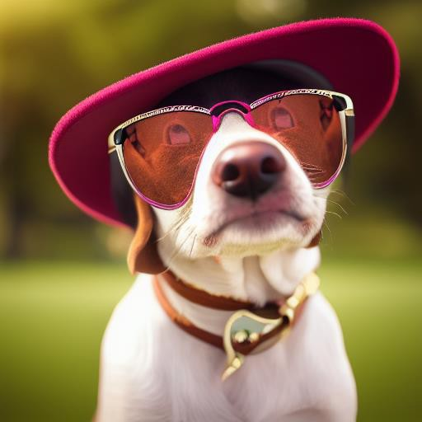
What is Stable Diffusion?
Stable Diffusion is a text-to-image deep learning model, based on diffusion models. Introduced in 2022, developed by the CompViz Group at LMU Munich. https://github.com/Stability-AI/stablediffusion
Output
Prompt
Picture of a dog with glasses
Notes:
It is trained on 512 × 512 images from a subset of the LAION-5B database The model uses a frozen CLIP ViT-L/14 text encoder to condition the model on text prompts
It uses a 860M UNet and 123M text encoder, is relatively lightweight, and can run on a GPU with at least 10GB memory

Slide 4
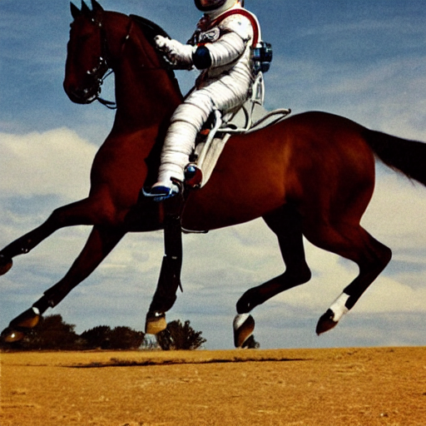
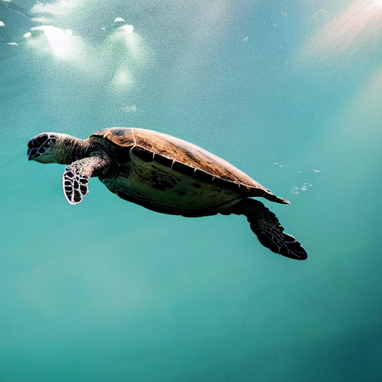
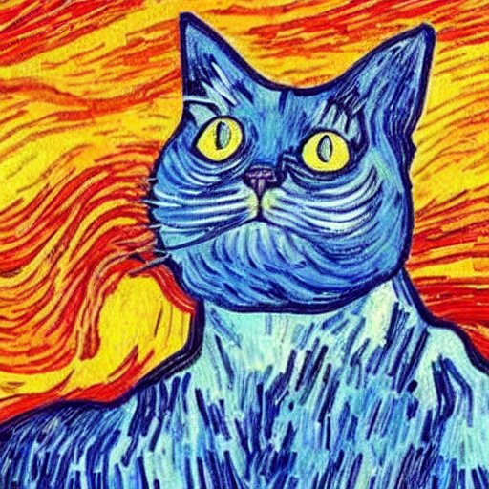
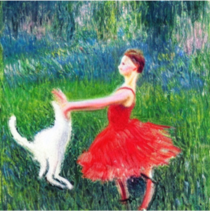
More examples of images generated by Stable Diffusion.
Turns text prompts (e.g. “an astronaut riding a horse”) into images.
It can also do a variety of other things!
You may have also heard of MidJourney or DALL·E, which work similarly.
Notes:
Cat in the style of van gogh or edvar munch
Girl dancing with cat done in impressionistic style

Slide 5
Diffusion Model in Action

Slide 6
Diffusion Model in Action

Slide 7
Diffusion Model in Action

Slide 8
What is a generative model?
A generative model learns a probability distribution of the data set such that we can then sample from the distribution to create new instances of data.
For example, if we have many pictures of cats and we train a generative model on it, we then sample from this distribution to create new images of cats.

Slide 9
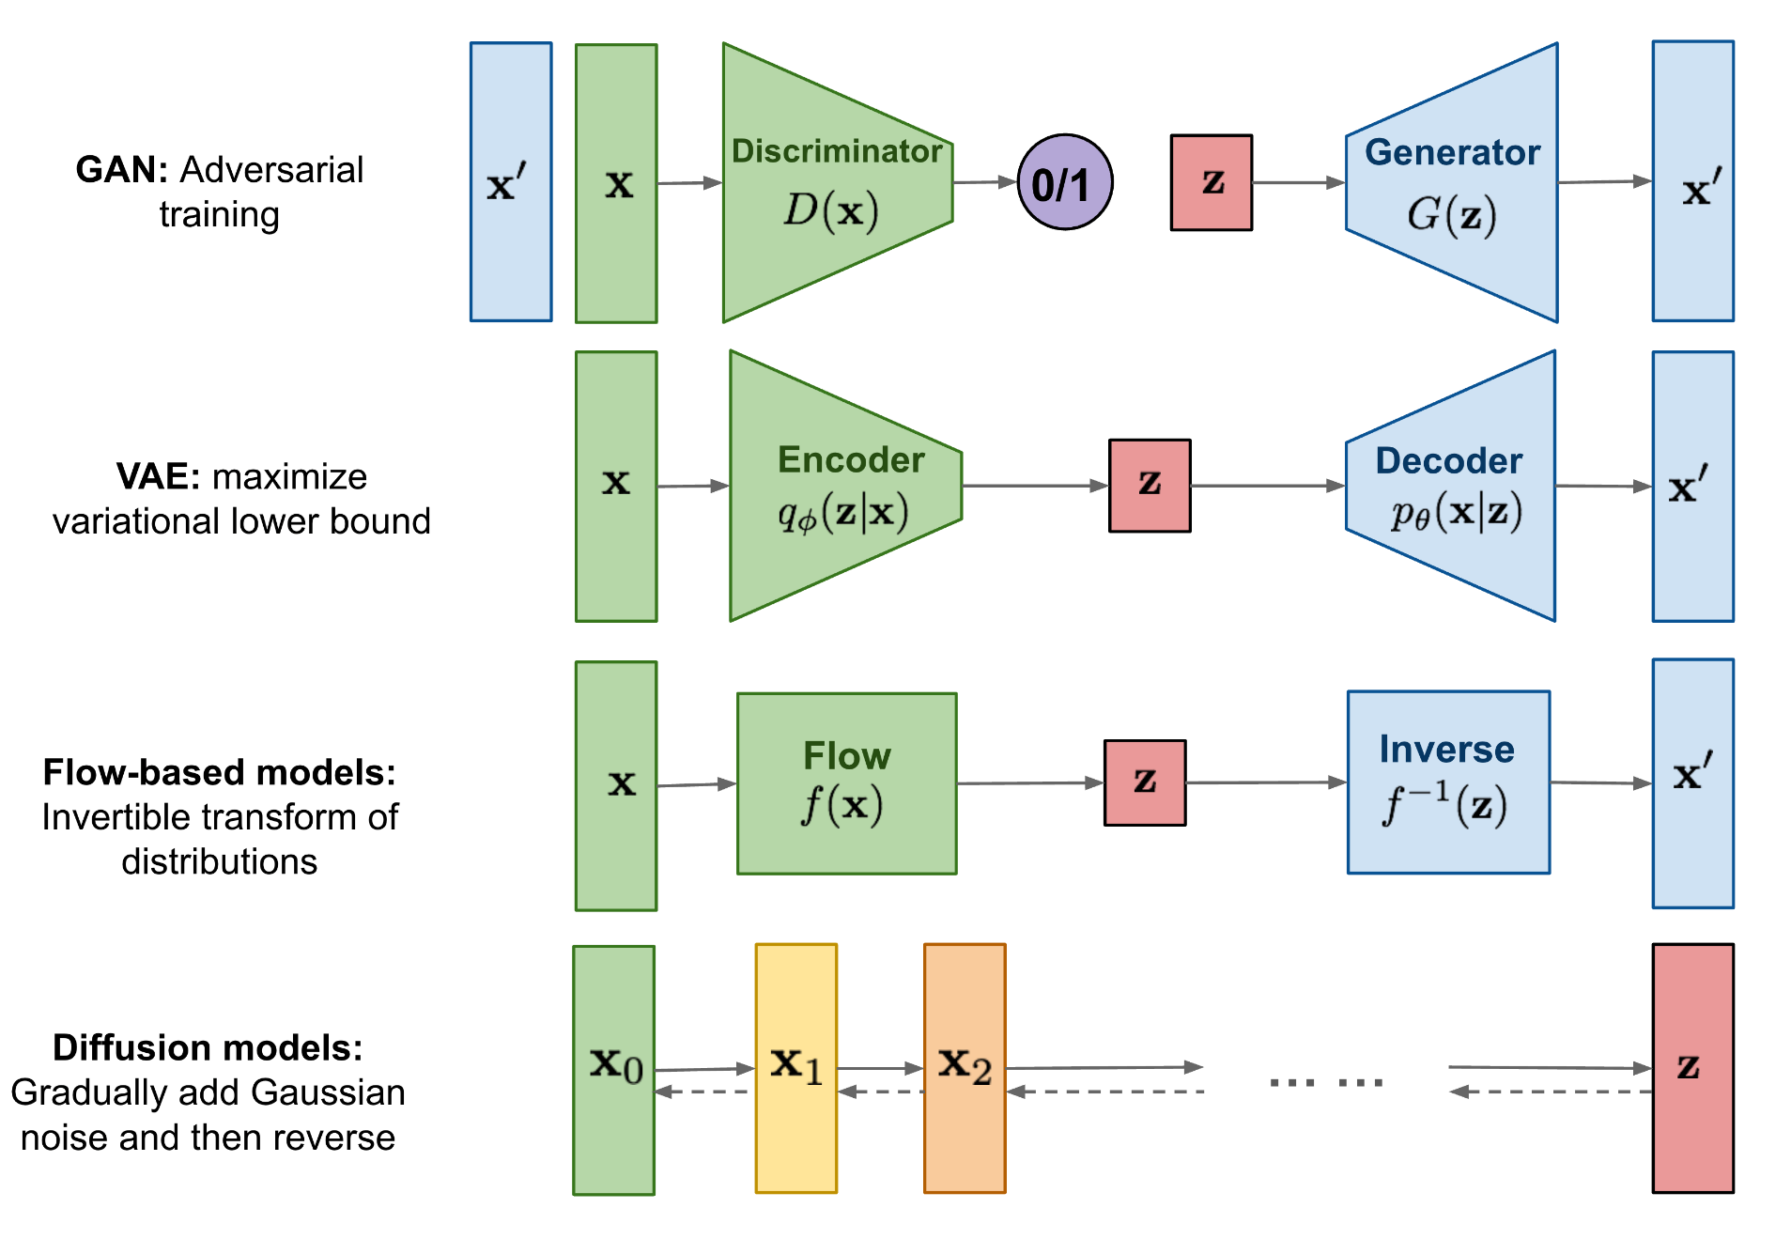
Types of Generative Models
Notes:
First three types of generative models are GAN, VAE, and Flow-based models. They have shown great success in generating high-quality samples, but each has some limitations of its own. GAN models are known for potentially unstable training and less diversity in generation due to their adversarial training nature. VAE relies on a surrogate loss. Flow models have to use specialized architectures to construct reversible transfer
Diffusion models define a Markov chain of diffusion steps to slowly add random noise to data and then learn to reverse the diffusion process to construct desired data samples from the noise

Slide 10
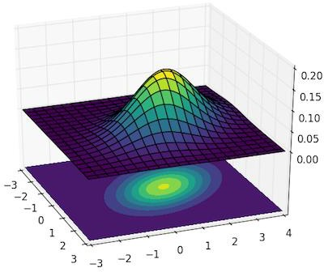
Why do we model data as distributions?
Imagine you’re a criminal, and you want to generate thousands of fake identities. Each fake identity, is made up of
variables, representing the characteristics of a person (Age, Height).
You can ask the Statistics Department of the Government to give you statistics about the age and the height of the population and then sample from these distributions.
Age: N(40, 30²)
At first, you may sample from each distribution independently to create a fake identity, but that would produce unreasonable pairs of (Age, Height).
To generate fake identities that make sense, you need the joint distribution, otherwise you may end up with an unreasonable pair of (Age, Height)
We can also evaluate probabilities on one of the two variables using
conditional probability and/or by marginalizing a variable.
Height: N(120, 100²)

Slide 11
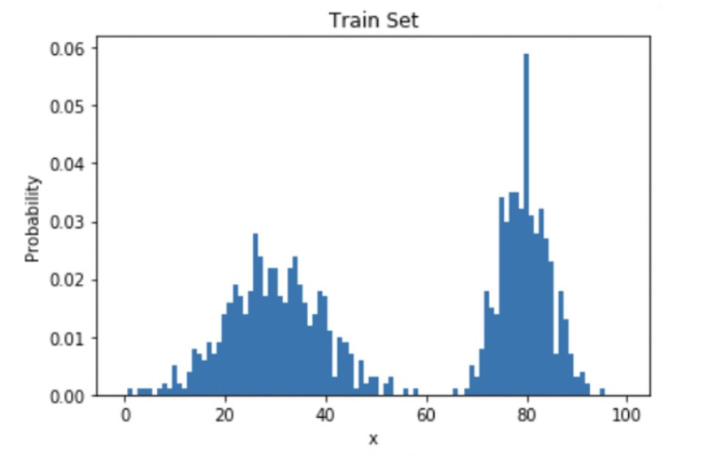
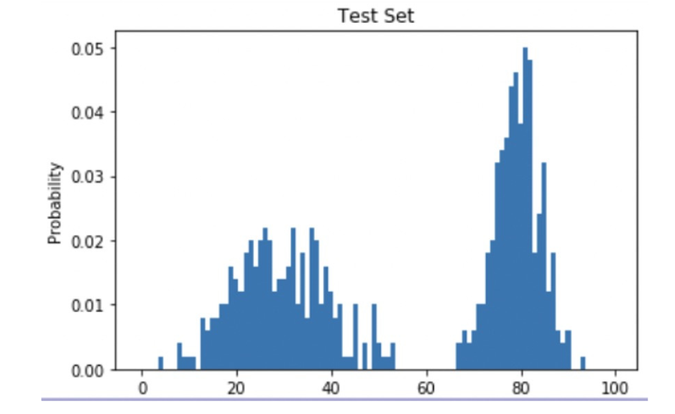
Learning the distribution p(x) of our data.
We have a data set made of up images, and we want to learn a very complex distribution that we can then use to sample from.
Let's say we have some training set of data following some distribution p_{data}(x):
We generate new data by sampling from the learned distribution
The goal of generative machine learning models is to learn this distribution to the best of their ability.

Slide 12
Methods for Learning Data Distribution
We want to train models that maximize the expected log likelihood of $p_{θ}\left(x\right)$
I.e., If I sample from the distribution and get a:
high likelihood $→$ likely the sample came from the training distribution
low likelihood $→$ the sample probably didn’t come from the training distribution
We want to minimize some divergence metrics between the training data distribution, and the distribution that the model learns

Slide 13
Generative Adversarial Networks (GANs)
Convert latent noise vector to target distribution in one step
Lots of issues with training:
Vanishing gradients: if discriminator is too good, gradients go to zero
Mode collapse: if the generator learns to generate an exceptionally plausible output, it will just continue generating it. Then the discriminator will learn to always reject it, and then the generator will produce the same outputs, which the discriminator will then reject… bad loop!

Slide 14
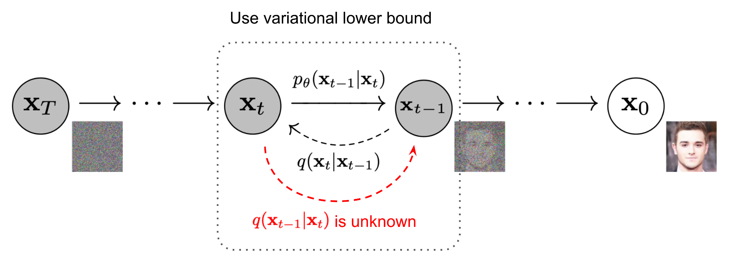
Diffusion Models
Idea: Estimating and analyzing small step sizes is more tractable/easier than a single step from random noise to the learned distribution
Convert a well-known and simple base distribution (like a Gaussian) to the target (data) distribution iteratively, with small step sizes, via a Markov chain:
Markov chain: outlines the probability associated with a sequence of events occurring based on the state in the previous event.

Slide 15
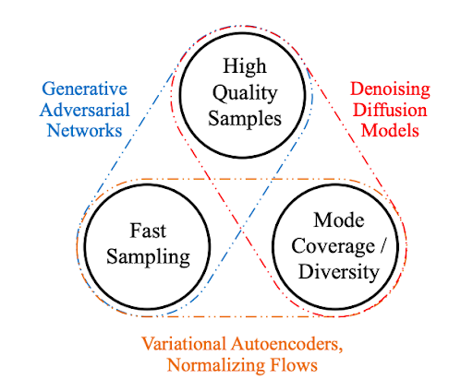
Review: GANs vs Diffusion
GAN
Diffusion
One shot generation. Fast.
Harder to control in one pass.
Adversarial min-max objective. Can collapse.
Multi-iteration generation. Slow.
Easier to control during generation.
Simple objective, no adversary in training.

Slide 16
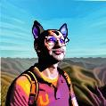
Reverse process: Neural network
Original image
Pure noise
X₀
Z₁
Z₂
…
Z₃
Z_{T}
Forward process: Fixed

Slide 17
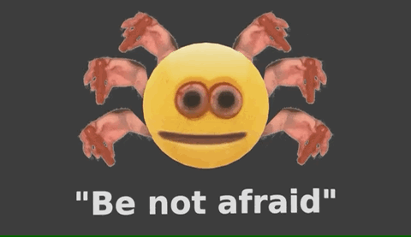
The math of diffusion models… simplified!

Slide 18
Math Formalism: General Diffusion Model
For a forward diffusion process
$$dx=f\left(x,t\right)dt+g\left(t\right)dw$$
There is a backward diffusion process that reverses the time
$$dx=\left[f\left(x,t\right)−g{\left(t\right)}^{2}∇_{x}\log{p(x,t)}\right]dt+g\left(t\right)dw$$
If we know the time-dependent score function $∇_{x}\log{p(x,t)}$
Then we can reverse the diffusion process.

Slide 19
Training a Diffusion Model$:$ Learning to denoise
If we can learn a score model
$$f_{θ}\left(x,t\right)≈∇\log{p(x,t)}$$
Then we can denoise samples, by running the reverse diffusion equation. $x_{t}→x_{t−1}$
Score model $f_{θ}:𝒳×\left[0,1\right]→𝒳$
A time dependent vector field over $x$ space.
Training objective: Infer noise from a noisy sample
$$x∼p\left(x\right), ε∼𝒩\left(0,I\right),t∈[0,1]$$
$$\min{{\left\|ε+f_{θ}\left(x+σ^{t}ε,t\right)\right\|}_{2}^{2} }$$
Add Gaussian noise $ε$ to an image $x$ with scale $σ^{t}$, learn to infer the noise $σ$.

Slide 20
Conditional denoising
Infer noise from a noised sample, based on a condition $y$
$$x,y∼p\left(x,y\right), ε∼𝒩\left(0,I\right),t∈[0,1]$$
$$\min{{\left\|ε−f_{θ}\left(x+σ^{t}ε,y,t\right)\right\|}_{2}^{2} }$$
Conditional score model $f_{θ}:𝒳×𝒴×\left[0,1\right]→𝒳$
Use U-net as to model image to image mapping
Modulate the U-net with condition (text prompt).

Slide 21
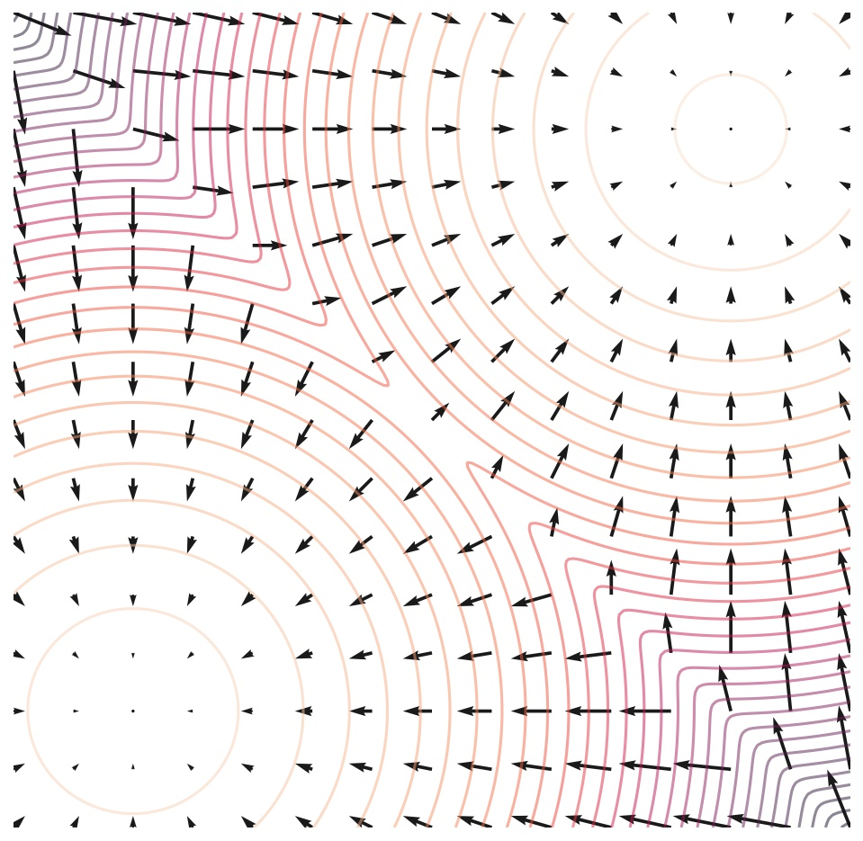
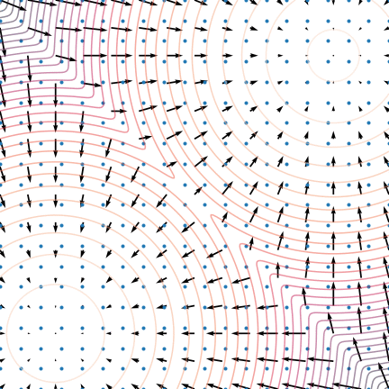
Animation for the Reverse Diffusion
Score Vector Field
Reverse Diffusion guided by the score vector field
https://yang-song.net/blog/2021/score/

Slide 22
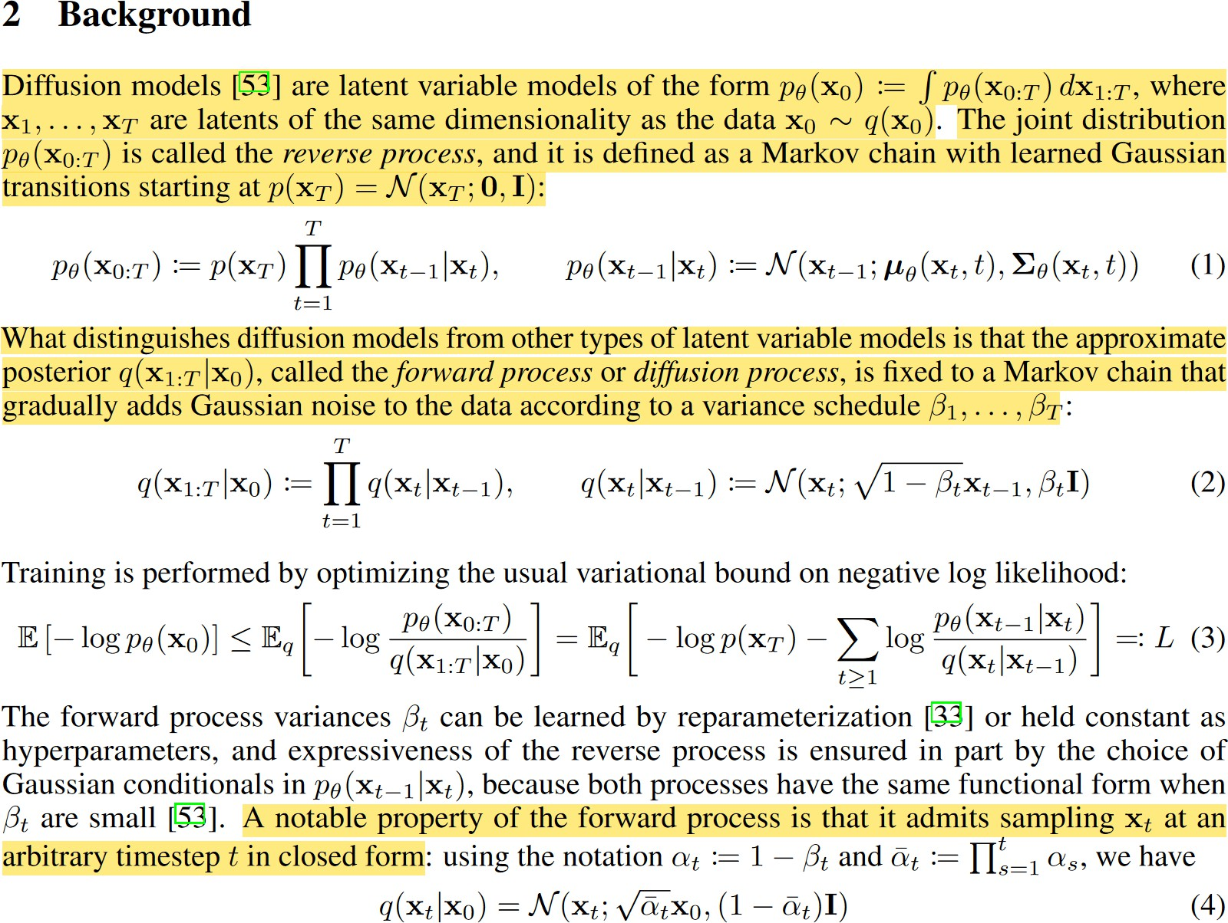
Denoising Diffusion Probabilistic Models
Just like with a VAE, we want to learn the parameters of the latent space
Reverse process p
Evidence Lower Bound (ELBO)
Forward process q
Reparameterization trick
Ho, J., Jain, A. and Abbeel, P., 2020. Denoising diffusion probabilistic models. Advances in Neural Information Processing Systems, 33, pp.6840-6851.
Notes:
Noise added can be parameterized by: q(x1:T jx0) := T Y t =1q(xtjxt-1); where we Vary the parameters of the Gaussian according to a noise schedule
You can prove with some math that as T approaches infinity, you eventually end up with an Isotropic Gaussian (i.e. pure random noise)
● Note: forward process is fixed Do you have to add noise iteratively to get to some timestep !? Nope!
Reverse process can be written in one step:
This will be useful during training!

Slide 23
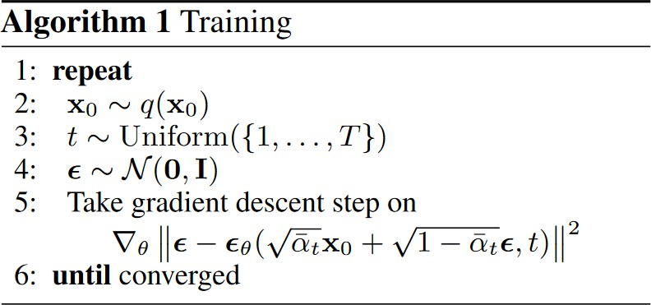
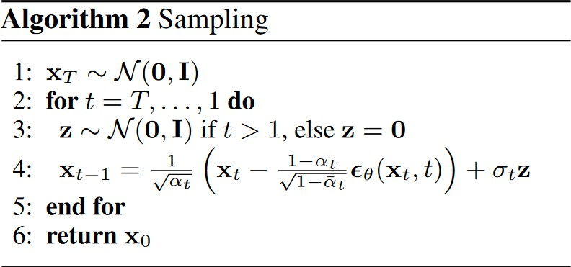
We take a sample from our dataset
We generate a random number t, between 1 and T
We sample some noise
We add noise to our image, and we train the model to learn to predict the amount of noise present in it.
We sample some noise
We keep denoising the image progressively for T steps.

Slide 24
How do we generate new data?
Reverse process: Neural network
Original image
Pure noise
X₀
Z₁
Z₂
…
Z₃
Z_{T}
Forward process: Fixed

Slide 25
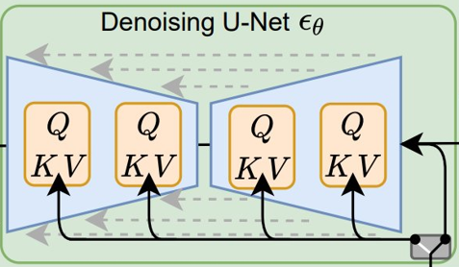
Modelling Score function over Image Domain
Introducing U-Net

Slide 26
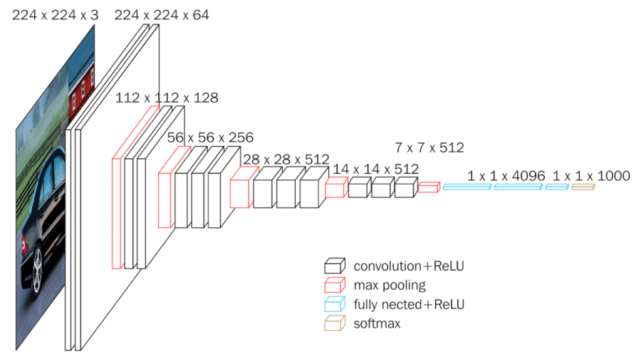
Convolutional Neural Network
Features of larger scale (larger RF)
Higher abstraction level.
CNN parametrizes function over images
Motivation
Features are translational invariant
Extract feature at different scale / abstraction level
Key modules
Convolution
Downsamping (Max-pool)
VGG
Very Deep Convolutional Networks for Large-Scale Image Recognition, Karen Simonyan and Andrew Zisserman. 2014
Notes:
VGG stands for Visual Geometry Group; it is a standard deep Convolutional Neural Network (CNN) architecture with multiple layers. The “deep” refers to the number of layers with VGG-16 or VGG-19 consisting of 16 and 19 convolutional layers. he VGG model, or VGGNet, that supports 16 layers is also referred to as VGG16, which is a convolutional neural network model proposed by A. Zisserman and K. Simonyan from the University of Oxford. These researchers published their model in the research paper titled, “Very Deep Convolutional Networks for Large-Scale Image Recognition.”

Slide 27
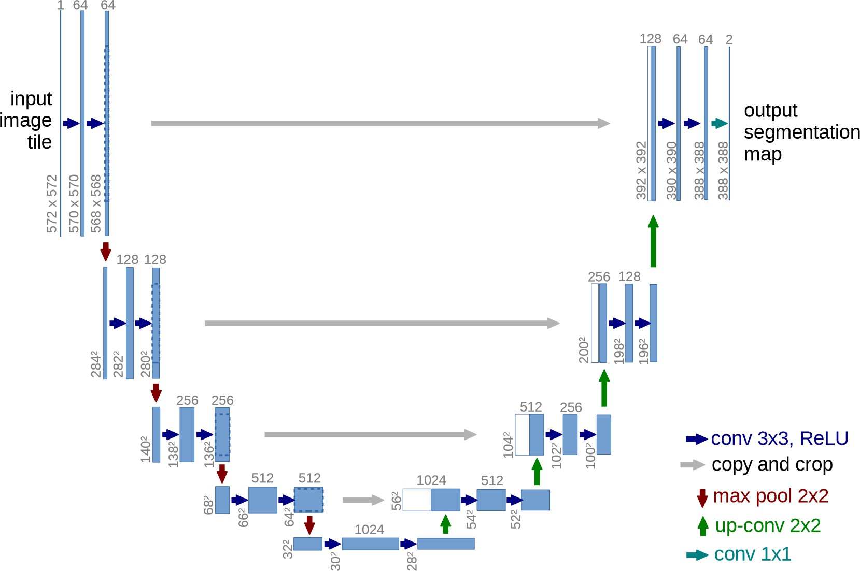
U-Net
CNN + inverted CNN $⇒$ UNet
Inverted CNN (generator) can generate images.
CNN + inverted CNN could model Image $→$ Image function.
Ronneberger, O., Fischer, P. and Brox, T., 2015. U-net: Convolutional networks for biomedical image segmentation. In Medical Image Computing and Computer-Assisted Intervention–MICCAI 2015: 18th International Conference, Munich, Germany, October 5-9, 2015, Proceedings, Part III 18 (pp. 234- 241). Springer International Publishing.

Slide 28
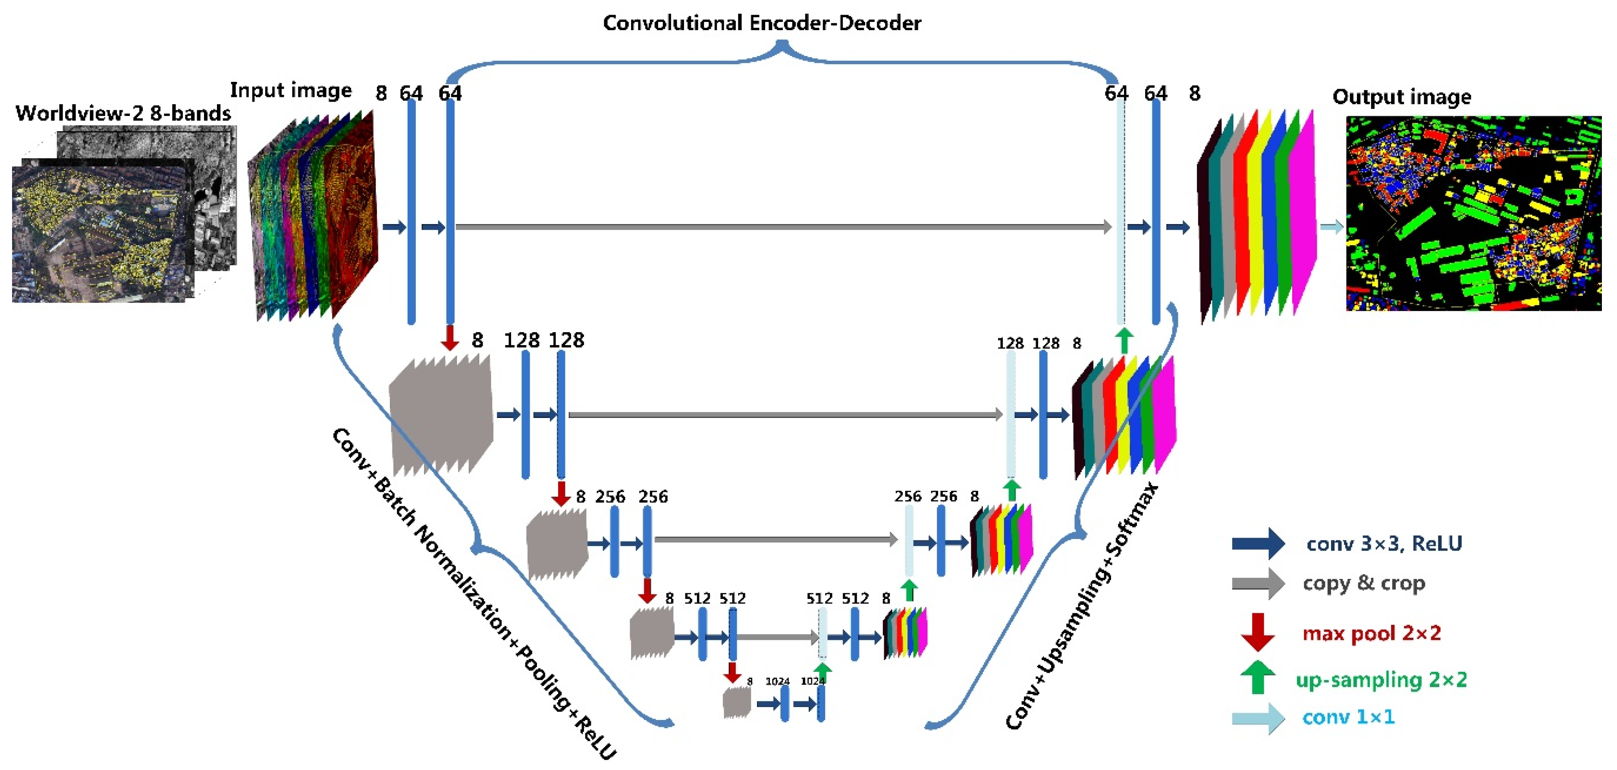
U-Net: A Natural Architecture for mage-to-image Function
Skip connection
Transporting information at the same resolution.
Down (sampling) side
Encoder
Up (sampling) side
Decoder

Slide 29
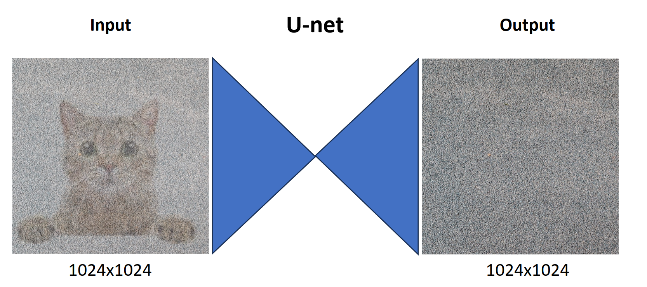
U-net Problem
Problem: operating in the input space is very computationally expensive!

Slide 30
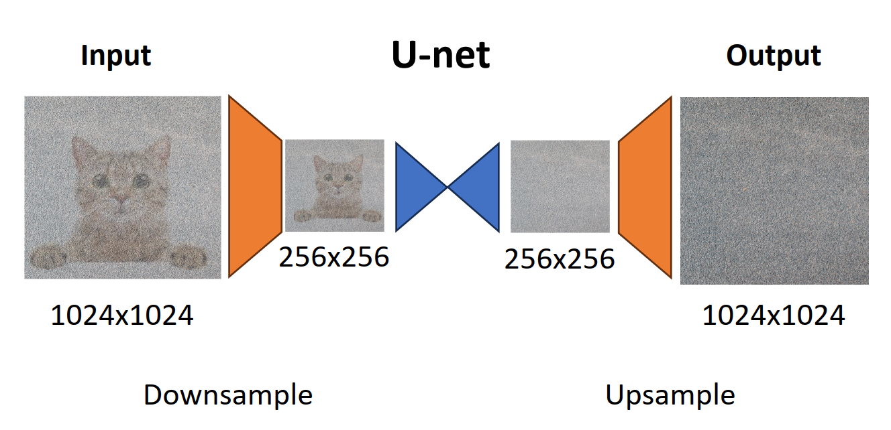
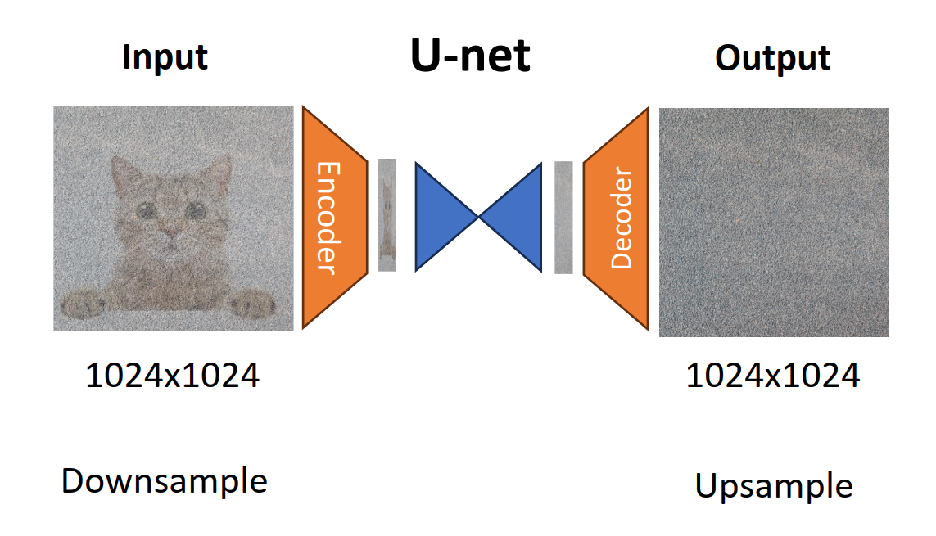
Solutions
Option #1: Generate Low-Resolution + Upsample
Option #2: Generate in Latent Space
(Used by Stable Diffusion)
Notes:
Latent space refers to an abstract multi-dimensional space containing feature values that we cannot interpret directly, but which encodes a meaningful internal representation of externally observed events.
1) Word Embedding Space - consisting of word vectors where words similar in meaning have vectors that lie close to each other in space (as measured by cosine-similarity or euclidean-distance) and words that are unrelated lie far apart (Tensorflow's Embedding Projector provides a good visualization of word embedding spaces).
2) Image Feature Space - CNNs in the final layers encode higher-level features in the input image that allows it to effectively detect, for example, the presence of a cat in the input image under varying lighting conditions, which is a difficult task in the raw pixel space.

Slide 31
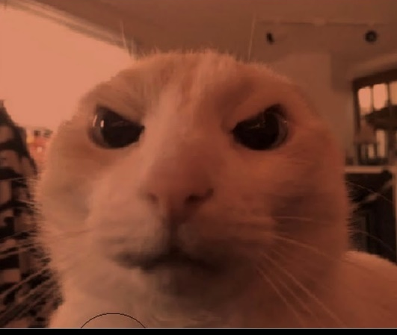
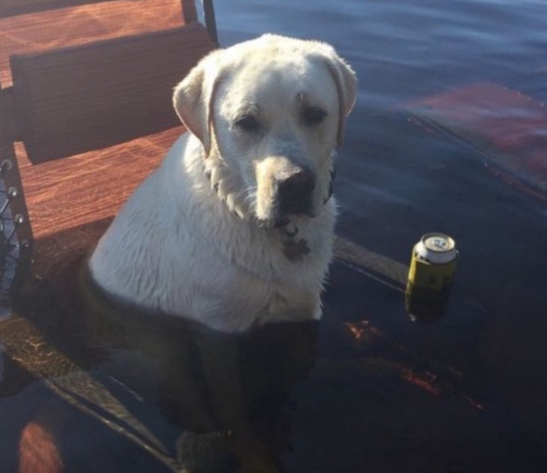
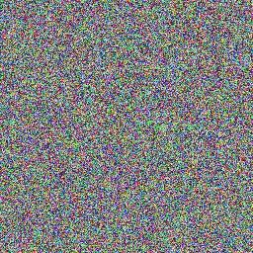
Guided/Conditioned Diffusion
Let’s say we train a diffusion model on images of two cats and two dogs:
If we start from random noise, and generate a new image, what will the model generate?
?
Explicit Conditioning
Classifier Guidance
Classifier-Free Guidance
Notes:
Explicit: How do we train this? Use an Image-Text dataset (for example, LAION 5B)
Classifier: Diffusion goes from noise to real images step-by-step. Idea: Perturb the Denoising Trajectory using gradients of a classifier , Finetune the classifier on noisy images
Classifier-free: Idea: Use the diffusion model itself to get perturbations for guidance

Slide 32
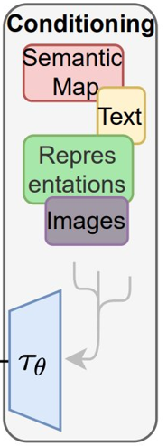
How do we get Diffusion Models to Understand Prompts?
Answer:
Language / Multimodal Transformer, CLIP!
Next up, a small intro to language modelling

Slide 33
Word as Vectors: Language Model 101
Unlike a pixel, meanings of words are not explicitly in the characters (in some languages).
Works differently for Kanji
Word can be represented as index in dictionary
But indices are also meaningless.
Represent words in a vector space
Vector geometry => semantic relation.
Words in a sentence
I love cats and dogs .
Token Index
328 793 3989 537 3255 269
Word Vectors
Notes:
Hiragana and Katakana are phonetic symbols, each representing one syllable while Kanji is ideogram, each stand for certain meaning.

Slide 34
Word Vector in Context: RNN / Transformers
N layers
Meaning of word depends on context, not always the same.
“I book a ticket to buy that book.”
Word vectors should depend on context.
Transformers let each word “absorb” influence from other words to be “contextualized”
Transformer
Block
Transformer
Block
I love cats and dogs .

Slide 35
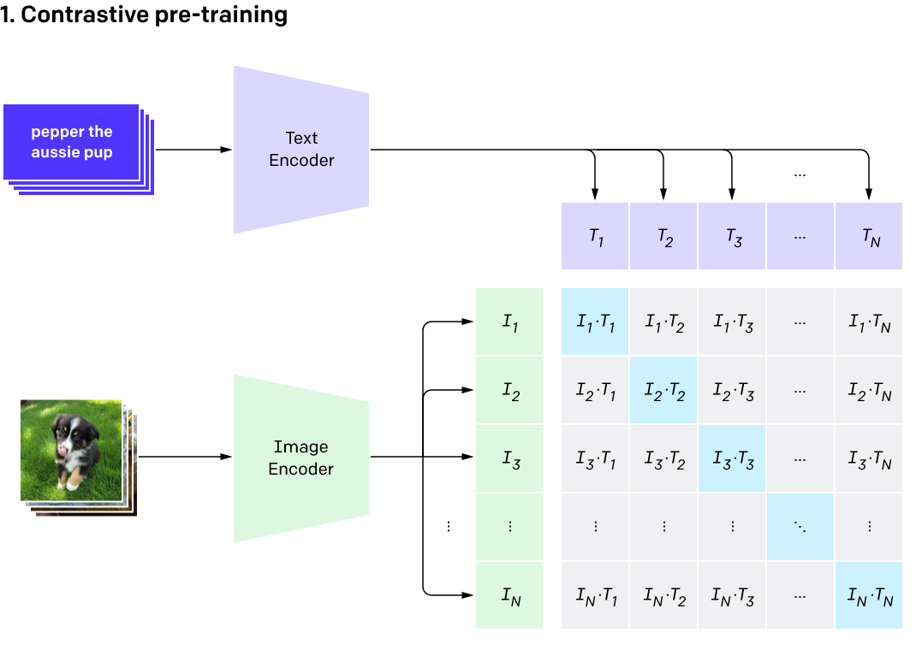
Joint Representation for Vision and Language: Contrastive Language–Image Pre-training (CLIP)
Learn a joint encoding space for text caption and image
Maximize representation similarity between an image and its caption.
Minimize other pairs
Transformer
Vision Transformer
Learning Transferable Visual Models From Natural Language Supervision, Radford et al. 2021

Slide 36
Optional Slides Next

Slide 37
How do we condition the reverse process?
Since we start from noise in the reserve process, how can the model know what we want as output? How can the
model understand our prompt? This is why we need to condition the reverse process.
If we want to condition our network, we could train a model to learn a joint distribution of the data and the conditioning signal 𝑝(𝑥, 𝑐), and then sample from this joint distribution. This, however, requires the training of a model for each separate conditioning signal.
Another approach, called classifier guidance, involves the training of a separate model to condition the output.
The latest and most successful approach is called classifier-free guidance, in which, instead of training two networks, one conditional network and an unconditional network, we train a single network and during training, with some probability, we set the conditional signal to zero, this way the network becomes a mix of conditioned and unconditioned network, and we can take the conditioned and unconditioned output and combine them with a weight that indicates how much we want the network to pay attention to the conditioning signal.

Slide 38
Classifier Free Guidance (Training)
Ronneberger, O., Fischer, P. and Brox, T., 2015. U-net: Convolutional networks for biomedical image segmentation. In Medical Image Computing and Computer-Assisted Intervention–MICCAI 2015: 18th International Conference, Munich, Germany, October 5-9, 2015, Proceedings, Part III 18 (pp. 234- 241). Springer International Publishing.

Slide 39
Classifier Free Guidance (Inference)
Ronneberger, O., Fischer, P. and Brox, T., 2015. U-net: Convolutional networks for biomedical image segmentation. In Medical Image Computing and Computer-Assisted Intervention–MICCAI 2015: 18th International Conference, Munich, Germany, October 5-9, 2015, Proceedings, Part III 18 (pp. 234- 241). Springer International Publishing.

Slide 40
Classifier Free Guidance (Combine output)
o𝑢𝑡𝑝𝑢𝑡 = 𝑤 ∗
^{𝑜𝑢𝑡𝑝𝑢𝑡}𝑐𝑜𝑛𝑑𝑖𝑡𝑖𝑜𝑛𝑒𝑑 ^{− 𝑜𝑢𝑡𝑝𝑢𝑡}𝑢𝑛𝑐𝑜𝑛𝑑𝑖𝑡𝑖𝑜𝑛𝑒𝑑
^{+ 𝑜𝑢𝑡𝑝𝑢𝑡}𝑢𝑛𝑐𝑜𝑛𝑑𝑖𝑡𝑖𝑜𝑛𝑒𝑑
A weight that indicates how much we want the model to pay attention to the conditioning signal (prompt).

Slide 41
Performing many steps on big images is slow
Reverse process: Neural network
Original image
Pure noise
X₀
Z₁
Z₂
…
Z₃
Z_{T}
Forward process: Fixed
Since the latent variables have the same dimension (size of the vector) as the original data, if we want to perform many steps to denoise an image, that would result in a lot of steps through the Unet, which can be very slow if the matrix representing our data/latent is large. What if we could “compress” our data before running it through the forward/reverse process (UNet)?
Notes:
Since the latent variables have the same dimension (size of the vector) as the original data, if we want to perform many steps to denoise an image, that would result in a lot of steps through the Unet, which can be very slow if the matrix representing our data/latent is large. What if we could “compress” our data before running it through the forward/reverse process (UNet)?

Slide 42
Latent Diffusion Model
Stable Diffusion is a latent diffusion model, in which we don’t learn the distribution p(x) of our data set of images, but
rather, the distribution of a latent representation of our data by using a Variational Autoencoder.
This allows us to reduce the computation we need to perform the steps needed to generate a sample, because each data will not be represented by a 512x512 image, but its latent representation, which is 64x64.

Slide 43
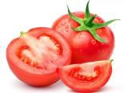
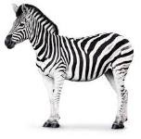
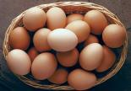
What is an Autoencoder?
X
X’
* The values are random and have no meaning
Encoder
Z
Decoder
Code
[1.2, 3.65, …]
[1.6, 6.00, …]
[10.1, 9.0, …]
[2.5, 7.0, …]
Input
Reconstructed Input

Slide 44
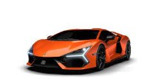
What’s the problem with Autoencoders?
The code learned by the model makes no sense. That is, the model can just assign any vector to the inputs without the numbers in the vector representing any
pattern. The model doesn’t capture any semantic relationship between the data.
X
X’
Z
Encoder
Decoder
Code
Input
Reconstructed Input

Slide 45
Introducing the Variational Autoencoder
The variational autoencoder, instead of learning a code, learns a “latent space”. The latent space represents the parameters of a (multivariate) distribution.
X
X’
Z
Encoder
Decoder
Latent Space
Input
Reconstructed Input

Slide 46
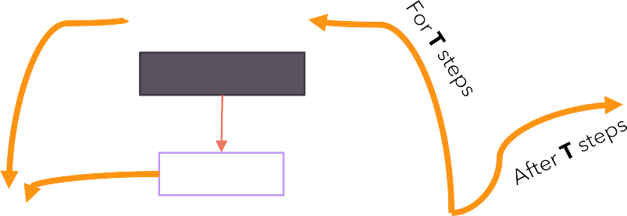
Architecture (Text-To-Image)
Random Noise
Scheduler
Time
X’
Encoder
Z
Z’
Decoder
Time Embeddings
A dog with glasses
CLIP
Encoder
Prompt Embeddings
Text Prompt

Slide 47
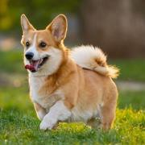
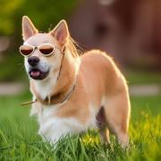
Architecture (Image-To-Image)
X
Add noise to latent
Scheduler
Time
X’
Encoder
Z
Z’
Decoder
Time Embeddings
A dog with glasses
CLIP
Encoder
Prompt Embeddings
Text Prompt

Slide 48
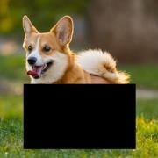
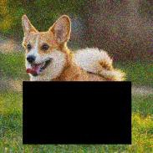
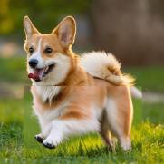
Architecture (In-Painting): how to fool models
Add noise
Combine with latent at current time step
X
Scheduler
Time
X’
Encoder
Z
Z’
Decoder
Time Embeddings
A dog running
CLIP
Encoder
Prompt Embeddings
Text Prompt

Slide 49
Layer Normalization
𝜇
_{𝜎}2
f1 f2 f3
f1 f2 f3
Item 1
a₁ | a₂ | a₃
𝜇₁ | _{𝜎}2 1
Item 1
a'₁ | a'₂ | a'₃
Item 2
Item 2
Item 3
Item 3
Each item is updated with its normalized value, which will turn it into a normal distribution with 0 mean and variance of 1.
The two parameters gamma and beta are learnable parameters that allow the model to “amplify” the scale of each feature or apply a translation to the feature according to the needs of the loss function.
X =
(10, 3)
X’ =
With batch normalization we normalize by columns (features)
With layer normalization we normalize by rows (data items)
Item 10
Item 10

Slide 50
Group Normalization

Slide 51
Moving to our demo!

Slide 52
Code is available on GitHub!
Full code: https://github.com/hkproj/pytorch-stable- diffusion
Special thanks to:
https://github.com/CompVis/stable-diffusion/
https://github.com/divamgupta/stable-diffusion-tensorflow
https://github.com/kjsman/stable-diffusion-pytorch
https://github.com/huggingface/diffusers/
https://lilianweng.github.io/posts/2021-07-11-diffusion-models/
https://sander.ai/2022/05/26/guidance.html

