Slide 1
Introduction to Evolutionary Computing

Slide 2
Contents
Key components of an EC system
Positioning of EC and the basic EC metaphor
Biological inspiration:
Darwinian evolution theory (simplified!)
Genetics (simplified!)
Motivation for EC
What can EC do: examples of application areas

Slide 3
Key Components of an EC System
Idea: Applies biological evolution to a population of solutions
Given: Fitness Function
Chromosomal Representation
EC
System
Selection
Mechanism
Genetic
Operators
Population Management
Kind of Survival of the fittest

Slide 4
The Evolutionary Cycle
Selection
Parents
Recombination
Population
Mutation
Replacement
Offspring

Slide 5
The Ingredients
Population
t
reproduction
t + 1
selection
Fitness function
7
2
mutation
recombination
Survival of Fittest

Slide 6
Different Views of EC/EA/GA/EP
The techniques and technology that is discussed in this course can be viewed as:
An approach to computational intelligence and for soft computing
A search paradigm
As an approach for machine learning
As a method to simulate biological systems
As a subfield of artificial life
As generators for new ideas, new designs and for music and computer art

Slide 7
EC as Search
Search Techniques
Backtracking Hillclimbing Simulated A* EC
Annealing
How is EC different from the other search techniques?
Works with population of solutions, not a single solution
Uses crossover that creates a new solution using two solutions;
the new solutions contains partial solutions from each parent
“Very probabilistic” approach to search

Slide 8
EC as Machine Learning
Machine Learning
Learning from Examples Reinforcement Learning Classifier Systems
…
Genetic Programming

Slide 9
EC as Randomized Algorithms
Algorithms
Randomized Algorithms
Deterministic Algorithms
EC
Question: What are the Advantages of Randomized Algorithms?

Slide 10
Advantages of Randomized Algorithms
Never get stuck or get caught in infinite loops
Find many “good” solutions not a single good solution
Often “efficient”

Slide 11
News Feb. 21, 2022
Submit your exactly four person groups to Nathan by tomorrow, 5p; the remaining groups will then be formed by Nathan and should be ready by Feb. 24.
A first draft of the group project presentation has ben posted; it will be briefly discussed on Feb. 23. Duration: Feb. 25-April 16
Task2 is due tomorrow, Tuesday end of the day.
Today’s Background: Surfside Beach, Texas; near Freeport
More faculty candidate talks on Feb. 25+28, 11a.
Today’s Topics:
Evolutionary Computing
Brief discussion of GHC task Group D
A Very Brief Introduction to Game Theory

Slide 12
The Main Evolutionary Computing Metaphor
EVOLUTION
Environment
Individual
Fitness
PROBLEM SOLVING
Problem
Candidate Solution
Quality
Fitness → chances for survival and reproduction
Quality → chance for seeding new solutions

Slide 13
Darwinian Evolution 1: Survival of the fittest
Q: Some species have very colorful male fish
but not colorful, well camouflaged female fish.
Why??
All environments have finite resources
(i.e., can only support a limited number of individuals)
Lifeforms have basic instinct/ lifecycles geared towards reproduction
Therefore some kind of selection is inevitable
Those individuals that compete for the resources most effectively have increased chance of reproduction
Note: fitness in natural evolution is a derived, secondary measure, i.e., we (humans) assign a high fitness to individuals with many offspring

Slide 14
Darwinian Evolution 2: Diversity drives change
Example:
Blond Hair vs. Dark Hair
Phenotypic traits:
Behaviour / physical differences that affect response to environment
Partly determined by inheritance, partly by factors during development
Unique to each individual, partly as a result of random changes
If phenotypic traits:
Lead to higher chances of reproduction
Can be inherited
then they will tend to increase in subsequent generations,
leading to new combinations of traits …

Slide 15
Darwinian Evolution:Summary
Population consists of diverse set of individuals
Combinations of traits that are better adapted tend to increase representation in population
Individuals are “units of selection”
Variations occur through random changes yielding constant source of diversity, coupled with selection means that:
Population is the “unit of evolution”
Note the absence of “guiding force”: evolution occurs probabilistically in a distributed enviroment.

Slide 16
Natural Genetics
Switch to other presentation!
The information required to build a living organism is coded in the DNA of that organism
Genotype (DNA inside) determines phenotype
Genes → phenotypic traits is a complex mapping
One gene may affect many traits (pleiotropy)
Many genes may affect one trait (polygeny)
Small changes in the genotype lead to small changes in the organism (e.g., height, hair colour)

Slide 17
Crossing-over in Humans
Chromosome pairs align and duplicate
Inner pairs link at a centromere and swap parts of themselves
Outcome is one copy of maternal/paternal chromosome plus two entirely new combinations
After crossing-over one of each pair goes into each gamete
After crossover the offspring has some properties of each parent

Slide 18
Mutation
Occasionally some of the genetic material changes very slightly during this process (replication error)
This means that the child might have genetic material information not inherited from either parent
This can be
catastrophic: offspring in not viable (most likely)
neutral: new feature not influences fitness
advantageous: strong new feature occurs
Redundancy in the genetic code forms a good way of error checking

Slide 19
Problem type 1 : Optimization
We have a model of our system and seek inputs that give us a specified goal
e.g.
time tables for university, call center, or hospital
design specifications, etc etc

Slide 20
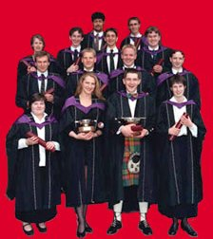
Optimisation example 1: University timetabling
Enormously big search space
Timetables must be good
“Good” is defined by a number of competing criteria
Timetables must be feasible
Vast majority of search space is infeasible

Slide 21
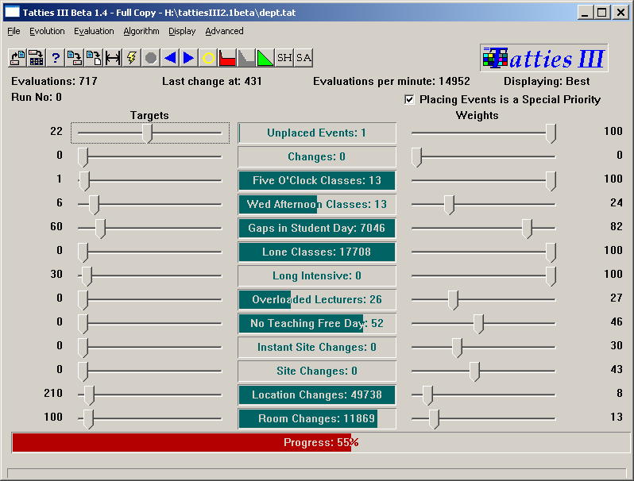

Slide 22
Optimisation example 2: Satellite structure
Optimized satellite designs for NASA to maximize vibration isolation
Evolving: design structures
Fitness: vibration resistance
Evolutionary “creativity”

Slide 24
Problem types 2: Modelling
We have corresponding sets of inputs & outputs and seek model that delivers correct output for every known input
Evolutionary machine learning, e.g. Genetic
Programming which evolves programs using crossover
and mutation and the survival of the fittest.

Slide 25
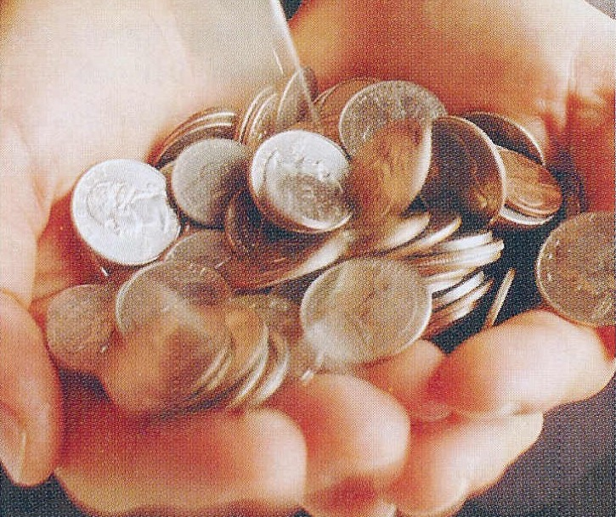
Modelling example: loan applicant creditibility
British bank evolved creditability model to predict loan paying behavior of new applicants
Evolving: prediction models
Fitness: model accuracy on
historical data

Slide 26
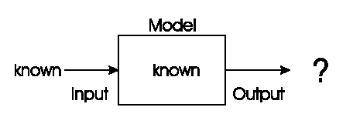
Problem type 3: Simulation
We have a given model and wish to know the outputs that arise under different input conditions
Often used to answer “what-if” questions in evolving dynamic environments
e.g. Evolutionary economics, Artificial Life

Slide 27
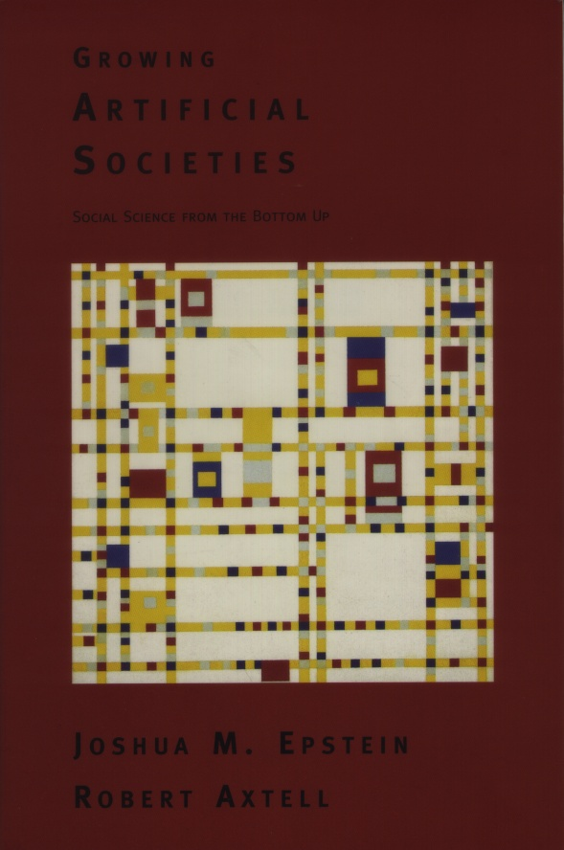
Simulation example: evolving artificial societies
Simulating trade, economic competition, etc. to calibrate models
Use models to optimise strategies and policies
Evolutionary economy
Survival of the fittest is universal (big/small fish)

Slide 28
Problem type 4: Building Systems that Adapt
We have a model and want to adapt it based on feedback from the environment
Model
behavior
Environmental response
adaptation

Slide 29
Example Problem type 4:
Poker Systems that Play Poker
…

Slide 30
What is unique about EC?
EC approaches work on multiple solutions in parallel (a complete population) and not a single solution.
Employ crossover operators which take 2 solutions and create a new solution which shares some properties with the parent solution; traditional search techniques only employ mutation operators.
Can solve problems for which fitness functions are neither differentiable nor continuous. Can operate on symbolic or integer-valued fitness functions.
They employ probabilistic, non-deterministic search strategies which are capable to find different good solutions in a single or in different runs.
They are based on the survival of the fittest: the genetic material of fitter solutions is recombined with a higher probability.
Christoph F. Eick

