Slide 1
Lecture on GPT
Md Mahin

Slide 2
Chat GPT
A large language model
It can understand the patterns and structure of language
In response, generate human-like responses
If we think simply:
We have a very large knowledge bank
You can ask it any question in your language
It can find close solution to that information based on the knowledge it has learnt so far
Then it will provide you that knowledge in a manner you can understand
Base is GPT 3.5

Slide 3
What is GPT?
GPT: Generative Pre-Trained Transformer (OpenAI)[1]
A language model
It can predict the likelihood of an output sequence given an input sequence.
Based on a specific neural network architecture type called Transformer
Transformers uses similar auto encoder architecture
Current GPT versions are: GPT-3, 3.5, 4

Slide 4
Other Language Models
Google: Bert
Facebook: RoBERTa (based on Bert)
Microsoft: Turing model, DeBERTa(based on Bert)
Anthropic Assistant:
The model is designed to assist users in complex decision-making tasks, such as strategic planning or scientific research.
DeepMind- Sparrow
that generates realistic and detailed representations of 3D objects from text descriptions.
Github Copilot:
Based on GPT. To suggest code
DeepMind: Alpha Code
Toped 54th percentile among human coders on codeforce [2]

Slide 5
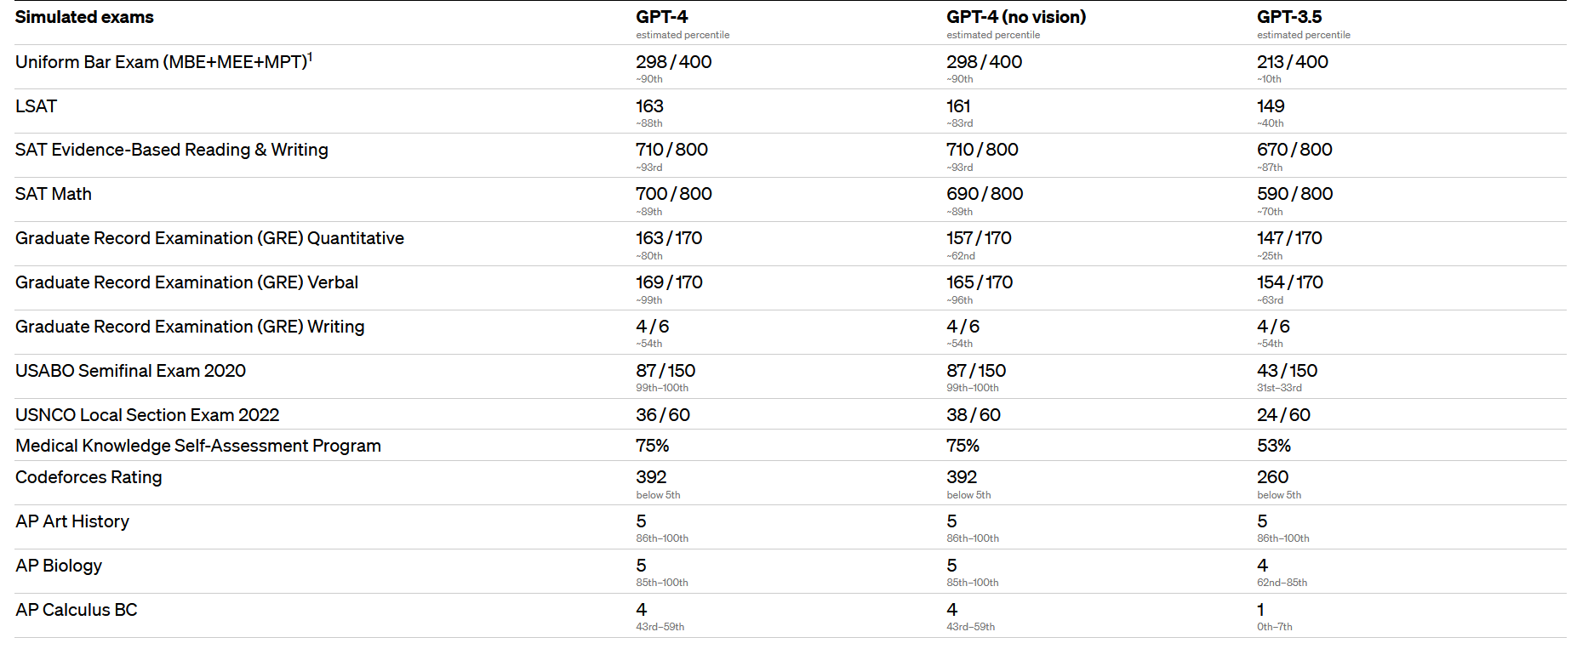
How Intelligent Are GPT?
Source: https://openai.com/research/gpt-4 [3]

Slide 6
Technical Details on GPT3
Trained with 45 TB of text data
Has 175 billion parameters
60% data are from common crawl
Crawl free web data
Generally it is petabytes in size
They filtered important data
Others are: Books + Wiki
96 decoder layer
Built on a system with 285k cpu cores, 10k gpus, 400 Gbps network connectivity for each HPU server (a Super computer built by Macrosoft and Open AI)
How it is trained[3]
Paper on GPT3[4], GPT-4

Slide 7
GPT 4
It is multimodal:
Can work with text, images, videos, audios to take input unlike previous versions
Capabilities:
Generate recopies just from a image of foods from your fridge
Create a basic website just from a basic drawing
Exhibits human-level performance on various professional and academic benchmarks.
For example, it passes a simulated bar exam with a score around the top 10% of test takers; in contrast, GPT-3.5’s score was around the bottom 10%.
Has one trillion parameters

Slide 8
Parameter Comparison
More parameters, more heavy a model is, with more capabilities
Some Comparison:
Bert: 110m-340m
GPT2: 1.5B
T5: 11B
Turing NLG: 17B
GPT3: 175B
GPT4: 1T

Slide 9
Question
How these advances will impact our:
Education
Job Market
Society

Slide 10
References
https://towardsdatascience.com/gpt-3-101-a-brief-introduction-5c9d773a2354
https://www.theverge.com/2022/2/2/22914085/alphacode-ai-coding-program-automatic-deepmind-codeforce
https://openai.com/research/gpt-4
https://www.youtube.com/watch?v=VPRSBzXzavo
https://arxiv.org/abs/2005.14165
https://arxiv.org/abs/2303.08774
https://towardsdatascience.com/gpt-4-vs-chatgpt-an-exploration-of-training-performance-capabilities-and-limitations-35c990c133c5

