Slide 1
Outline
Jupyter Notebook
Problem Set2 Task3 explanation
DAIS

Slide 2
Jupyter Notebook
A web-based interactive computing platform
It supports programming languages such as Julia, Python, and R
It can be installed via Python “pip” command or with Anaconda environment.
# pip install notebook
Type Jupyter notebook on command line
https://docs.anaconda.com/anaconda/install/index.html
DAIS

Slide 3
PS2 Task3 Background
It is a supervised learning task
Supervised learning involves given a set of training examples with labels, and thereafter predict the labels of test examples
Examples of supervised learning algorithms include
Linear Regression
Decision Tree
SVM
Random Forest
MLP
DAIS

Slide 4
PS2 Task3 – Predicting Heart Disease
It is a binary classification task
We are using two models – SVM and MLP
The dataset has 303 examples and 14 attributes
We are predicting the “num” attribute
Split the dataset into train and test sets
Split strategy can be any of 70/30, 75/25, 80/20, 90/10
First train your model with the train set using different parameters
Thereafter use the test set to obtain prediction accuracy
DAIS

Slide 5
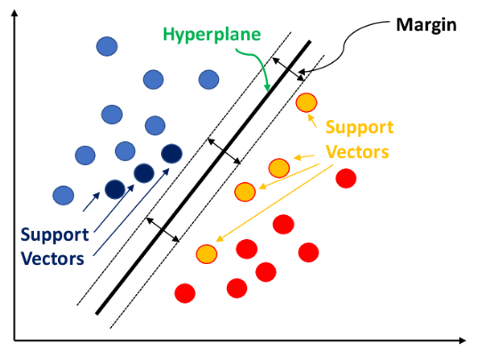
PS2 Task3 – SVM
It is a machine learning algorithm mostly used for classification tasks
It separates input examples in classes using line known as a hyperplane
It can be used for both linear and non-linear tasks
For non-linear task, SVM transform inputs into a higher dimensional space in what is known as kernel trick
DAIS

Slide 6
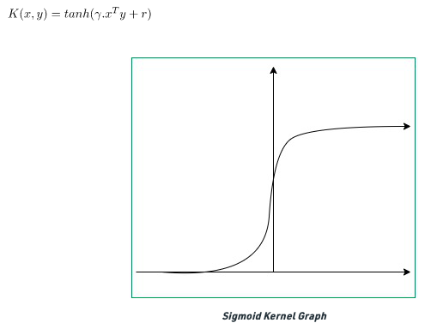
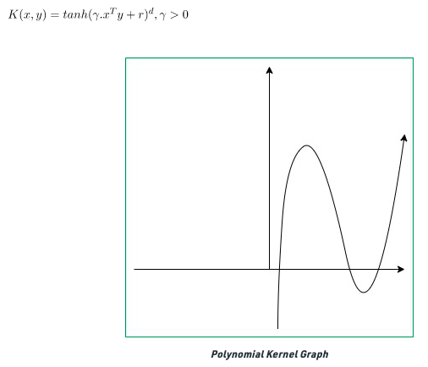
PS2 Task3 – SVM Kernel Functions
It is a method used to transform input into a higher dimension
To ensure a non-linear decision surface can transform to a linear equation in a higher dimension
Examples of kernels are linear, sigmoid, polynomial, RBF etc
DAIS

Slide 7
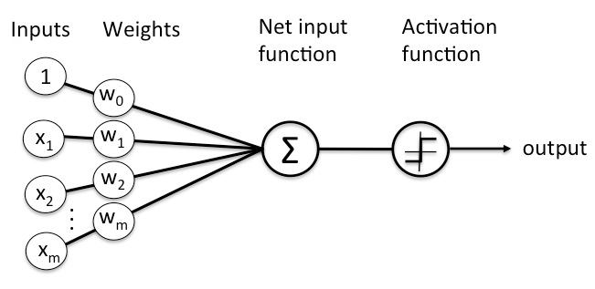
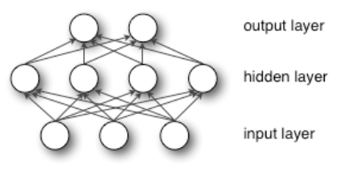
PS2 Task3 – Neural Network(MLP)
Neural networks are patterned after the operation of neurons in the brain
They are designed to recognize patterns.
The patterns they recognize are numerical, which are contained in vectors
Neural networks are made of nodes, which are where computations occur
DAIS

Slide 8
PS2 Task3 – Neural Networks Attributes
Some important attributes of neural networks are :
Weights:
they are used to manage connection between two basic units withing a neural network.
They can be either deceased or increased
Optimizer :
It is a function or algorithm that neural network attributes such as weights, learning rates.
It helps to improve accuracy by reducing overall loss of an objective function
Activation Function:
It is used to determine the output of a neural network
Learning Rate:
It defines how quickly the neural network updates what it has learned.
It usually controls the weights of NN with respect to the loss
DAIS

Slide 9
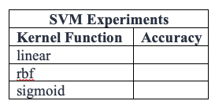
PS2 Task3 – Reporting
Follow the instructions as given
For SVM we are interested in the kernel function hyperparameter
Linear
Sigmond
RBF
DAIS

Slide 10
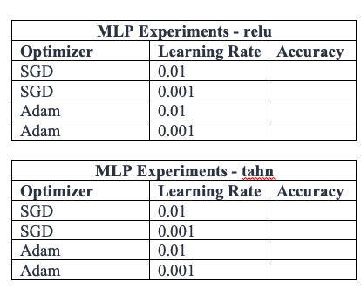
PS2 Task3 – Reporting
Follow the instructions as given
For MLP we are interested in three hyperparameters
Activation function
Optimizer
Learning rate
DAIS

Slide 11
Questions?
DAIS

