Slide 1
General Aspects of Learning
Different Forms of Learning:
Learning agent receives feedback with respect to its actions (e.g. using a teacher)
Supervised Learning: feedback is received with respect to all possible actions of the agent
Reinforcement Learning: feedback is only received with respect to the taken action of the agent
Unsupervised Learning: Learning when there is no hint at all about the correct action
Inductive Learning is a form of supervised learning that centers on learning a function based on sets of training examples. Popular techniques include decision trees, neural networks, nearest neighbor approaches, discriminant analysis, and regression.
The performance of an inductive learning system is usually evaluated using n-fold cross-validation.
Notes:
The last technology I like to introduce in today’s presentation are shared ontologies. Shared ontologies are important to standardize communication, and for gathering information from different information sources. Ontologies play an important role for agent-based systems.
Ontologies basically describe...

Slide 2
N-Fold Cross Validation
10-fold cross validation is the most popular technique to evaluate classifiers
Leave one out and stratified cross validation also has some popularity
Cross validation is usually perform class stratified (frequencies of examples of a particular class are approximately the same in each fold).
Example should be assigned to folds randomly (if not → cheating!)
Accuracy:= % of testing examples classified correctly
Example: 3-fold Cross-validation; examples of the dataset are subdivided into 3 joints sets (preserving class frequencies); then training/test-set pairs are constructed as follows:
1
2
1
3
2
3
Training:
3
2
1
Testing:
Notes:
The last technology I like to introduce in today’s presentation are shared ontologies. Shared ontologies are important to standardize communication, and for gathering information from different information sources. Ontologies play an important role for agent-based systems.
Ontologies basically describe...

Slide 3
Neural Network Terminology
A neural network is composed of a number of units (nodes) that are connected by links. Each link has a weight associated with it. Each unit has an activation level and a means to compute the activation level at the next step in time.
Most neural networks are decomposed of a linear component called input function, and a non-linear component call activation function. Popular activation functions include: step-function, sign-function, and sigmoid function.
The architecture of a neural network determines how units are connected and what activation function are used for the network computations. Architectures are subdivided into feed-forward and recurrent networks. Moreover, single layer and multi-layer neural networks (that contain hidden units) are distinguished.
Learning in the context of neural networks mostly centers on finding “good” weights for a given architecture so that the error in performing a particular task is minimized. Most approaches center on learning a function from a set of training examples, and use hill-climbing and steepest decent hill-climbing approaches to find the best values for the weights.

Slide 4
Perceptron Learning Example
Learn y=x1 and x2 for examples (0,0,0), (0,1,0), (1,0,0), (1,1, 1) and learning rate 0.5 and initial weights w0=1;w1=w2=0.8; step₀ is used as the activation function
w0 is set to 0.5; nothing else changes --- First example
w0 is set to 0; w2 is set to 0.3 --- Second example
w0 is set to –0.5; w1 is set to 0.3 --- Third example
No more errors occurs for those weights for the four examples
1
w0
x1
w1
Step₀-Unit
y
x2
w2
Perceptron Learning Rule: W_{j}:= W_{j} + α*A_{j}*(T-O)

Slide 5
Neural Network Learning --- Mostly Steepest Descent Hill Climbing on a Differentiable Error Function
Important: How far you jump depends on:
the learning rate α.
On the error |T-O|
The input activation of the node
Current Weight Vector
Gradient of the Error Function
Remarks on α:
too low → slow convergence
too high → might overshoot goal
New Weight Vector

Slide 6
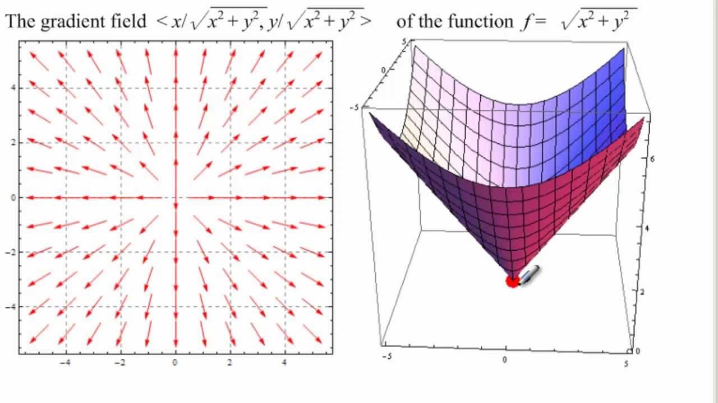
Error Function Gradient based on 2 Weights
Remark: To minimize the error function we will walk in the inverse direction of the arrows!
If the steepest gradient is for example (1,2) then the second weight contributes more to the error.

Slide 7
Back Propagation Algorithm
Initialize the weights in the network (often randomly)
repeat for each example e in the training set do
O = neural-net-output(network, e) ; forward pass
T = teacher output for e
Calculate error (T - O) at the output units
Compute error term Δ_{i} for the output node
Compute error term Δ_{i} for nodes of the intermediate layer
Update the weights in the network Δw_{ij}=α*a_{i}*Δ_{j}
until all examples classified correctly or stopping criterion satisfied
return(network)

Slide 8
Updating Weights in Neural Networks
w_{ij}:= Old_w_{ij} + α∗input_activation_{i}∗associated_error_{j}
Perceptron: Associated_Error:=(T-O)
2-layer Network: Associated_Error:=
Output Node i: g’(z_{i})*(T-O)
Intermediate Node k connected to i: g’(z_{i})*w _{ki} *error_at_node_i
w13
Δ3
a1
a3
Δ5
I1
Δ3
w35
a1
error
Δ4
w23
a5
w13
I1
w14
Δ5
a3
w45
error
a2
Δ4
a4
a2
w23
w24
I2
I2
Multi-layer Network
Perceptron

Slide 9
Back Propagation Formula Example
g(x)= 1/(1+e^{−x} )
g’(x)= g(x)*(1-g(x))
γ is the learning rate
w13
I1
a3
w35
w23
a5
w14
w45
I2
a4
w24
w35= w35 + γ*a3*Δ5
w45= w45 + γ*a4*Δ5
w13= w13 + γ*x1*Δ3
w23= w23 + γ*x2*Δ3
w14= w14 + γ*x1*Δ4
w24= w24 + γ*x2*Δ4
a4=g(z4)=g(x1*w14+x2*w24)
a3=g(z3)=g(x1*w13+x2*w23)
a5=g(z5)=g(a3*w35+a4*w45)
Δ5=error*g’(z5)=error*a5*(1-a5)
Δ4= Δ5*w45*g’(z4)=Δ5*w45*a4*(1-a4)
Δ3=Δ5*w35*a3*(1-a3)

Slide 10
Example BP
Example: all weights are 0.1 except w45=1; γ=0.2
Training Example: (x1=1,x2=1;a5=1)
g is the sigmoid function
w13
a5 is 0.6483 with the adjusted
weights!
I1
a3
w35
w23
a5
w14
w45
w35= w35 + γ*a3*Δ5=
0.1+0.2*0.55*0.08=0.109
w45= w45 + γ*a4*Δ5=1.009
w13= w13 + γ*x1*Δ3=0.1004
w23= w23 + γ*x2*Δ3=0.1004
w14= w14 + γ*x1*Δ4=0.104
w24= w24 + γ*x2*Δ4=0.104
a4’=g(0.208)=0.551
a3’=g(0.2008)=0.551
a5’=g(0.611554)=0.6483
I2
a4
w24
a4=g(z4)=g(x1*w14+x2*w24)=g(0.2)=0.550
a3=g(z3)=g(x1*w13+x2*w23)=g(0.2)=0.550
a5=g(z5)=g(a3*w35+a4*w45)=g(0.605)=0.647
Δ5=error*g’(a5)=error*a5*(1-a5)=
0.353*0.353*0.647=0.08
Δ4=Δ5*w45*a4*(1-a4)=0.02
Δ3=Δ5*w35*a3*(1-a3)=0.002

Slide 11
Example BP
Example: all weights are 0.1 except w45=1; γ=1
Training Example: (x1=1,x2=1;a5=1)
g is the sigmoid function
w13
a5 is 0.6594 with the adjusted
weights!
I1
a3
w35
w23
a5
w14
w45
w35= w35 + γ*a3*Δ5=
0.1+1*0.55*0.08=0.145
w45= w45 + γ*a4*Δ5=1.045
w13= w13 + γ*x1*Δ3=0.102
w23= w23 + γ*x2*Δ3=0.102
w14= w14 + γ*x1*Δ4=0.12
w24= w24 + γ*x2*Δ4=0.12
a4’=g(0.24)=0.557
a3’=g(0.204)=0.554
a5’=g(0.66045)=0.66
I2
a4
w24
a4=g(z4)=g(x1*w14+x2*w24)=g(0.2)=0.550
a3=g(z3)=g(x1*w13+x2*w23)=g(0.2)=0.550
a5=g(z5)=g(a3*w35+a4*w45)=g(0.605)=0.647
Δ5=error*g’(z5)=error*a5*(1-a5)=
*0.353*0.647*0.353=0.08
Δ4=Δ5*w45*a4*(1-a4)=0.02
Δ3=Δ5*w35*a3*(1-a3)=0.002

