Slide 1
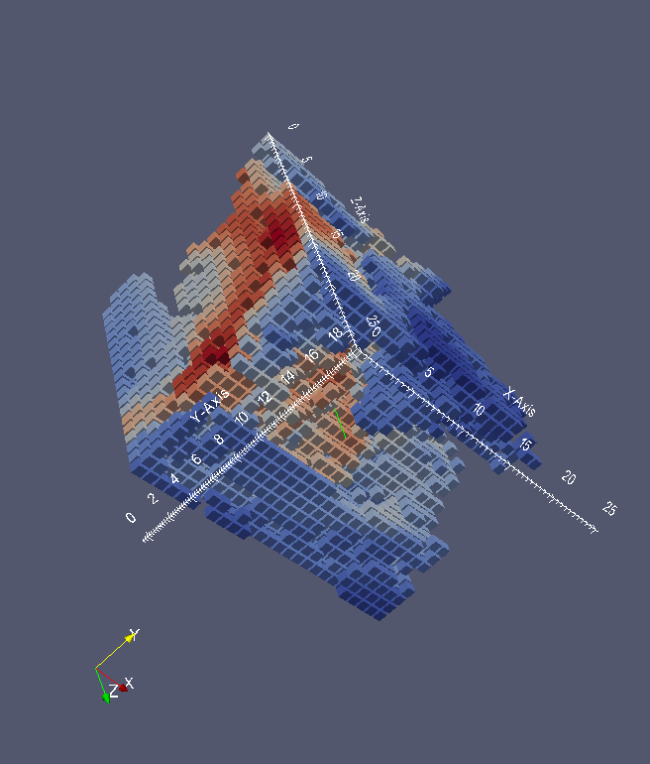
ACM BigSpatial Nov. 4 2014 in Dallas
1
A Computational Framework for Finding Interestingness Hotspots in Large Spatio-Temporal Grids
Fatih Akdag, Josh Urban Davis, and Christoph F. Eick
Department of Computer Science, University of Houston, U.S.A
Talk Organization
Introduction
Interestingness Hotspot Discovery
Case Study
Related Work
Summary and Conclusion

Slide 2
1. Introduction
2
Large amounts of data stored in gridded datasets/raster datasets.
Hundreds of variables stored in each grid.
It is challenging to store, query, summarize, visualize, mine such datasets.
A common problem: How to find interesting contiguous regions in gridded datasets?
Our approach: Non-clustering approach to obtain interestingness hotspots using plug-in reward functions:
Novel hotspot discovery framework and algorithms
Capable of identifying much broader class of hotspots than traditional distance based clustering algorithms
4-dimensional gridded air pollution dataset is introduced
We find high correlation and low variance hotspots w.r.t. pollutants.

Slide 3
Talk Organization
Introduction
Interestingness Hotspot Discovery Framework
Case Study
Related Work
Summary and Conclusion
3

Slide 4
2. Interestingness Hotspot Discovery Framework
4
Problem Definition:
Given
1. Dataset O
2. Neighborhood relation N⊆O×O
3. Interestingness measure i:2^{O}→{0}∪ℜ⁺
The goal of this research is to develop frameworks and algorithms that find interestingness hotspots H⊆O; H is an interestingness hotspot with respect to i, if the following 2 conditions are met:
1. i(H) ≥θ
2. H is contiguous with respect to N; that is, for each pair of objects (o,v) with o,v∈H, there has to be a path from o to v that traverses neighboring objects (w.r.t. N) belonging to H.
In summary, interestingness hotspots H are contiguous regions in space that are interesting (i(H) ≥ θ).

Slide 5
Example Interestingness Functions
5
Reminder: Our goal is to find interestingness hotspots H,
with respect to interestingness functions i which evaluates
the “newsworthiness” of H.
1.Correlation interestingness function:
i_{corr (p1, p2)}(H)= $\left\{\begin{aligned}0, if |correlation\left(p_{1},p_{2}\right)|<θ \\ |correlation(p_{1},p_{2})|−θ, otherwise\end{aligned}\right\}$
2. Variance interestingness function:
i_{var (p1)}(H) = $\left\{\begin{aligned}−variance(p_{1}), if variance\left(p_{1}\right)<θ \\ 0, otherwise\end{aligned}\right\}$
where $$ is a threshold value, p₁ and p₂ are attributes.

Slide 6
Neighborhood Definition for Grids
6
Neighborhood Definition 4D-Grid dataset with x, y, z, and t dimensions:
$Neighbor\left(o_{1},o_{2}\right) ⇔ \left|o_{1}.x−o_{2}.x\right|+\left|o_{1}.y−o.y\right|+ \left|o_{1}.z−o_{2}.z\right|+\left|o_{1}.t−o_{2}.t\right|=1$ (3)
where o₁ and o₂ are two grid cells and o_{i.}x corresponds to x dimension value of o_{i}.
Neighborhood definition is a plugin function. Can be changed based on application domain.
For a grid cell, there is a total of 8 neighbors in 4D and 6 neighbors in 3D according to definition (3).

Slide 7
Hotspot Growing Algorithm
7
A. Seeding phase:
Divide dataset into smaller regions of same size called seed candidate regions
For a 4 dimensional dataset with 10×10×10×10 grid cells, dividing the dataset into smaller regions of 2×2×2×2 grid cells yields (10 / 2)⁴ = 625 such regions.
Identify seed regions with high interestingness value and grow them in the next step
B. Growing phase
Find the neighbor of the seed region which increases a reward function most when added.
Add this neighbor into region and update neighbors list. (A hash set data structure is used to keep neighbors list. Hash set has O(1) runtime complexity for add/remove/contains operations)
Continue adding more neighbors (repeat 1&2) until the reward value cannot be increased for N trials.

Slide 8
Growing Algorithm Pseudo Code
8
FUNCTION AddBestNeighborForRegion(region)
SET bestNewReward = -1
SET bestNeighbor = null
FOREACH neighbor of region
Add Neighbor to region
SET reward = CalculateReward(region)
IF reward > bestNewReward THEN
SET bestNewReward = reward
SET bestNeighbor = neighbor
ENDIF
Remove Neighbor from region
ENDFOREACH
Add bestNeighbor to region
Remove bestNeighbor from region’s neighbors list
Add neighbors of bestNeighbor to region’s neighbors list which are not already in the region or region’s neighbors list
IF bestNewReward > region’s previous reward value THEN
SET returnValue = true
ELSE
SET returnValue = false
ENDIF
SET regions current reward value to bestNewReward
IF bestNewReward > region’s all time best reward THEN
SET region’s all-time best cells = region’s current cells
SET region’s all-time best reward = bestNewReward;
ENDIF
RETURN(returnValue)
ENDFUNCTION

Slide 9
Growing Algorithm Pseudo Code
9
FUNCTION AddBestNeighborForRegion(region)
SET bestNewReward = -1
SET bestNeighbor = null
FOREACH neighbor of region
Add Neighbor to region
SET reward = CalculateReward(region)
IF reward > bestNewReward THEN
SET bestNewReward = reward
SET bestNeighbor = neighbor
ENDIF
Remove Neighbor from region
ENDFOREACH
Add bestNeighbor to region
…
complex
Remark: The interestingness of O(H) hotspots of size H+1 has to be computed.

Slide 10
Hotspot Post Processing
10
C. Post-processing step: remove specific overlapping hotspots:
Input: a set of hotspots H,
an overlap threshold λ
Find a subset H’⊆H for which
∑_{h∈H} i(H) is maximal,
subject to the following constraint: ∀h∈H’∀h’∈H’ λ≥overlap(h,h’)
overlap(h,h’) = (number of grid-cell h and h’ have in common)/(total number of grid-cells in h and h’)
Other post-processing issues: Simplify hotspots by removing low density regions from hotspots.

Slide 11
3. Case Studies
11
Centering on the Houston Metropolitan Area we ran two experiments:
Identify regions with low variance ozone concentration (aka regression trees)
Identify regions with high correlations of ozone and PM2.5

Slide 12
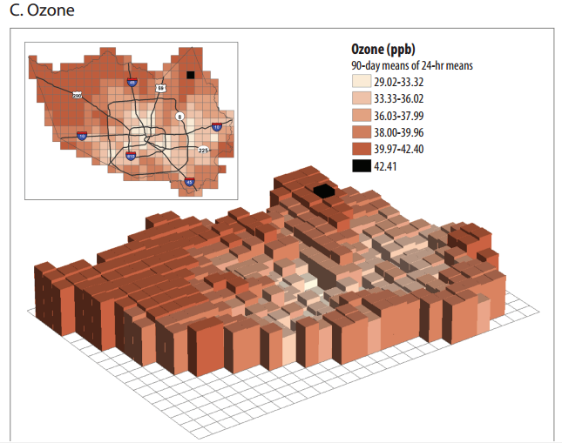
HMA Grid-based Air Pollution Dataset
12

Slide 13
HMA Grid-based Pollution Dataset
13
Huge amounts of gridded data are generated every day by Environmental Protection Agency (EPA). We just use a subset of the air pollution data covering the Houston Metropolitan area.
4x4km squares in the longitude/latitude space
This dataset contains 4 dimensions (longitude, latitude, altitude, and time (as measurements are taken every hour)) including 84 columns, 66 rows, 27 layers and 24 hours for each day. This corresponds to 3.6 million grid cells for a day (1.8 GB) and 1.3 billion grid cells for a year;
Each grid cell contains 132 air pollutant densities as attributes, and these observations are typically extended by adding meteorological and other types of observations for a particular analysis task, such as humidity, temperature, wind speed and solar radiation.
The city of Houston covers about 15% of the dataset.

Slide 14
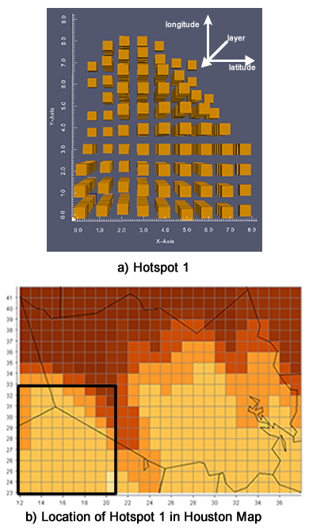
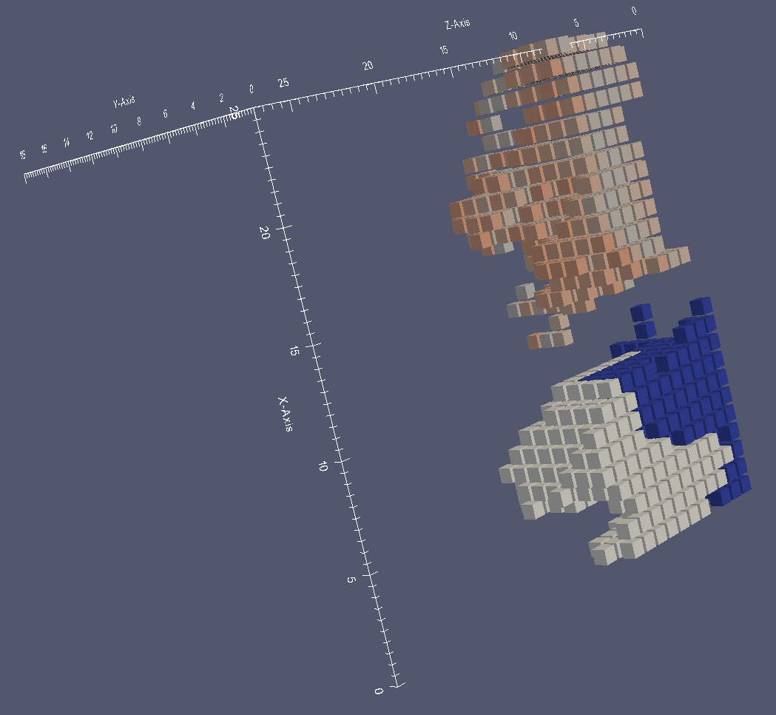
Case Study I: Low Ozone Variance Regions
14
Use a 3D grid for the Houston Metropolitan area for Sept. 1, 2013, noon: 26x19x27=13,338 grid cells
Reward function: ϕ(R_{i}) = interestingness(R_{i}) x size(R_{i})^{β} where β parameter determines preference for larger regions, where i is the variance interestingness function.
Seed size was set to 3x3x3 (432 seed candidates)
Use β=1.01
Variance threshold = 1x10⁻³ ppmV
Results: 47 hotspots identified
Many of the hotspots are overlapping
Paraview was used for visualization
A low variance hotspot and its location in the map
Hotspot 1 (gray), Hotspot 2(blue), Hotspot 8 (orange)

Slide 15
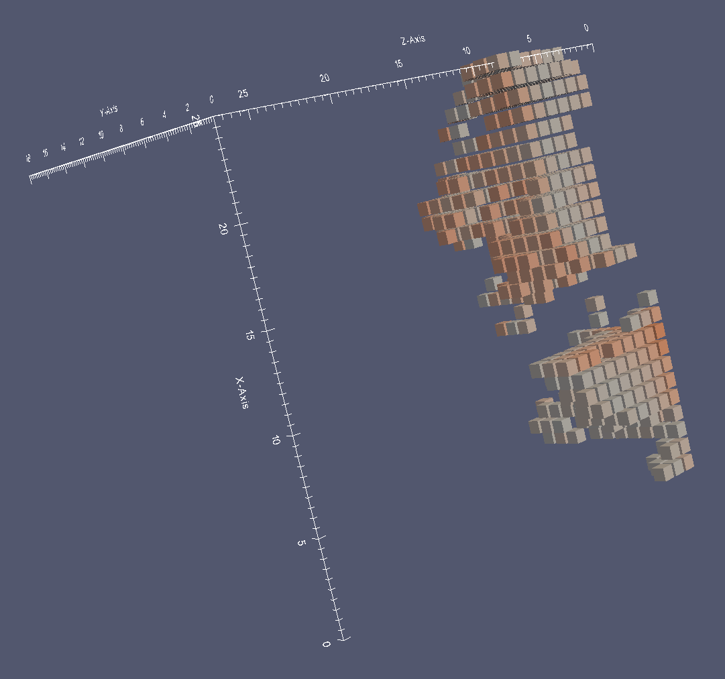
Other Hotspots
15
Hotspot 2 (bottom) and Hotspot 8 (top)

Slide 16
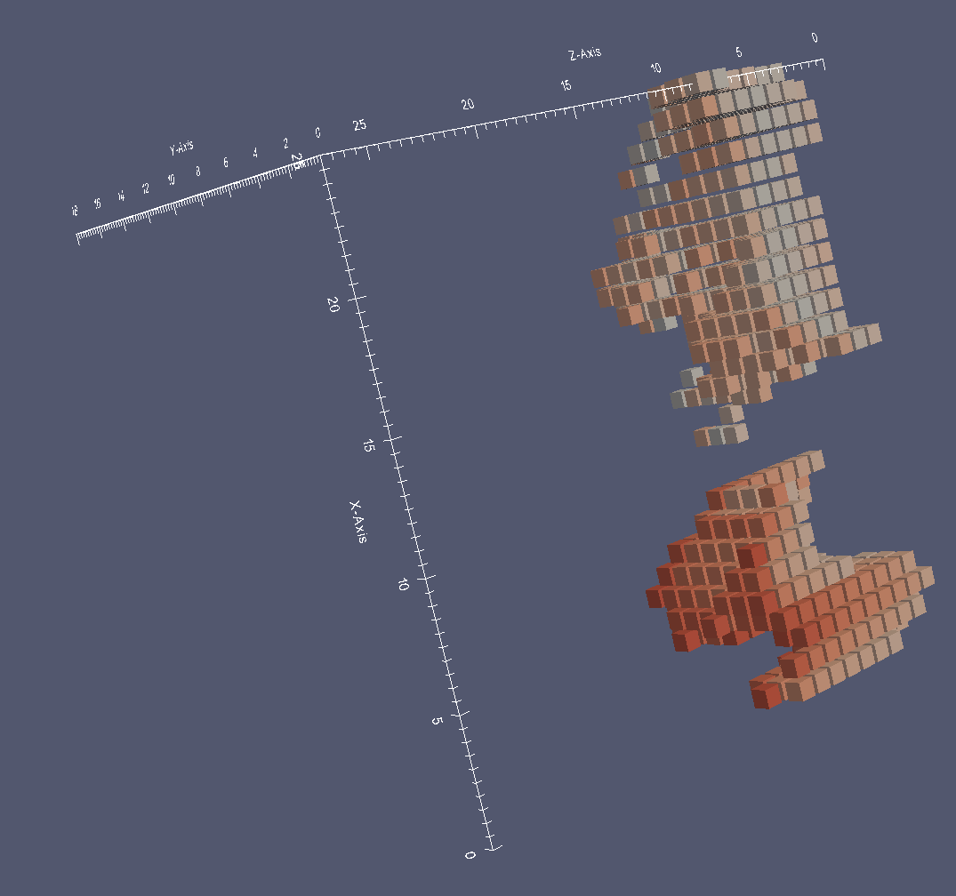
Other Hotspots
16
Hotspot 1 (bottom) and Hotspot 8 (top)

Slide 17
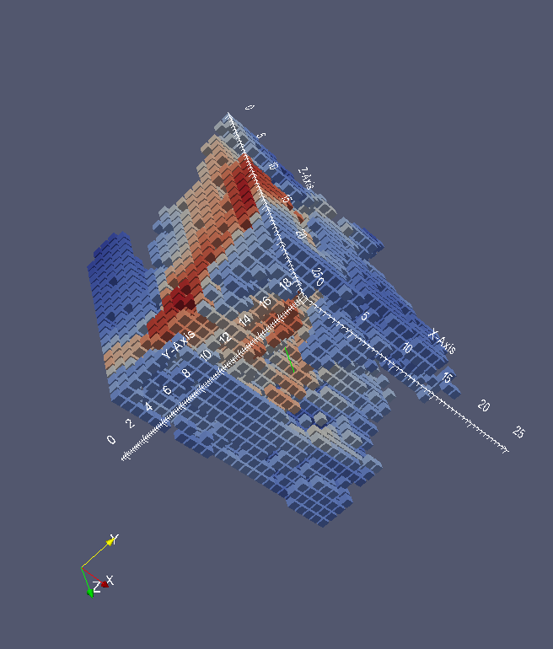
3.2Correlation interestingness hotspots
17
Find regions of high correlation w.r.t. Ozone and Pm2.5 levels
Correlation of Ozone and PM2.5 levels in the dataset is -0.47
Out of 432 seed candidates, 59 of them have > 0.99 correlation. There are too may highly correlated smaller regions in the dataset.
Most correlation hotspots grow very large up to more than half of the whole dataset. Find both negative and positive correlation hotspots.
A hotspot colored by Ozone and PM2.5 concentrations (correlation=0.86)

Slide 18
Runtime analysis
18
hotspot size (grid cells) | growing time (sec)
356 | 1.05
1240 | 16.22
4510 | 353.42
6730 | 772.35
9200 | 1537.10
Table 1. Hotspot Growing Phase Execution Times for the 3D dataset
hotspot size (grid cells) | growing time (sec)
450 | 2
1016 | 13
1251 | 25
1684 | 60
2082 | 111
3547 | 527
3933 | 705
Table 1. Hotspot Growing Phase Execution Times for the 4D dataset (1 week=168 hours of data)
Hotspot growing phase: O(n³) algorithm. Can be parallelized by assigning each hotspot to a different processor.
By incrementally calculating the interestingness value, can be reduced to O(n²).

Slide 19
4. Related Work
Distance-based Spatio-temporal clustering algorithms [3-9]
Clustering Algorithms with plug-in interestingness functions [11-14]
Hotspot Discovery Algorithm [1-2]
Remark: Clustering approaches do not have to deal with overlapping hotspots; however, as hotspots are found in parallel, likely hotspot discovery algorithms have a better chance to find “hotter” hotspots.
19

Slide 20
Summary
21
To the best of our knowledge, this is the only hotspot discovery algorithm in the literature that grows seed regions using a reward function
We claim that the proposed framework is capable of identifying a much broader class of hotspots, compared to other approaches.
Proposed hotspot discovery algorithm succeeded to find interestingness hotspots by maximizing the plugin reward function.
We are working on parallelizing hotspot growing algorithm, incrementally calculating reward value during the hotspot growing phase, post processing of overlapping hotspots, and simplification of very complex hotspots.
A unique air pollution dataset and associated analysis tasks were introduced, which should provide other BigGISData scientists with a valuable benchmark to test and evaluate their methods and frameworks.

Slide 21
Research Challenges
20
Visualization of individual 3D/4D hotspots and visualization of all hotspots
Need to compute things incrementally
Need to explore faster, more greedy, heuristic versions of the growing algorithm
Need for parallel computing and distributed computing to be able to process larger datasets
For some interestingness functions hotspots seem to have quite irregular shapes →need for post-processing; relationship of shapes of hotspots and interestingness functions
How do we store large grid-based datasets more efficiently?
Finding the optimal subset in overlapping hotspot removal is a challenge

