Slide 1
Do incentives build robustness in bit torrent? By Piatek, Isdal, Anderson, Krishnamurthy, Venkataramani
Presentation by Manasee Conjeepuram Krishnamoorthy

Slide 2
Topics Covered
Main idea
Introduction
Bit Torrent Overview
Modeling Altruism in BitTorrent
Building BitTyrant
Evaluation
Related Work
Conclusion

Slide 3
Main Idea
Fundamental problem of peer-to-peer systems – free riding
BitTorrent was designed to address this using TFT reciprocity and provide positive incentives for nodes that contribute
Though BitTorrent is successful – incentive mechanism is not robust to strategic clients
Implementation of BitTyrant to solve this
Notes:
Free riding – consume resources without contributing to the system

Slide 4
Introduction – BitTyrant
A modified BitTorrent client designed to benefit strategic peers
Key Idea - Carefully select peers and contribution rates
Robustness requires that performance does not degrade
Discover the presence of significant altruism in BitTorrent
Unnecessary contributions that can be reallocated to improve performance for strategic clients
Notes:
Key Idea - Carefully select peers and contribution rates – so as to maximize download per unit of upload BW
Robustness requires that performance does not degrade – if peers attempt to strategically manipulate the system
Peers NOT using bit tyrant can experience degraded performance
Significant altruism – all peers regularly make contributions to the system that do not directly improve their performance

Slide 5
Bit Torrent Overview - Protocol
How file transfer happens
Peers download a metadata file called torrent
Metadata file specifies the name, size of the file, address of the tracker server
Tracker Server – coordinates interactions amongst peers
Peers contact the tracker upon startup, departure and when download is in progress
Seeds – Users in possession of the complete file
Local Neighborhood
Set of directly connected peers
Each peer transmits messages indicating the blocks they currently possess and signal their interest in the blocks of other peers
Notes:
In order to connect to a swarm peers download a metadata file called torrent from a content provider usually via a HTTP request.
All users in a particular swarm are interested in obtaining the same set of files
Tracker maintains a list of currently active peers and delivers a random subset of these to clients, upon request
Seeds redistribute small blocks to other participants in the swarm

Slide 6
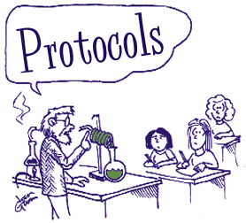
Protocol contd…
Active Set
Set of peers to which a BitTorrent client is currently sending data
Unchoked Peers
Peers from which one peer has received data rapidly in the recent past
Optimistically Unchoked Peers
Randomly chosen peers
Notes:
After active set – each round a peer sends data to unchoked peers
Clients also send data to a small number of randomly chosen peers

Slide 7
Protocol contd…
Choked Peers
Peers that do not send data quick enough and removed from the active set
Equal Split Rate
Each peer provides an equal share of its upload capacity to peers in its active set
Active set size α √upload capacity
Notes:
Give an example for equal split rate

Slide 8
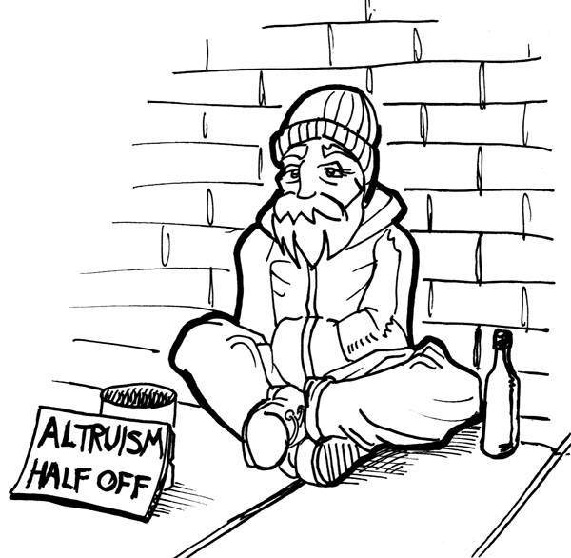
Modeling altruism in BitTorrent
How much altruism is present?
What are the sources of altruism?
Assumptions to model altruism
Representative distribution
Uniform sizing
No steady state
High block availability
Notes:
First question suggests whether or not strategizing is likely to improve performance second informs design.

Slide 9
Assumptions to model altruism
Representative distribution
The distribution of the bandwidth capacity of IP addresses in a swarm is not identical over many swarms.
High capacity peers
Finish quickly and join more swarms
Results in increase of low capacity peers.

Slide 10
Assumptions to model altruism
Uniform sizing
Aggressive active set sizes reduce altruism
Our model provides a conservative estimate of altruism
Implementation Percentage share
Azureus 47%
BitComet 20%
Μtorrent 15%
BitLord 6%
Unknown 3%
Reference 2%
Remaining 7%
BitTorrent implementation usage as drawn from measurement data.

Slide 11
Assumptions to model altruism
No Steady state
If churn is low, over time TFT may match peers with similar equal split rates, biasing active set draws
High Block Availability
Peers always need interesting data to download
Static active set sizing may degrade block availability for high capacity peers
Notes:
What is steady state - Steady state is when all the peers you are connected to in the active set – have equal or better equal split rates.
Steady state – bit torrent is slow to reach steady state, particularly for high capacity peers
High block availability – bit torrent is designed to ensure this

Slide 12
Tit-for-tat matching time
Reference bit torrent optimistically unchokes two peers every 30 seconds
Expectation * Active set = Time taken for a new peer to wait before filling its active set
Notes:
In an attempt to explore the local neighborhood for better reciprocation
Every 30 sec a peer explores two candidate peers and is explored by two candidate peers

Slide 13
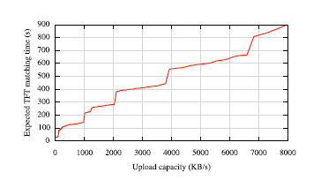
Expected TFT matching time vs. Upload capacity
For a peer with 6000 KB/s upload capacity, it takes about 670 seconds to reach steady state ( 4 GB of data transmitted)
High capacity clients are forced to peer with those of low capacity
Notes:
Steady state is when all the peers you are connected to in the active set – have equal or better equal split rates.

Slide 14
Reciprocation
Reciprocation from peer Q to peer P is determined by 2 factors
Rate at which P sends data to Q
Rate at which other peers send data to Q

Slide 15
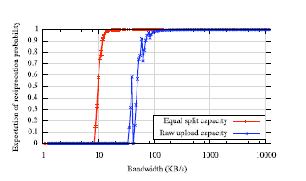
Probability of reciprocation
Equal split capacity = 16 KB/s while reciprocation is 1.0
Equal split capacity = 11 KB/s while reciprocation is 0.6
Reciprocation probability for a peer as a function of raw upload capacity as well as reference BitTorrent equal split bandwidth
Equal split rate >14KB/s reciprocation is assured
Further contribution may be altruistic
To 29

Slide 16
Expected download rate
A peer P receives data from
TFT reciprocation
Optimistic Unchokes
Number of optimistic unchokes is 2
Each peer unchokes 2 peers and also receives two optimistic unchokes

Slide 17
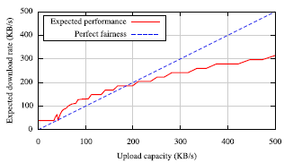
Expected download rate
Expectation of download performance as a function of upload capacity
Sub-linear growth suggests significant unfairness in bit torrent
Unfairness improves performance for low capacity peers
High capacity peers can better allocate upload capacity to improve performance
Notes:
Take the example of 200KB/s and 400KB/s

Slide 18
Expected Upload Rate
Two factors control the upload rate of a peer
Data availability
Capacity limit
Limited data availability – Peer does not have enough data of interest
Upload capacity is wasted and utilization suffers
It is crucial that client downloads new data, so it can redistribute and saturate upload capacity

Slide 19
Expected Upload Rate
This is the case in reference bit torrent client because of its square root growth rate of active set
In practice active set is a static parameter but NOT dynamic
Azureus, a bit torrent client suggests an active set size of 4
Notes:
Active set size of 4 is appropriate for many cable and DSL hosts but far lower than that required for high capacity peers.

Slide 20
Modeling altruism
We consider two definitions of altruism
Altruism = Expected Upload rate – download rate
Any upload contribution that can be withdrawn without loss in download performance

Slide 21
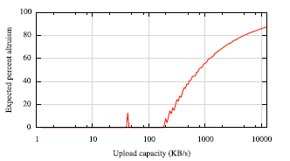
Modeling Altruism
Expected percentage of upload capacity which is altruistic (w.r.t def 1 Altruism = Expected upload rate – Download rate
Reflects the asymmetry of upload contribution
Only when upload capacity > 100 KB/s we have altruism

Slide 22
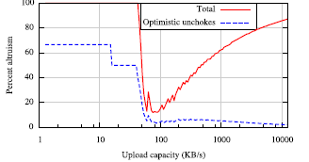
Modeling altruism
Expected percentage of upload capacity that is altruistic - upload capacity not resulting in direct reciprocation
High capacity peers send data much faster than that required for minimal reciprocation
Low capacity peers despite not being reciprocated - still receive data faster than they send
Receive indiscriminate optimistic unchokes in spite of low upload capacity
Notes:
If your upload capacity is say 100KB/s your altruism is only 20% but if your upload capacity is 1000KB/s your altruism is 60%. In this case it is sufficient if you send only 400KB of data.
Optimistic unchokes – low capacity peers

Slide 23
Validation
The relationship between download throughput and upload is not linear
Each time a bit torrent client receives a complete data block from another peer it broadcasts a ‘have’ message
Now, it can redistribute this block to other peers
We average the rate of have messages over the duration our measurement client observes a peer

Slide 24
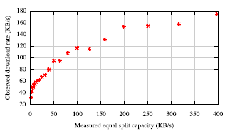
Validation
Measured validation of sub-linear growth in download throughput as a function of rate
These results indicate an even higher level of altruism than that predicted by our model
Peers contributing 250KB/s had a download rate of 150KB/s
In our model, the download rate was 200KB/s for the same upload capacity
This is due to more conservative set sizes in practice

Slide 25
Building Bit Tyrant: A strategic client
We base bit tyrant on the Azureus client as it is most popular
As contribution increases, performance improves, but not in direct proportion
Performance of low capacity peers is disproportionately high
Strategic user can exploit this unfairness by masquerading many low capacity clients to improve performance
Notes:
Majority of users are low capacity peers and they benefit from unfairness today.
Designs intended to promote fairness globally at the expense of so many users seems unlikely

Slide 26
Building Bit tyrant: A strategic client
We focus on bit torrent’s robustness to strategic behavior
Focus on improving performance in isolation while promoting fairness at scale
Maximizing reciprocation
Maximize reciprocation bandwidth per connection
Maximize number of reciprocating peers
Deviate from equal split

Slide 27
Maximizing reciprocation
Maximize reciprocation BW per connection
Find peers that reciprocate with high band width for a low offered rate
Reciprocation bandwidth is dependent on its upload capacity and active set size
By identifying peers that have large reciprocation bandwidth - a client can optimize for a higher reciprocation BW per connection
Notes:
By discovering which peers have large reciprocation bandwidth, a client can optimize for a higher reciprocation bandwidth per connection.

Slide 28
Maximizing reciprocation
Maximize number of reciprocating peers
A client can add to its active set size until its performance is not detrimentally affected
Deviate from equal split
A client can reduce its upload contribution to a particular peer as long as it continues to reciprocate
The bandwidth savings can then be reallocated

Slide 29
Maximizing reciprocation
Largest source of altruism – unnecessary contribution to peers in active set
The reciprocation behavior points to a performance trade-off
Increase in active set size reduces equal split rate, hence reducing reciprocation probability
15

Slide 30
Maximizing reciprocation
The expected download performance of a client with 300KB/s upload capacity for increasing active set size
Maximum download rate – 450 KB/s
Active set size > 25, sharp downfall of download rate

Slide 31
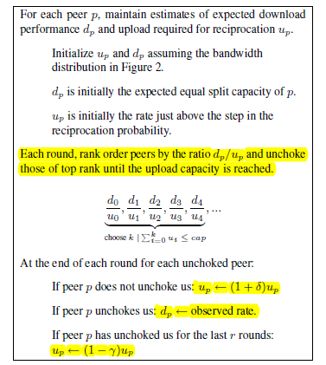
BitTyrant Unchoke Algorithm
Notes:
Up – upload rate required for reciprocation
Dp – download rate when p reciprocates
Once the ranking of the peers are done by the bit tyrant peer and unchokes are complete, there are only 2 possibilities. Either the peer can reciprocate or the peer can choke the bit tyrant peer.
If peer p chokes us – then the only choice we have is to increase our upload rate to the peer. That is represented by the addition ‘delta’ in the equation 1
If peer p reciprocates – change the initial value of dp to the observed download rate
If peer p has reciprocated many times – then we can risk reducing our upload rate and hence the reduction of ‘gamma’ in the last equation

Slide 32
BitTyrant Unchoke Algorithm
Assumptions and Characteristics
The download benefit (d_{p}) and upload cost (u_{p}) are not known a priori. The update operation dynamically estimates these rates
BitTyrant continues to unchoke peers until it exhausts its upload capacity.
User-defined priorities can be implemented by using scaling weights for the d_{p}/u_{p} ratios across multiple swarms

Slide 33
How to predict peer capacities and reciprocation requirements?
Determine upload contributions
In our implementation, u_{p} is typically decreased by Υ = 10%, if the peer reciprocates for r = 3 rounds
Increase δ by 20% if the peer fails to reciprocate after being unchoked in previous round
Notes:
When a peer receives a complete block that can be uploaded it broadcasts a ‘have’ signal.

Slide 34
How to predict peer capacities and reciprocation requirements?
Estimating reciprocation bandwidths
We consider the average download rate over a TFT round
Determine the rate of ‘have’ signals from a peer
Use this as the total upload capacity of the peer
From Azureus, determine the active set size for this upload rate
Using this determine the equal split rate and use as d_{p}
Notes:
When a peer receives a complete block that can be uploaded it broadcasts a ‘have’ signal.
Give an example of rate of have signals = 1000KB/s and the corresponding active set size is say 5. 1000/5 = 200 gives the equal split rate

Slide 35
Sizing the local neighborhood
The active set is sized to provide a diverse set of data to enable data exchange without any data availability constraints
Extract more peers using “Gossip among peers”.
The bit Torrent protocol extension is push based
As the size of the local neighborhood increases – the protocol overhead also increases.
Increases from 0.9% to 1.9% of total file data received.
Notes:
In a push based gossip model – the client can gossip to its peers, the identity of other peers, but cannot induce those peers to gossip.
Hence we cannot exploit the gossip mechanism to extract more peers
Overhead – peers need to exchange block availability information, messages indicating interest in blocks, peer lists

Slide 36
Additional cheating strategies
Exploiting optimistic unchokes
If a peer has built up a deficit in the number of traded bytes it is less likely to be picked for optimistic unchokes
Cheating client – disconnect and reconnect with different client identifiers
Can be prevented by maintaining IP addresses and peer statistics across disconnections

Slide 37
Additional cheating strategies
Downloading from seeds
Seeds upload to peers that are the fastest downloaders
Falsify download rates by emitting ‘have’ messages
Perform random unchokes to spread the data uniformly
Falsifying block availability
Peers appear to be more attractive by falsifying block announcement – to increase unchoking
Not very effective – client can stop transferring once peer does not satisfy block requests.
Notes:
A client would prefer to unchoke peers that has the block it needs.

Slide 38
Evaluation
Evaluate BitTyrant on real swarms drawn from popular aggregation sites to measure performance for a SINGLE strategic client
Evaluate sensitivity to various upload rates and measure performance for many BitTyrant peers
Notes:
To evaluate bit tyrant we explore the performance improvement possible in two kinds – single client, many bit tyrant peers

Slide 39
Evaluation – Single strategic peer
CDF of download performance for 114 real world swarms
Shown – ratio between download times for an existing Azureus client and BitTyrant
Median performance gain for BitTyrant – factor of 1.72
Expect relative performance gains to be greater for clients with greater upload capacity
Notes:
Azureus/bittyrant – peers are concentrated between ratio of 1 to 2 suggesting that bit tyrant is faster
25% of downloads finished twice as fast with BitTyrant

Slide 40
Evaluation – Single strategic peer
Download times and sample standard deviation comparing performance of a single bit tyrant client and an unmodified Azureus client
Shown – download performance for a single BitTyrant client as a function of rate averaged over six trials
BitTyrant - improves performance and provides consistent performance across multiple trials
This consistency allows peers to detect and reallocate excess capacity for other uses
Azureus – spread of download times over six trials is more; prediction hard

Slide 41
Evaluation – Many BitTyrant peers
Consider two types of peers – strategic and selfish
Any peer that uses BitTyrant unchoking algorithm is strategic
If such a peer withholds contributing excess capacity that does not improve performance it is strategic and selfish

Slide 42
Evaluation – Many BitTyrant peers
CDFs of completion times for a 350 node planet lab experiment
BitTyrant and the original unmodified client assume all users contribute all of their capacity
Capped BitTyrant shows performance when high capacity selfish peers limit their contribution
If peers reallocate – aggregate capacity and average performance are reduced for low capacity peers
Notes:
Upload capacity of all high capacity peers capped at 100KB/s. As expected the aggregate performance decreases.
There is a reduction in capacity which lengthens the download time for all peers. Though high capacity peers may see an increase in aggregate download rate, low capacity peers that cannot successfully compete in multiple swarms simultaneously will see a reduction in download rate
Stable rate of diminishing returns bittyrant identifies.

Slide 43
Evaluation – Many BitTyrant peers
Impact of selfish BitTyrant caps on performance
Download times at all bandwidth levels increase
Beyond a certain point peers that contribute significantly more data (high capacity peers)do not see faster download rates

Slide 44
Related Work
Work done in this paper differs from existing work in two ways
Refute – BitTorrent’s incentive mechanism makes it robust
Methodology – Explore BitTorrent with implementation of a strategic client, perform experiments in realistic network conditions
Alternate peer selection algorithms based on the below have been suggested
Matching peers with similar bandwidth
Enforcing TFT at the block level
Strategies for assigning rates to connections – leads to fairness and minimal altruism
Notes:
Methodology - Most studies consider small or simulated settings which do not capture the diversity of BitTorrent

Slide 45
Conclusion
Although TFT discourages free-riding, bulk of BitTorrent’s performance has little to do with TFT
Dominant performance effect – altruistic contribution of high capacity peers
BitTorrent works well today as most people use client software as-is without trying to cheat
Strategic behavior may induce low BW peers to invest in higher BW leading to better performance
Uncertainties leave us with an open question – do incentives build robustness in BitTorrent??

Slide 46
THANKYOU

