Slide 1
CHAINING
COSC 7360

Slide 2
Content
Motivation
Introduction
Multicasting
Chaining
Performance Study
Conclusions

Slide 3
Motivation
Paper written in 1997 by Sheu et al.
Network I/O cause of media delivery bottleneck
Batch requests for same video but unfair to early
Let’s chain (virtual batch) using single data stream
Pipeline data stream through chain of stations

Slide 4
Introduction
Thanks to advances in data communication, VoD
Dedicated channel for VoD but expensive
Limits the # of users accessing VoD server
Bottleneck (limit 120 MPEG-1 video streams)
8 servers needed for 4K homes (Time Warner, Tiger)
Let’s batch!

Slide 5
Batching
Resource sharing: batch requests same stream
Batch
launched->video is retrieved to group->store-and-forward mechanism
Limitation:
# of batches still constrained by Net I/O
Unfair distribution, delays
Annoyed viewers will cancel requests
Chaining:
Generalized batching
Caches data locally
First request served first, second from first, and so on

Slide 6
Multicasting

Slide 7
Chaining
MPEG-1
Group Of Frames (GOF): Set of I-, P-, or B-frames
Data Unit: Retrieval Block (R-Block)

Slide 8
Standard Chaining
Chaining can reduce the demand on the net I/O
Offer to service requests in single chain
Cost is small disk space used at client station
56MB cache for 5 min of MPEG-1 video ($10)
Increased # of users make up for nominal cost
Small disk space is already required VCR functions

Slide 9
Extended Chaining
Temporal distances between the arrival time become large, bigger than t(bd), the playback duration of bd R-blocks
A more comprehensive design is necessary
This scheme makes use of minimal time each requester is willing to wait, Wmin
Whenever a set C of candidate requests are considered for joining an existing chain as a batch, the algorithm HEC (Heuristic Extended Chaining) is used

Slide 10
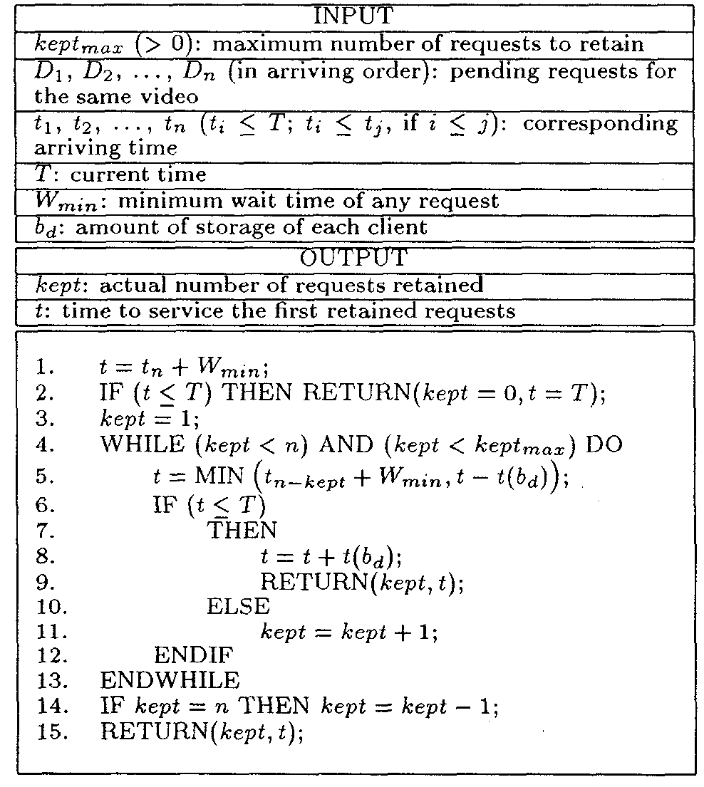
Extended Chaining Algorithm

Slide 11
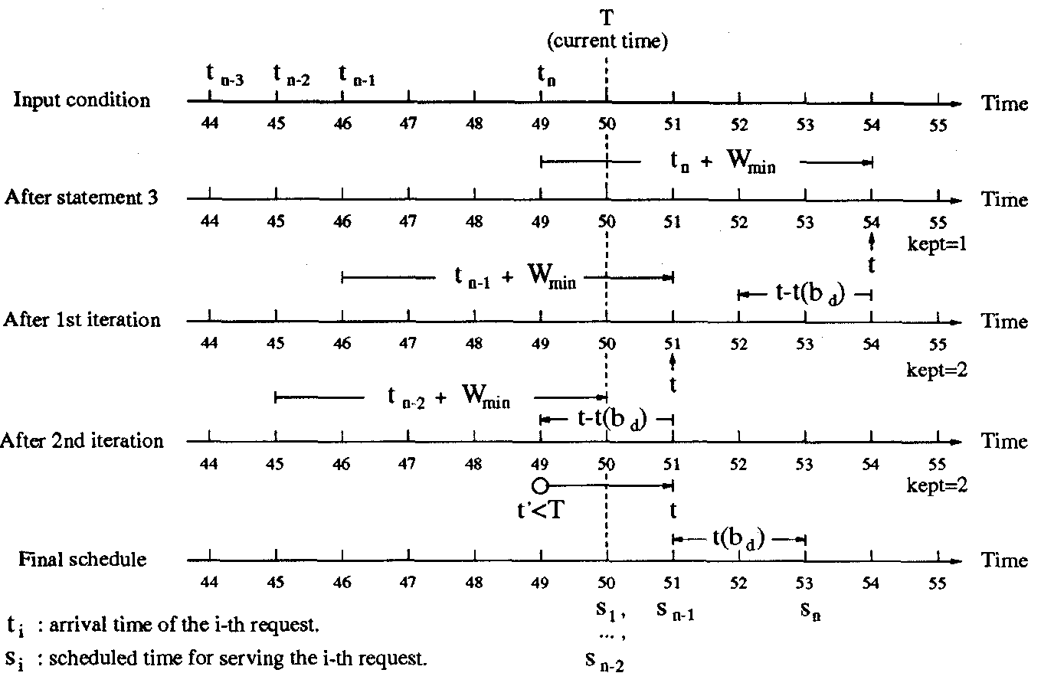

Slide 12
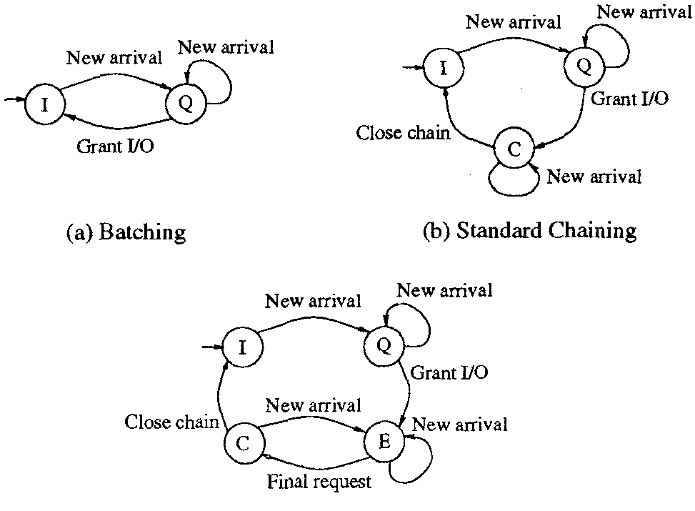

Slide 13
Performance Study

Slide 14
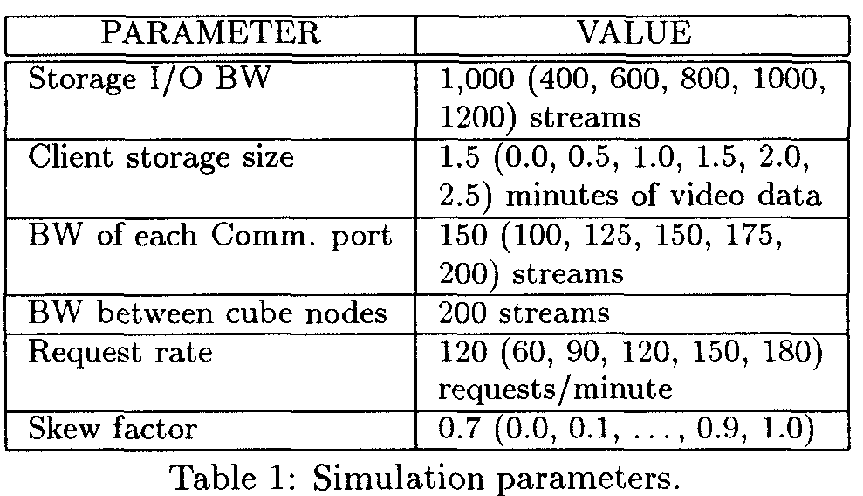

Slide 15
Performance under Different Communication Bandwidths

Slide 16
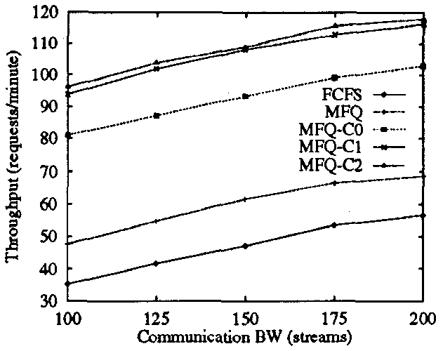

Slide 17
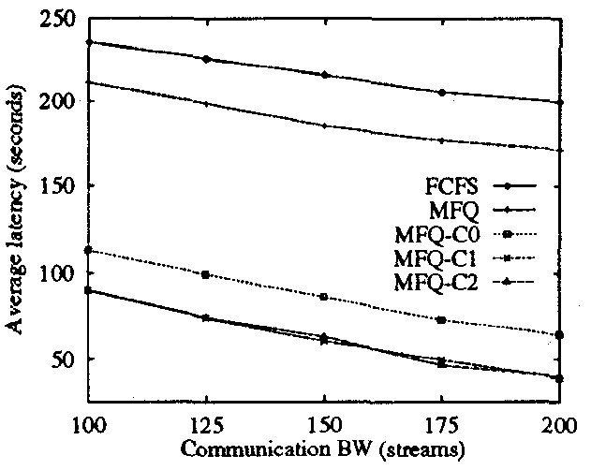

Slide 18
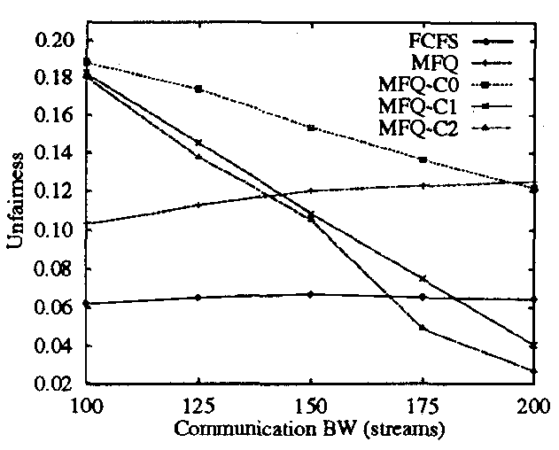

Slide 19
Performance under various Request Rates

Slide 20
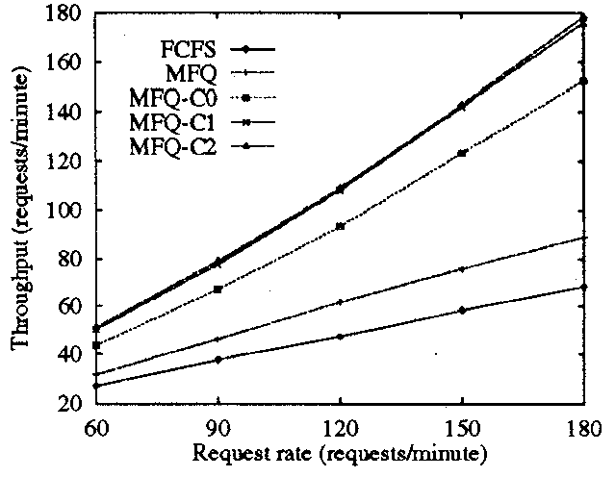

Slide 21
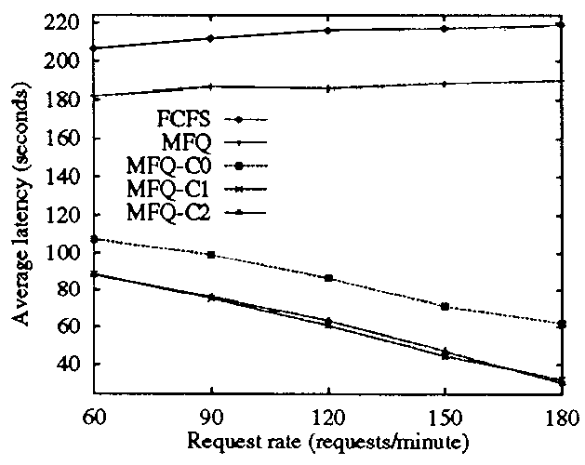

Slide 22
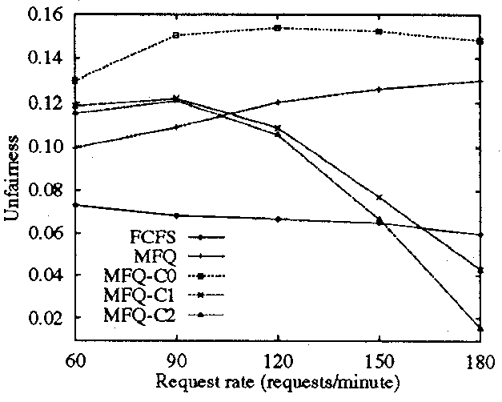

Slide 23
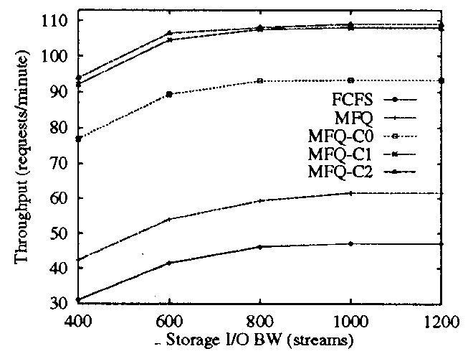

Slide 24
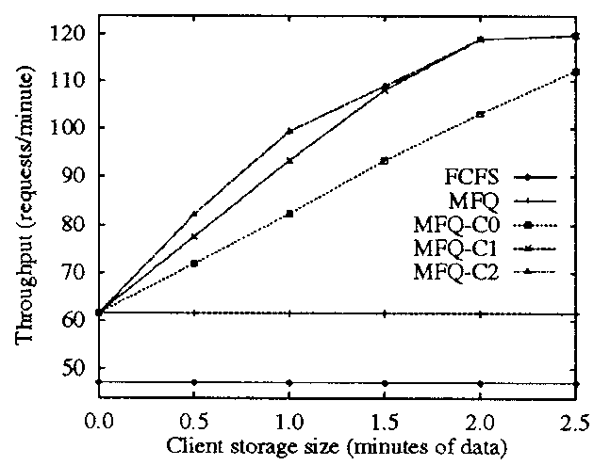

Slide 25
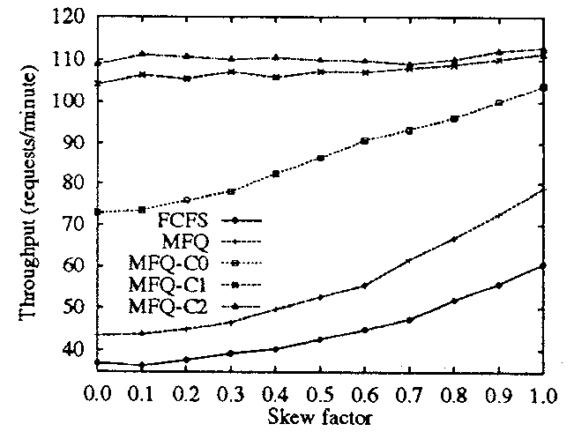

Slide 26
Conclusions
Multicast is useful feature but expensive
Chaining is a generalized multicast system
It is similar to conventional multicast except that the multicast tree if a conventional multicast is statically determined
Chaining trees grows dynamically
Achieved by caching data in the local storage of clients located in the network
Maximizing chaining by strategically deferring service time

