Slide 1
A Lightweight Currency-based P2P VoD Incentive Mechanism
by Chi Wang, Hongbo Wang, Yu Lin, and Shanzhi Chen
Presented by Svetlana Geldfeld

Slide 2
Paper Overview
P2P VoD system has to allow its users to watch video at any point in time and to provide such features as fast forward, rewind and pause.
The proposed system provides a lightweight incentive mechanism based on virtual currency to improve its performance.
Game theoretic analysis is provided to prove that the proposed incentive mechanism can relieve server’s heavy load and increase users’ contributions.

Slide 3
P2P Systems Overview
P2P is very popular due to its powerful sharing and distributing ability.
This ability is heavily reduced without a suitable incentive mechanism.
Users have strong motivations to be free riding the system.
For example, Gnutella study shows that 85% users share no files.

Slide 4
Barter-Exchange Incentive Mechanism
Peer offers data needed by another peer and gets data he needs as reward.
Easy to implement.
Prone to delays while seeking for suitable peer
Peer has no incentive to keep sharing file after download completes.
Example: Bit-Torrent tit-for-tat mechanism

Slide 5
Virtual Currency Incentive
System first establishes an account for every user.
It charges users for every download and rewards for every upload.
System removes time delay while seeking for peers.
Adds extra load into the system by tracking every transaction.
Examples:
Micro-payment, Dandelion, Scrip, Pace, etc.

Slide 6
P2P and Media Streaming
Media streaming system has its own particular characteristics:
1. Peer with advanced point in playback can provide data for the behind peer, but the latter has nothing to give in exchange (barter-exchange will not work).
2. Real-time streaming requires quick location of a peer and data exchange. It also requires that the incentive mechanism to be as light as possible.
3. Users are scattered among thousands of video files so it is difficult for them to cooperate.

Slide 7
Media Streaming Classification
Can be subdivided into two groups:
1. Live streaming
Content transmitted in real time to all users
2. Video on Demand
Asynchronous content distribution => heavier burden on the server.

Slide 8
Multiple Video Cache
Main characteristic:
larger buffer for storage of additional data (not just the playback buffer)
Users allocate additional memory for previous movies, which they have viewed before and upload that data while they are watching a different movie.
Greatly improves cooperation and reduces server load.

Slide 9
Virtual Currency-based Incentive Mechanism
Server keeps all account information for each user.
Peer gains “money” when uploads the completely downloaded file.
Other peers “pay” to that peer for the download.
Audience peers (watching the same video file) are not considered by the system.

Slide 10
Features
Incentive is applied to the entire system (not a single file).
Only upload and audience peers data exchange is considered.
Encourages users to share the file that is completely downloaded.

Slide 11
Further Discussion
Currency-based incentive mechanism system details
Game theory analysis of the system
Conclusions

Slide 12
System Structure
Two main modules are considered:
1. Servers
Provide centralized management of the system including video content and peers’ account maintanance.
2. Peers
Can start watching a movie at any point in time with small startup times and sustainable playback rates.

Slide 13
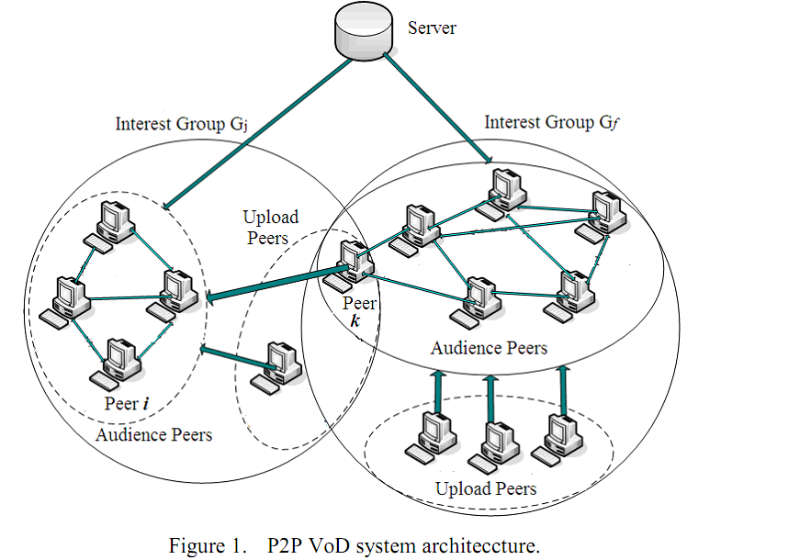
System Architecture –Cont.

Slide 14
Pricing Scheme
Two main questions when constructing:
1. What to price
2. How to set the price
Main requirements:
Peer actions that result in reducing server load should be rewarded and the opposite should be charged accordingly.
Playback quality should not be affected.

Slide 15
Pricing Scheme Considerations
Uploading peers are main contributors to saving server bandwidth.
No uploading peers = server does all the work.
Upload peer’s contribution is much more significant due to the fact that he has the whole file downloaded = higher probability of having complete file received from that source by the audience peer.
Upload peer contribution considered higher on average.

Slide 16
Pricing Scheme Considerations – cont.
Data sharing between audience peers is also important, but not accounted for in the pricing.
The accounting that would be required to keep these records would surpass the effectiveness gained by the system.
Therefore, only upload and audience peers data exchanges are considered for accounting by the server.

Slide 17
Main Pricing Factors
Reward can be calculated as:
where R is reward that peer k gets from uploading file j, p is the unit price per upload bandwidth, and y is the rate of peer kuploading file j.
So total reward of the set of upload peers can be calculated as
From the above we can derive , where Bj is the bill a peer group pays for downloading file j.

Slide 18
Resulting System Overview
Main idea: Price of upload bandwidth is global and uniform.
Therefore:
Reward is directly dependent on the shared bandwidth.
Reward does not depend on the actual video file shared.
The payment decreases with number of peers in the audience group.
Collusion will not work in such system:
Case when there are only collusion peers in the system: the total balance will be 0 => no incentive.
Case the peers disguising as an audience: balance will not come right (upload rates are not sustainable)

Slide 19
System Mechanisms
When a new peer joins:
Bank server opens a new account and offers a subsidy to help with first file download
The amount of subsidy is the major consideration for system effectiveness:
Subsidy too small – new peer will not download a complete file
Subsidy too large – peers can avoid to contribute to the system (periodically leave and rejoin the system getting new subsidy each time)
Currently the subsidy is set to the median price of all the video files in the system.

Slide 20
System Mechanisms
A request for a video chunk process:
1. A peer i chooses a video interest group G to join as an audience peer.
2. Peer i sends request for a video chunk to the server
3. Server replies i with a list of peers in the video group
4. i chooses from the list the audience peers with data available
5. If no such peer is available, i searches the upload peer list
6. If no upload peers are available, i requests the server to transfer data.

Slide 21
System Mechanisms
End of video chunk transmission:
1. After a video chunk is transmitted from upload peer to audience peer, the server records the interest group, the upload peer and his upload bandwidth.
2. The Bank server records every trade and deposits the rewards in the account of the seller.
3. The Bank server draws points from the balance of the buyer.

Slide 22
Game Theoretic Evaluation
Game consists of three main components:
1. Set of players (peers)
2. Set of strategies for each player
3. Utility function that gives each player’s utility to each list of the players’ strategies.
Players are assumed to be selfish and rational
Each player’s belief about other players’ strategies is believed to be correct.
Peer decisions reflect several VoD system parameters: video group to join, download and upload rate, usage of disk space (bandwidth and jitter are omitted for simplicity).

Slide 23
No Incentive Mechanism System Analysis
The utility function of such system can be represented as follows:
U(x,y,d), where
X = download rate
Y = upload rate
D = occupied disk space
The authors prove that such system is the most effective when user maximizes its download rate and minimizes upload rate and disk space utilization.

Slide 24
Lightweight Currency-based Incentive System Analysis
The utility function of such system can be represented as follows:
U(x,y,z,d), where
X = download rate
Y = upload rate
Z = upload rate of a completed file (already vewed)
D = occupied disk space
The authors mathematically prove that such system provides incentive for a peer to upload as much as possible in order to maximize his utility.
They further show that the more users download the better utility they can get, thus achieving maximum download rates.

Slide 25
Conclusions
1. Features of P2P VoD system were analyzed.
2. It was shown that the fundamental problem of the VoD system lies in the heavy server load and random action of the peers in the system.
3. A new lightweight incentive mechanism based on currency was proposed.
4. Its pricing scheme was analyzed and it was shown that the system stimulates peers to share the completely downloaded video files.
5. It was demonstrated through game theoretical analysis that the system can lighten the server load and increase cooperation between peers.

Slide 26
Future Work
1. Differentiated service scheme would be a nice addition to the system.
Example: higher resolution videos in exchange for higher points.
Study of reduction of cross-ISP traffic would be advantageous for the system. Alternatively, ISPs could become a part of the system and get “paid” for better network utilization.

Slide 27
Questions?

