Slide 1
Dandelion: Cooperative Content Distribution with Robust Incentives
Michael Sirivianos Xiaowei Yang Stanislaw Jarecki
Presented by
Vidya Nalan Chakravarthy

Slide 2
Contents
Introduction
Design
Overview
Robust incentives
Credit management
Unauthorized content distribution
Preliminary evaluation
Implementation
Experimental results
Conclusions

Slide 3
Motivation
Cost efficient solution to handle demand peaks
Robust incentives for client co-operation
Discourage unauthorized content exchange

Slide 4
Online Content Distribution
Issue
Cost effective solution to handle peak usage
Over-provisioning
Solutions
Content Distribution networks
Free CDNs
Dandelion

Slide 5
Online Content Distribution – Solutions
Content distribution networks
Example: Akamai
Services are costly
Free CDNs
Examples: Coral, CoDeen and Cob-Web
Lack viable model to scale

Slide 6
Online Content Distribution – Solutions
Dandelion
Cost effective solution to handle flash crowds
Utilizes clients’ bandwidth
Redirects requests to other clients with the content

Slide 7
Online Content Distribution – Solutions
Server
Dandelion Server
Flash crowd scenario
Peer-serving mode

Slide 8
BitTorrent Vs Dandelion
`BitTorrent uses rate based tit for tat
Susceptible to manipulation
No motivation to upload after completion of download
No incentives for uploading in BitTorrent

Slide 9
Design
Overview
Robust Incentives
Credit Management
Discouraging unauthorized content distribution

Slide 10
Overview

Slide 11
Dandelion server
Distributes small and large static files
Responds to client requests with content
Enters peer-serving mode when overloaded
Redirects requests to other clients with the content
Maintains virtual economy
Robust incentives
Credits used for future downloads

Slide 12
Data Distribution (I)
Server splits data into chunks
Chunks are disseminated independently
Allows clients to upload on receipt of a chunk
Increases efficiency of distribution pipeline
Incentivizes clients to upload chunks to earn credits for downloading other missing chunks
Chunk1
Chunk 2
Chunk3

Slide 13
Data Distribution (II)
Dandelion Server
Chunk 1
Chunk 3
Chunk 2
Chunk 2
Chunk 1
Chunk 3

Slide 14
Robust Incentives

Slide 15
Key challenges
Prevent client cheating
Client does not upload any data
Client uploads garbage and claims credit
Maintain low processing and bandwidth costs

Slide 16
Solution
Cryptographic fair exchange mechanism
Dandelion server mediates exchanges
Non – repudiable complaint mechanism

Slide 17
Peer serving protocol
Clients
have password protected accounts with server
establish a secure channel to obtain shared session keys
Message exchange during a flash crowd event is as shown:

Slide 18
Peer serving protocol
Step 1:
1
Notes:
Client B sends request to server

Slide 19
Peer serving protocol
Step2:
2
1

Slide 20
Peer serving protocol
Step 3:
3
2
1

Slide 21
Peer serving protocol
Step 4:
3
4
2
1

Slide 22
Peer serving protocol
Step 5:
3,5
4
2
1

Slide 23
Peer serving protocol
Step 6:
3,5
4,6
2
1

Slide 24
Peer serving protocol
Step 7:
3,5
4,6
2
1,7

Slide 25
Peer serving protocol
Step 8:
3,5
4,6
2,8
1,7

Slide 26
Peer serving protocol
A’s commitment does not verify due to
Transmission error or
A misbehaving or
B misbehaving
Server warns B and does not return encryption key k
It does not update A’s or B’s credit
B re-requests the chunk from A or another client

Slide 27
Peer serving protocol
If B receives repeated invalid commitments from A, it should disconnect from A and blacklist it
If server receives repeated decryption requests from B with invalid commitments from A, B is blacklisted

Slide 28
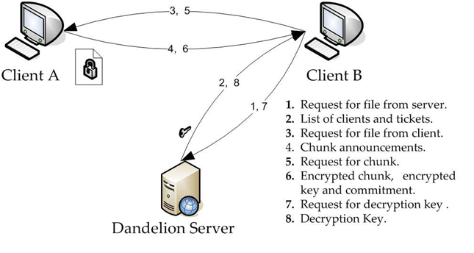
Peer serving protocol

Slide 29
Complaint Mechanism
If decrypted file is invalid, B complains to the server
Complaint message contains
A’s commitment
Digest of the encrypted chunk
Encryption of key k
A cannot repudiate it

Slide 30
Complaint Mechanism
If commitment verifies
Server checks if commitment is computed over a valid chunk
If it does not verify, A is misbehaving
If commitment does not verify
B is misbehaving

Slide 31
Credit Management

Slide 32
Credit Management
Clients spend Δ_{c} > 0
Clients earn Δ_{r} > 0
To prevent colluders from increasing sum of their credit, Δ_{c} = Δ_{r}

Slide 33
Credit Management
Users with paid accounts
User purchases initial credit
Content provider redeems credit for monetary rewards
Motivates client to upload to earn credit
Accounts without monetary transactions
New clients are given a portion of credit
Accumulates credits for uploading

Slide 34
Multiple registration
Boosting credit by registering multiple times
Not an issue with paid accounts
User purchases initial credit
Issue in free content distribution
Sybil attacks similar to Farsite and Pastiche
Requires a registration process

Slide 35
Discourage unauthorized content distribution

Slide 36
Unauthorized content distribution
Uploading to unauthorized users
No strong incentives
Server can refrain giving credit to unauthorized users
Verify legitimacy of requests
Avoid wasting bandwidth on unauthorized users
Clients are held responsible for uploading to unauthorized users

Slide 37
Preliminary Evaluation
Prototype Implementation
Experimental Results

Slide 38
Prototype Implementation
Cryptographic operations
Openssl C library
Credit management system
Database engine of Sqlite library
Architecture - combination of
Asymmetric Multi Process Event Driven Architecture
Staged Event Driven Architecture

Slide 39
Database Operations
Main thread reads request from network
sends requests to disk access or database access helper threads
Helper thread finishes and sends requests to another thread pool
Use zero-copy sendfile() for chunk transmission

Slide 40
Network Operations
use TCP
are asynchronous
are executed by thread processing the last stage of the request

Slide 41
Design features:
Exploits parallelism
Good performance with both small and large files
number of concurrent connections/pending requests are kept separate from number of threads that can be handled by the OS

Slide 42
Experimental results
Server tasks in a flash crowd event
1. Process key decryption requests
One HMAC operation and block cipher decryption
One query and two updates on credit database
Transmits decryption key
2. Send short responses
Types of client requests
Request for decryption keys
Requests for file chunks directly from server

Slide 43
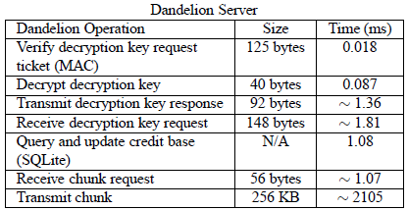
Server Operations
Cryptographic operations are highly efficient
Symmetric encryption is cheap
Bottleneck – download link

Slide 44
Client Operations
Client’s processing overhead does not affect its upload or download throughput

Slide 45
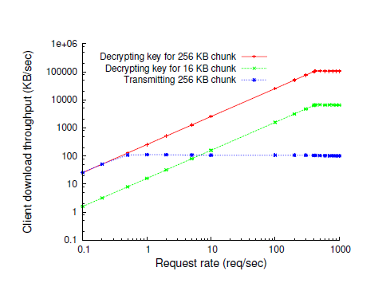
Peer serving mode

Slide 46
Results
Smaller chunk size reduces performance gain
more load on the server due to decryption key requests
Cost of complaining is higher
Involves reading chunk, encrypting, hashing
Cost is not incurred repeatedly
Misbehavers are blacklisted

Slide 47
Conclusions
Contributions:
Robust incentives
Discouraging unauthorized peers
Can be used for copyright-protected digital goods
Drawbacks of Dandelion
Less efficient than BitTorrent tracker
Less scalable than BitTorrent
Distribute dandelion server and credit banks over multiple trusted nodes to improve scalability

Slide 48
Thank You!

