Slide 1
Measurement Study of Peer-Peer File Sharing Systems By Stefan Saroiu, P. Krishna Gummadi, Steven D. Gribble
Presentation by
Manasee Conjeepuram Krishnamoorthy

Slide 2
Why?
Abundant research activity in peer-peer architectures
Need to evaluate the peers in a system to understand the effectiveness of the system
Dearth of such evaluations is the reason behind our study
Notes:
we remedy this situation by performing a detailed measurement study of the two
popular peer-to-peer file sharing systems, namely Napster and Gnutella.

Slide 3
Introduction
Peer-Peer systems lack dedicated centralized infrastructure
Depend on voluntary participation of peers to contribute resources
Challenge – figure out a mechanism for organizing peers so that they can cooperate to provide a useful service

Slide 4
Introduction contd…
System must consider the suitability of a given peer for a specific task
Care should be taken to ensure that none of the peers are overloaded
The two systems measured in our study are
Napster
Gnutella
Notes:
For example if some peers have low BW high latency system must be careful in delegating popular portions

Slide 5
Methodology
Two Step Process
Periodically ‘crawled’ each system to gather instantaneous snapshots of large subsets of the systems’ user population
Actively probe the users in the snapshot over a period of several days to measure various properties
Notes:
After the first point –
Information gathered in these snapshots include
IP Address
Port Number of the user’s client software as well as some information about the users as reported by their software

Slide 6
Napster Architecture
S
S
P
List
S
S
P
?
P
P
P
P
P
Notes:
Peer sends a file location query
Server returns a list of matching files and locations

Slide 7
Gnutella Architecture
P
?
P
P
?
?
P
P
P
R
?
?
P
P
?
?
?
P
?
P
Notes:
Whether or not a match is found the peer continues to flood the query through the overlay

Slide 8
Gnutella Architecture contd…
Any peer that sees a ping message sends a pong back to the originator
Also forwards the ping to its own set of neighbors causing flooding in the network
Scope of flooding is controlled with a time to live (TTL) that is decremented on each hop

Slide 9
Crawler
Goal:
To gather nearly instantaneous snapshot of a significant subset of the population
To gather metadata about peers in captured subsets
Two Crawlers
Napster Crawler
Gnutella Crawler

Slide 10
Napster Crawler
Napster server consists of ~ 160 servers
Server reports files shared by “local users” first, and then files shared by “remote users”
We establish large number of connections to a single server and issue many queries in parallel
Notes:
Parallel queries help in acquiring an instantaneous snap shot within 3-4 minutes.

Slide 11
Napster Crawler contd…
Metadata gathered from the server
Bandwidth of the peer’s connection as reported by the peer
Number of files currently being shared by the peer
Current number of uploads and downloads in progress
Names and sizes of all files being shared by the peer
IP address of the peer

Slide 12
Napster Crawler contd…
Each crawl captured 40% to 60% of the local peers
They contributed 80% - 90% of the total files
Crawler did not capture peers that do not share any popular content.

Slide 13
Gnutella Crawler
Crawler connects to several well-known popular peers
Begins an iterative process of sending ping messages with large TTLs
In addition to the IP address of a peer, each pong message contains metadata about the peer

Slide 14
Gnutella crawler contd…
After 2 minutes we have about 8000-10,000 unique peers
No bias in measurement – Gnutella crawler does not discriminate peers based on popular content.
Notes:
No. of peers are cyclic in nature everyday since the activity is more during specific times of the day.
Unlike our Napster measurements, in which we were more likely to capture hosts sharing popular songs,
we have no reason to suspect any bias in our measurements of the Gnutella user population.

Slide 15
Directly measured peer characteristics
Latency Measurements
Lifetime Measurements
Bottleneck bandwidth measurements

Slide 16
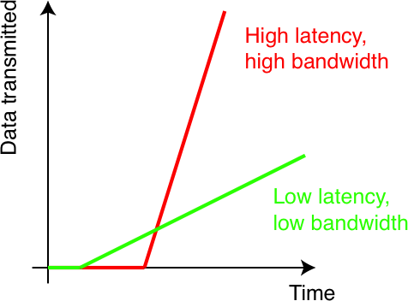
Latency Measurements
Measure round-trip latencies between peers and our measurement machines
TCP congestion control discriminates against flows with large round trip times
Also, the average size of files exchanged is in the order of 2-4 MB
This makes latency an important consideration when selecting amongst multiple peers sharing the same file

Slide 17
Lifetime measurements
Every peer connects to the system using a unique IP Address/port number pair
Three states
Offline
Inactive
active

Slide 18
Lifetime measurements contd…
Offline
Peer is either not connected to the internet or not responding to TCP SYN packets
Inactive
The peer is connected to the internet and is responding to TCP SYN packets but disconnected from the peer-peer system
Hence responds with TCP RST’s
Active
Peer is actively participating and is accepting incoming TCP connections

Slide 19
Bottleneck Bandwidth
1
2
3
4
10 KB/s
20 KB/s
5 KB/s
When Host 1 is connected to Host 4, the slowest bandwidth in our example is 5 KB/s
This is the bottleneck bandwidth for this individual link
Bottleneck bandwidth remains constant for a given individual link

Slide 20
Bottleneck Bandwidth Measurements
Rate at which content can be downloaded depends on:
Bottleneck bandwidth between downloader and the peer
Available bandwidth along the path
Latency
Substantial percentage of the Napster peers choose not to report their bandwidths
Clear incentive to discourage other peers from downloading by reporting a false low bandwidth
Bandwidth measurement tool - SProbe
Notes:
Sprobe uses tricks inspired by Sting to actively measure upstream and downstream BWs.

Slide 21
Summary of measurements

Slide 22
Measurement Results
How many peers fit the high bandwidth, low-latency profile of a server?
How many peers fit the high-availability profile of a server?
How many peers fir the no-files-to-share, always-downloading profile of a client?
The nature of shared files
How much are peers willing to cooperate in a P2P file sharing system?
Resilience of the Gnutella overlay in the face of attacks.

Slide 23
Peers that fit the high bandwidth, low latency profile
Need to understand the percentage of participating peers that exhibit server like characteristics
Such peers should have
High Bandwidth internet connections
Remain highly available
Low latency

Slide 24
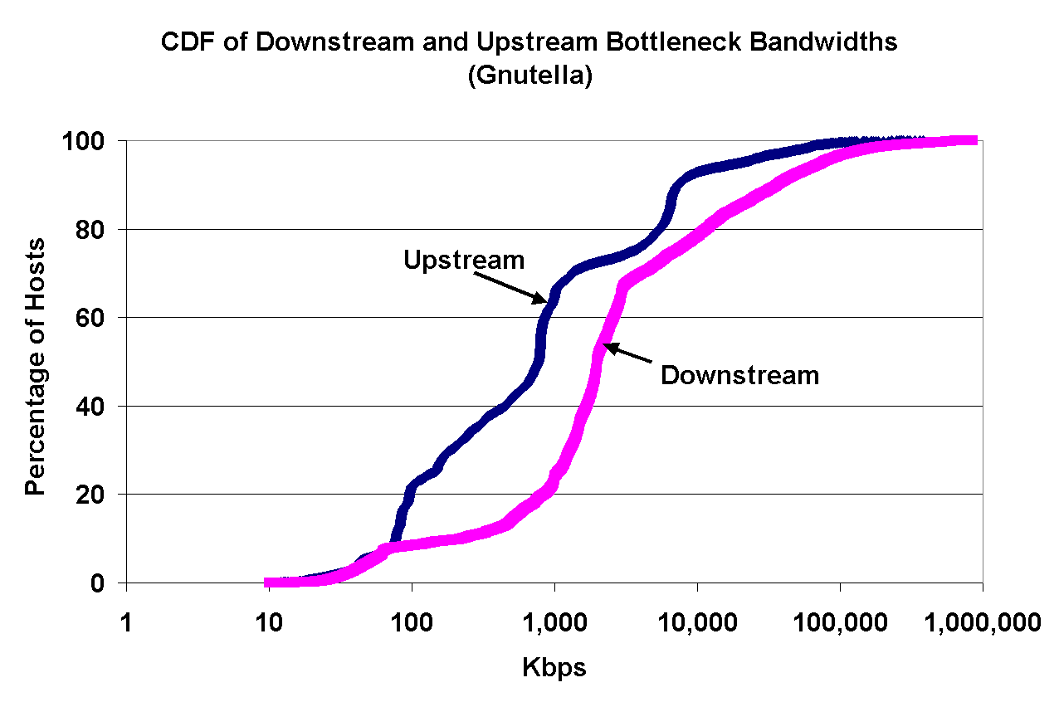
Downstream and Upstream Measured Bottleneck Link Bandwidths
92%
8% of hosts have BW > 10Mbps, exhibiting server like characteristics
22% of hosts have BW < 100Kbps
22%
An asymmetry exists between downstream and upstream bottleneck bandwidths

Slide 25
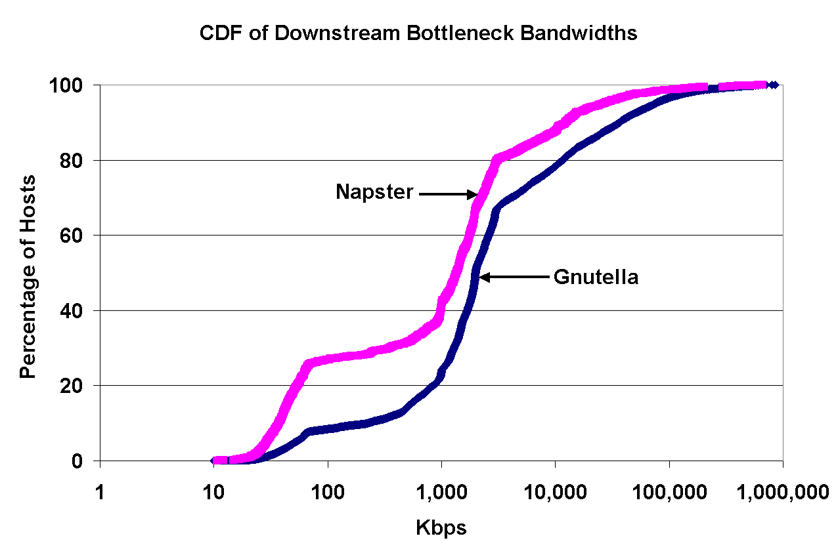
Downstream and Upstream Measured Bottleneck Link Bandwidths
Only 8% of Gnutella users use modem to connect to the internet
(< 64Kbps)
About 25% of the Napster users use a modem to connect to internet
(< 64Kbps)
25%
8%

Slide 26
Downstream and Upstream Measured Bottleneck Link Bandwidths
20% of Napster users and 30% of Gnutella users have very high bandwidth connections
Gnutella users tend to have high downstream bottleneck bandwidths
This is due to
Current flooding based Gnutella protocol is too high of a burden on low bandwidth connection
Gnutella is more popular to technically savvy users (widespread notion)
Notes:
This discourages users from participating
Gnutella users might have faster internet connection

Slide 27
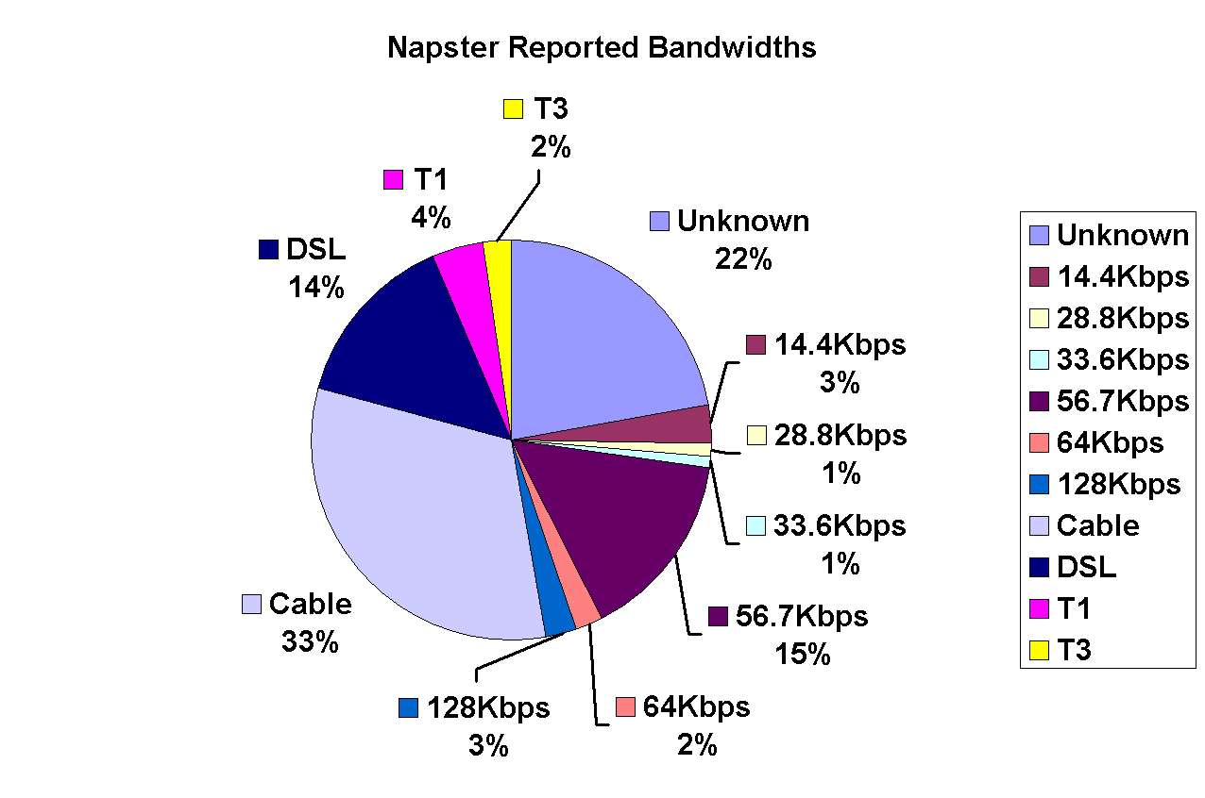
Reported bandwidths for Napster peers
Notes:
A significant percent of the Napster users (22%) report “Unknown”. These users are either unaware of their connection bandwidths, or they have no incentive to accurately report their true bandwidth. Indeed, knowing a peer’s connection speed is more valuable to others rather than to the peer itself; a peer that reports high bandwidth is more likely to receive download requests from other peers, consuming network resources. Thus, users have an incentive to misreport their Internet connection speeds. A well-designed system therefore must either directly measure the bandwidths rather than relying on a user’s input, or create the right incentives for the users to report accurate information to the system.

Slide 28
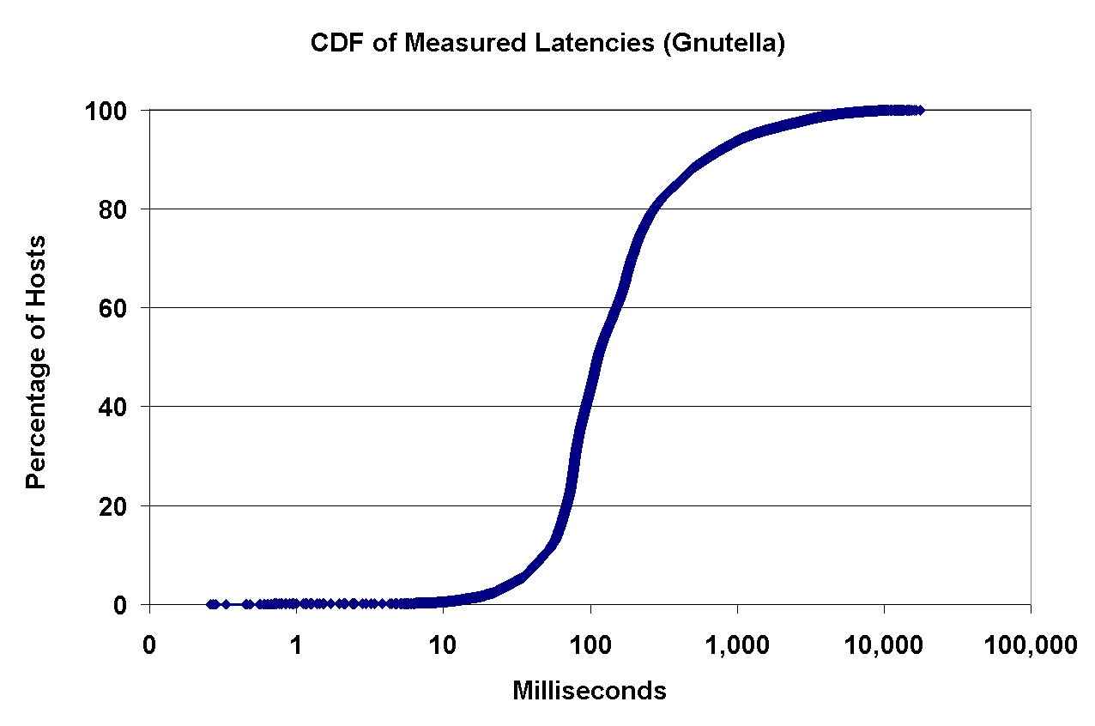
Measured latencies for Gnutella peers
20% of hosts have latencies of at most 70 milliseconds
20% of hosts have latencies at least 280 milliseconds
280ms
70ms
In a peer to peer system where connections are unstructured and ad-hoc, a substantial fraction of connections suffer from high latencies

Slide 29
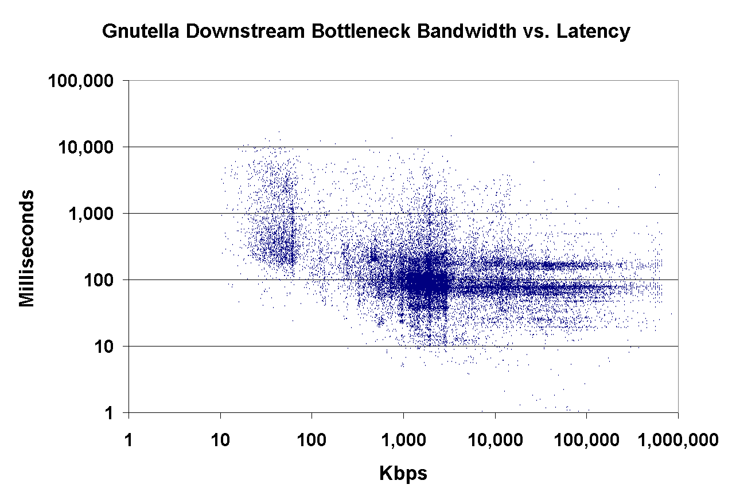
Measured latencies for Gnutella peers
Small cluster @ 20 – 60 Kbps corresponds to a set of modems
Larger cluster @ 1000 Kbps corresponds to a set of broadband connections
Interesting fact
Two horizontal bands – North American East Coast and Europe
3 Large classes of latencies
Notes:
Latencies to peers on the same part
Latencies to peers on opposite part of the continent
Latencies between trans-oceanic

Slide 30
How many peers fit the high availability profile of a server?
Uptime – Measured as the percentage of time the peer is available and is responding to traffic
Internet host Uptime
Represent uptime measured at IP level, i.e. peers that are in inactive or active states
Application host uptime
Represent the uptime of peers in the active state

Slide 31
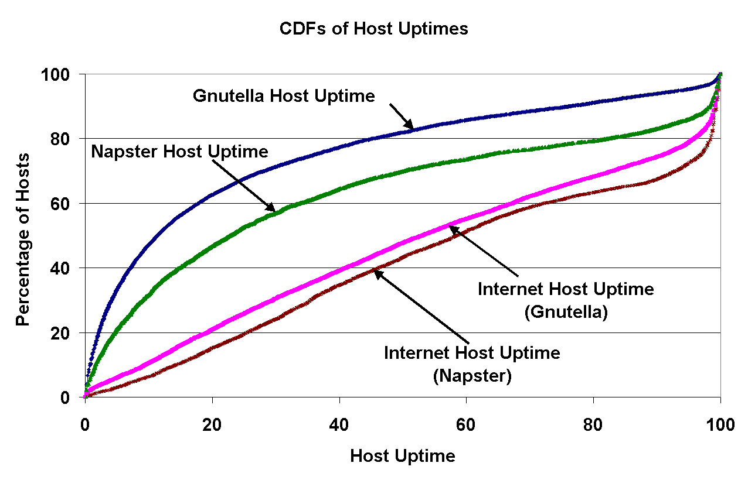
Host Uptimes
83%
93%
45%
Best 20% of Napster peers have an uptime of at least 83%
Best 20% of Gnutella peers have an uptime of at least 45%
More content leads to shorter uptimes – since Napster is of higher quality and more useful, peers tend to stay on the internet longer.
Hence increasing the uptime in Napster
Notes:
Napster’s website has a MP3 player and other attractive features which makes users linger more than they have to. This helps in increasing the uptime.

Slide 32
How many peers fit the no-files-to-share, always downloading profile of a client?
Need to understand the client like peers in the system
Previous studies represent these peers as “free-riders”
Correlating the number of downloads with the peers’ bandwidth should depict a clear picture as to how many of the participating peers bring no benefits to the system.

Slide 33
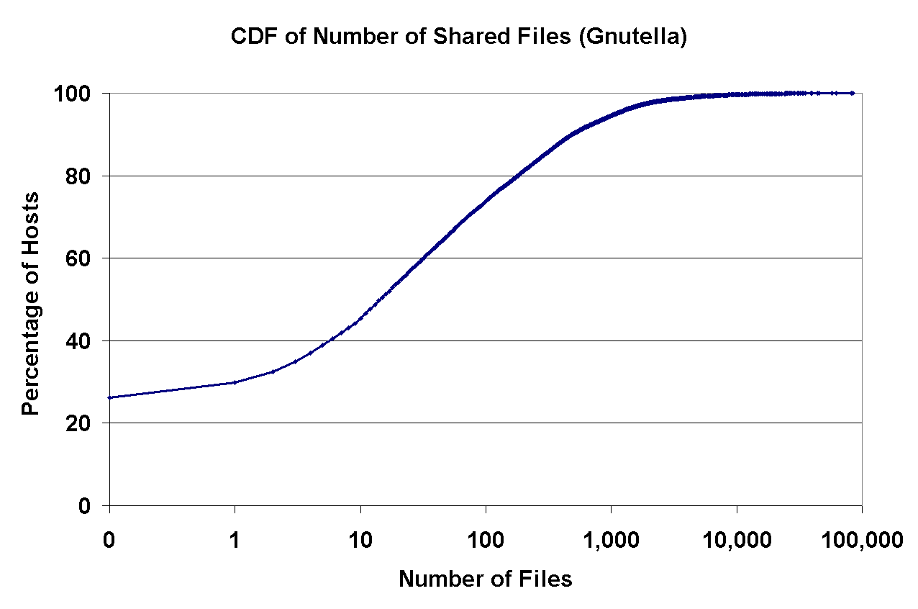
No. of files shared
7% of peers share 1000 files or more
75% of peers share 100 files or less
25% of peers do not share any files at all
The 7% of users together offer more files than all the other users combined.
Gnutella has a large percentage of free riders

Slide 34
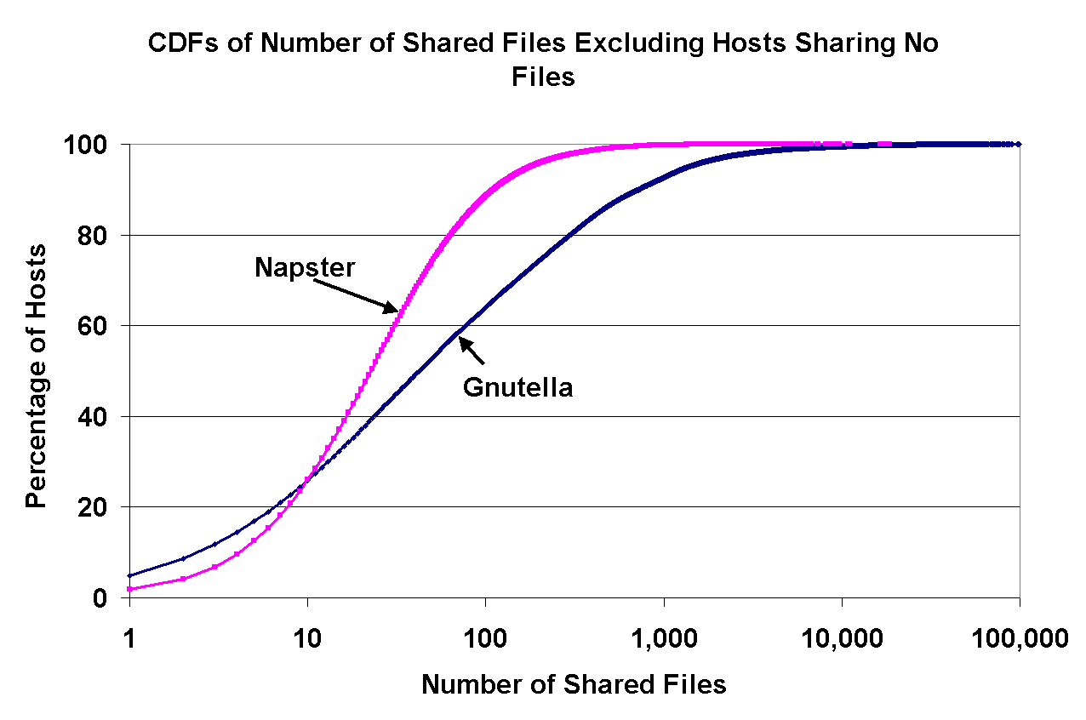
No. of files shared
Napster peers are slightly more consistent than Gnutella
40% - 60% of peers share only 5% - 20% of the shared files indicating large amount of “free-riders”

Slide 35
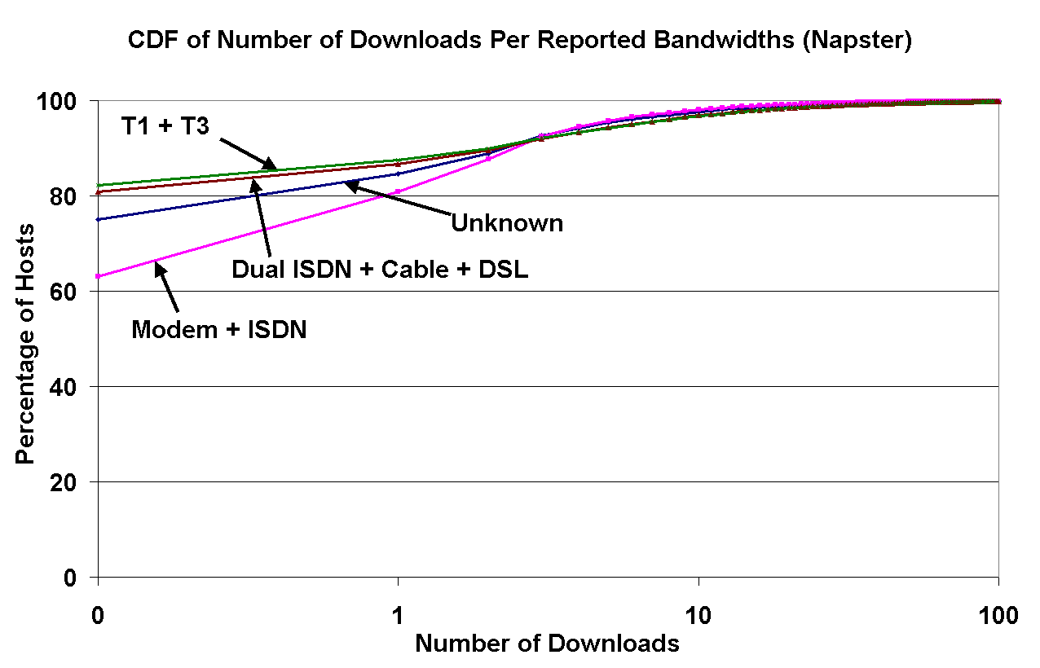
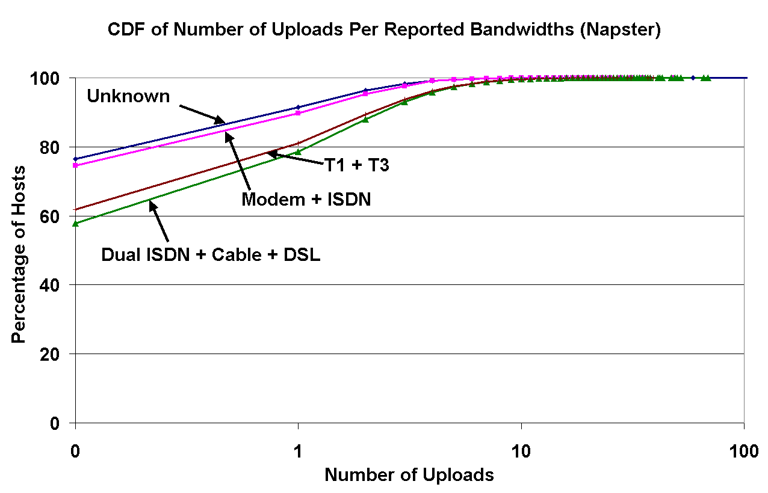
Number of Downloads and Uploads in Napster
20% more zero-download high-speed peers than zero-download low-speed peers
2 possible explanations
Higher bandwidth peers tend to download less often
Spend less time since they have high bandwidth
The correlation between bandwidths and downloads is reversed in uploads
Notes:
Second graph the number of zero uploads is more for low speed internet like modem than low speed

Slide 36
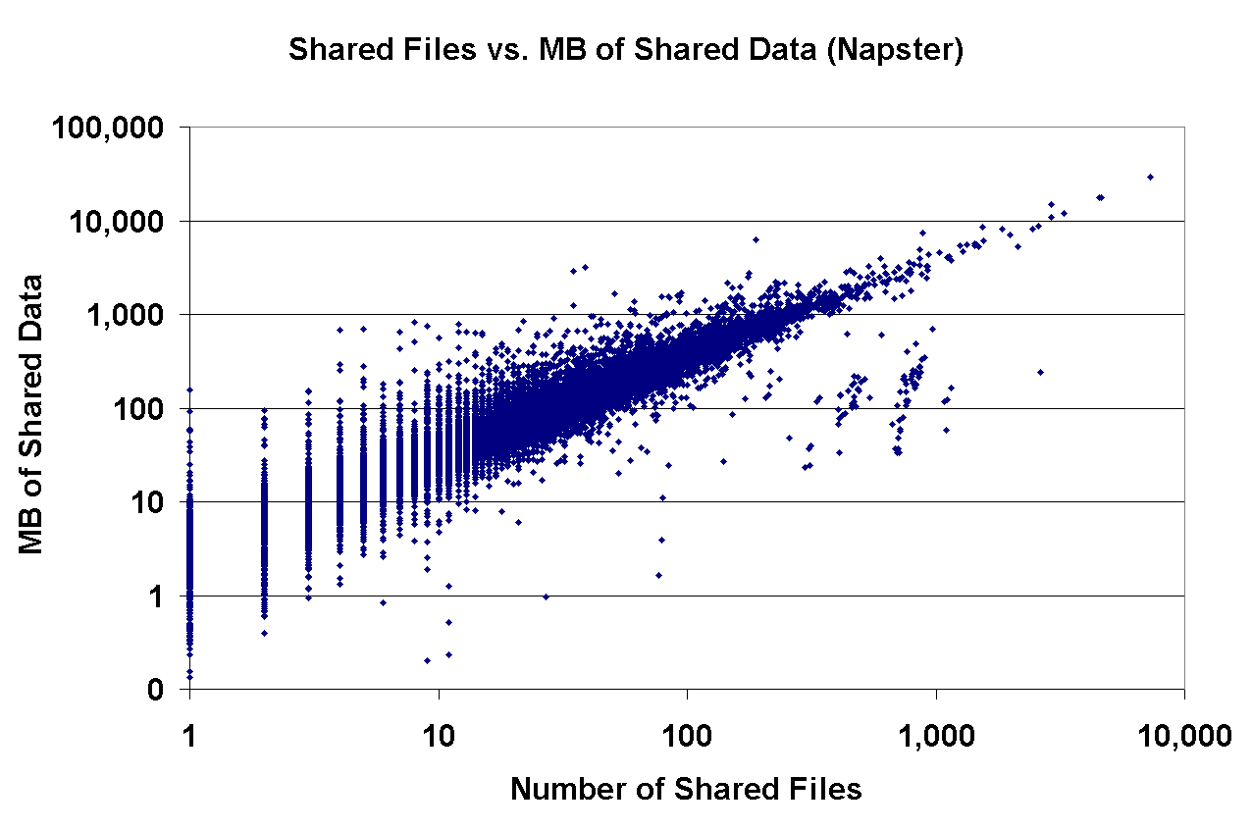
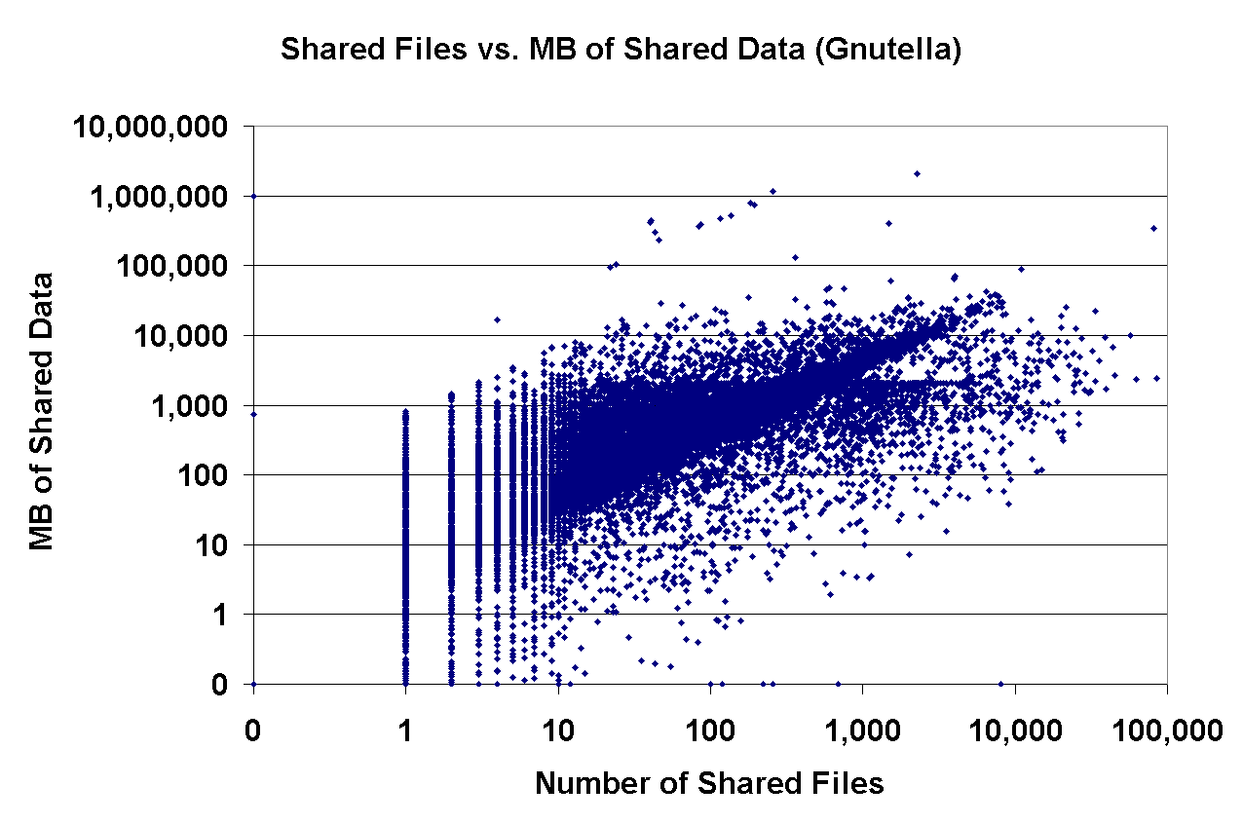
The nature of shared files
Napster – All shared files must be in MP3 format
Whereas any file type can be exchanged in Gnutella
The slope of the graphs below are identical and is 3.7MB ( average size of an MP3 audio file)
Notes:
Obvious lines in the graph imply that there is a strong correlation between the numbers of files shared and the number of shared MB of data.

Slide 37
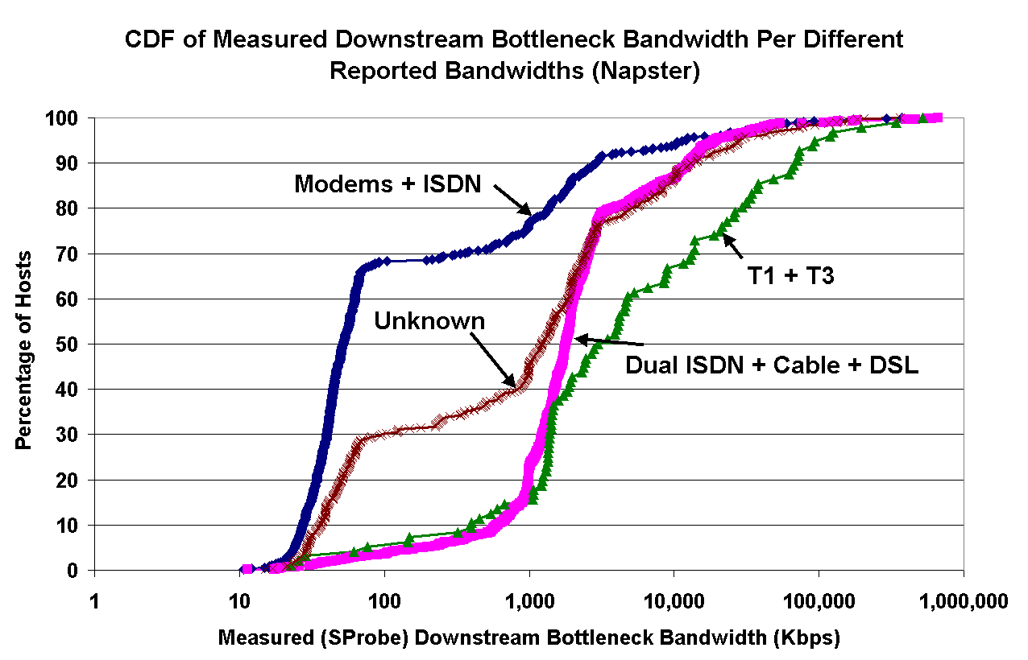
How much are peers willing to cooperate in a P2P file sharing system
30% of users that report BW as 64Kbps or less have a significantly greater BW
10% of the users reporting high BW, in reality have significantly low bandwidth

Slide 38
Resilience of the Gnutella overlay in the face of attacks
Figure a. shows the topology of 1771 peers forming a connected segment of the Gnutella network

Slide 39
Resilience of the Gnutella overlay in the face of attacks
Figure b. shows portion of the topology after 30% of the nodes are randomly removed
Largest connected component consists of 1106 nodes

Slide 40
Resilience of the Gnutella overlay in the face of attacks
Figure c. Shows the topology after removing 63 (less than 4%) of the best connected Gnutella peers.
Highly resilient with random breakdowns but highly vulnerable with orchestrated attacks.

Slide 41
Recommendations to peer-to-peer system designers
Implicit Assumptions | Recommendations
Delegation of responsibility across nodes in the overlay is uniform – all nodes participate equally | P2P systems should delegate different degrees of responsibility to different hosts depending on their characteristics
Peers tend to be willing to cooperate – In a P2P system peers must obey all protocols associated | Instead of relying on reported characteristics, a robust system should directly measure the characteristics of peers in the system
All peers behave equally both contributing resources and consuming them | Not true – client like and server like characteristics can be identified

Slide 42
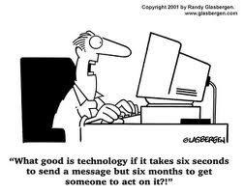
Lessons Learned and Conclusion
Significant amount of heterogeneity in Gnutella and Napster – w.r.t bandwidth, latency, availability and degree of sharing – P2P system must delegate carefully
Asymmetry – Clear evidence of client like or server like characteristics in a significant fraction of users’ population
Peers tend to deliberately misreport information if there is an incentive to do so – P2P systems must be able to directly measure and verify reported information

