Slide 1
Peer-Assisted Content Distribution with Prices
Christina Aperjis, Michael J. Freedman and Ramesh Johari
Presented By
Vidya Nalan Chakravarthy

Slide 2
Abstract
Role of prices
Price – based multilateral exchange
User Incentives
Hierarchical network model
PACE – Peer Assisted Content Exchange
Simulation Analysis
Conclusions

Slide 3
Introduction
P2P systems - Bit torrent
Bilateral barter content exchange mechanism
Problems
Resource allocation
Incentive mechanisms
Bilateral barter
Exchange between well-suited pairs
Implicit encoded prices through rate reciprocation mechanism
Slow stable peering
Hard to find a good reciprocation
Altruistic behavior critical to provide content availability

Slide 4
Multilateral Exchange
System matches user demand with available supply at other peers in the network
Explicit pricing
Helps identify files to disseminate
Identify location of resource congestion
Useful content providers

Slide 5
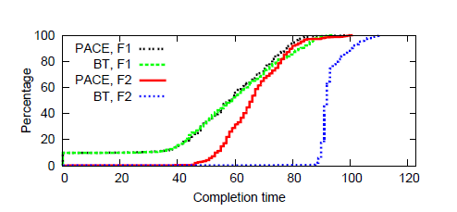
Bilateral Vs Multilateral exchange

Slide 6
Bilateral Vs Multilateral exchange
Multilateral exchange
Equilibrium exists
Efficient under general conditions
Robust to collusive behavior
Bilateral
Equilibrium fails to exist if exchange is restricted
May be inefficient if it exists
May fail to be robust to collusive behavior

Slide 7
PACE
Effectively and practically realizes multilateral exchange
Exchange currency using market based mechanism
Single price per peer
System specifies algorithmic buy and sell behavior
Shield honest users and prevents malicious users from damaging system operation
Gives incentives to contribute

Slide 8
PACE Features
Price Management
Decentralized to user clients
Easily discoverable price information
One price per peer
Incentive Benefits
Use of currency
“market power” is transient

Slide 9
PACE Features
Dynamic adaptation of resource constraints
Identify network congestion
Strong incentive to local transfers
Uses explicit pricing
Flexible

Slide 10
Pricing
Pricing schemes for multilateral exchange
1. one price per peer (PP)
2. one price per file (PF)
3. one price per file per peer (PFP)

Slide 11
Pricing
Comparing schemes through equilibrium or static settings
PP is the most desirable
PF,PP and PFP are equal if only upload capacity restricts transfers
PF is worse than PP if network topology is non trivial
PF and PFP yield equivalent equilibrium

Slide 12
Advantages of PP scheme
Leads to simpler price dynamics
Unpopular files with rare requests
Serves requests sequentially without preemption

Slide 13
Dynamics
Difficult to determine system’s equilibrium prices or allocation in advance
Need to consider dynamic issues
Issues related to dynamics
Peer discovery
Price discovery
Service discipline

Slide 14
Peer Discovery
Faster peer discovery for explicit per-peer prices
Long discovery time for implicitly priced systems
E.g. Bit Torrent’s rate based exchange ratios
System performs a brute force search across peers

Slide 15
Price Discovery
Update price of peers and links based on excess demand
If demand > supply, increase price
In PP scheme
Demand = sum of all received rate requests
Supply = upload capacity of access link
In PFP, excess demand calculation is complex
Excess demand for each file separately
Supply is based on prices
Optimal for peer to upload his most expensive file

Slide 16
Store and Exchange of currency
Advantages
Peers can trade before equilibrium prices are reached
Reach rate allocation by decentralized trading
Issues
Complicated
Exchange and credit balance need to be secured

Slide 17
PACE System design
Multilateral exchange through
Currency and
Per-peer pricing scheme
Peers and links are priced
Peers requests download rates of other peers

Slide 18
PACE System design
To download, peer pays
Uploading peer and
All the links traversed by its traffic
Payment to links is rebated equally among peers
Requests are served sequentially without preemption
Prices are updated based on excess demand

Slide 19
User Incentives
Efficient use of resources in large peer to P2P systems
Users are given incentives
To contribute high percentage of upload capacity
To share high-value content
Currency is stored over time
Users are paid for delivered rates

Slide 20
User Incentives
Network links are priced to reflect congestion
Market Power
Generally transient
Market manipulation cannot increase profit
Issue if few users have a file

Slide 21
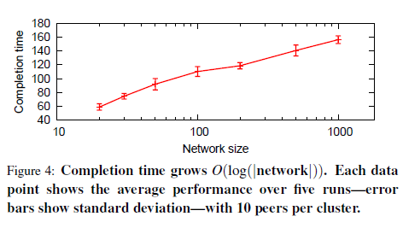
User Incentives

Slide 22
Hierarchical Network Model
Associating price with every link
Infeasible due to
1. lack of network topology and routing information
2. inaccurate bandwidth estimation and
3. computational complexity
Hierarchical model
Prices bottlenecks restricting supply separately

Slide 23
Model Description
Network is divided into local clusters
Types of links
Immediate (local) links
Access links
Transient congestion at access links
Capturing rare bottlenecks

Slide 24
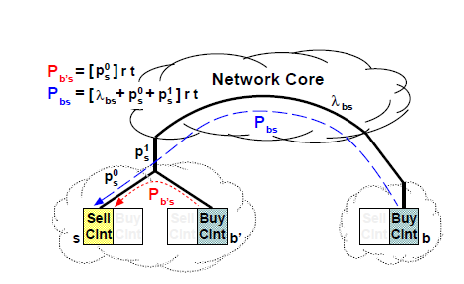
Hierarchical Network Model

Slide 25
Constraints
Nodes within a cluster share high capacity links
Transmission across wide area involves shared, lower capacity access links

Slide 26
PACE client mechanisms
Not directly exposed to end users
Serves as algorithmic devices to ensure efficient exchange
Exposes a simple interface to users
Users’ software computes buy and sell behavior
Mechanisms
Buy client and Sell client

Slide 27
Sell Client
User declares
Files to upload
Total upload capacity
Sell client maintains two prices – P⁰_{s} , P¹_{s}
Update Rule
Demand > Supply => price increases
Supply > Demand => price decreases

Slide 28
Pricing Scarce Resources
Update P¹_{s}
Demand = total requested download rate at remote buy client offering the least P¹_{s}
Supply = upload capacity of access link of sell client
Update P⁰_{s}
Demand = local requests + minimum of remote requests
Supply = upload bandwidth on sell client of immediate link

Slide 29
Service Disciplines
Requests are served in the order of arrival
No incentives to queue requests
per peer pricing

Slide 30
Buy Client
User chooses
Files of (Ti) to download
Savings rate – η% of current balance saved for future use
Steps :
1. order given sell clients (j) by total price
2. buy client spends budget committed
3. if j’s upload capacity is exhausted, move to next sell client
4. budget exhausted - buy client stops
5. unused budget is split between files(Ti - f) evenly

Slide 31
Buy Client
Tradeoff between user’s experience and personalizing utility function
Simplicity Vs descriptive power

Slide 32
PACE functionalities
Resource discovery
Network friendliness
User management
Transactions and currency security

Slide 33
PACE Architecture
Trade content for virtual currency
Rendezvous service
Network price service
Centralized currency mechanism
Secures transactions and currencies
Logically separate services
Rendezvous is file specific
Banks are currency specific
Network prices are independent of files and currency

Slide 34
Resource and Price Discovery
Rendezvous service stores single prices
Input to rendezvous service
File identifier
Buy client information
Output to rendezvous service
set of IP addresses with minimal cost
Determine latest prices
Allocate budget and prioritize transfers

Slide 35
Network Friendliness
Avoid expensive network links
For wide area traversal, network price λ is added to P_{s}
Methods to determine network prices
1. using third party service
2. explicit ISP input
Rendezvous service and network service may be:
1. loosely coupled
2. tightly coupled

Slide 36
Managing Users
Collusion
PACE is robust to collusion (consequence of multilateral exchange)
Aggregate wealth of clients cannot increase by combining trade
Bootstrapping new users
Grant money upon joining or
Ability to download for free

Slide 37
Managing Users
User registration
Protect against sybil attacks
PACE maintains currency as stored value
Bootstrapping occurs only at start and not at every transfer

Slide 38
Securing Transactions
Security through logically centralized banks
Exchanges should be Є – fair
Buy client pays for content received
Sell client receives payment with an Є of content transmitted for the agreed price

Slide 39
Securing Transactions
Failure during the transaction after i/k^{th} of content transfer and Є = 1/k, buy client pays
[(i-1)/k] * P <= P’ <= [i/k] * P
Clients cannot
Forge system currency
Spend more than the current balance

Slide 40
Securing Transactions
At the beginning of transfer
Buy client ‘b’ send cryptographic signature ‘σ’ and certified public key to ‘s’ for verification
To deposit payment
Bank verifies ‘σ’ of b and checks for replay
then it checks the cryptographic hash
Proceeds with the transaction
“double-entry book keeping”
One signature verification
One cryptographic hash

Slide 41
Securing currency and balances
Logically centralized banks are easily scalable
Currency is virtual
PACE uses local banks to aggregate local transactions and reduce load

Slide 42
Securing currency and balances
Content provider acts as
Bank to manage currency and
User registration authority
Public/Private key pairs identify users
Signed certificate is issued to new user
Bank refreshes certificates of active clients
For each registered user, bank stores
1. hash of its public key
2. current balance
3. counter c_{last}

Slide 43
Securing currency and balances
Preventing deposit replays
C_{t} > C_{last} of buy client
If deposit succeeds, C_{last} is set to C_{t}
Preventing overdraw on accounts
Minimize aggregation of payments
Minimize buy client’s certificate expiry time
Sell client performs online check at start
Negative balance is penalized

Slide 44
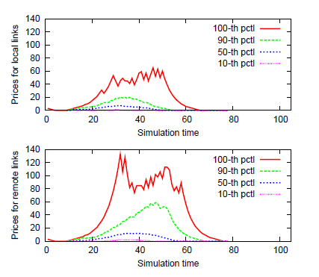
Simulation Analysis - I

Slide 45
Simulation Analysis - I
File prices reflect resource constraints
Local links are cheaper than remote links
Once chunks are disseminated, local prices drop

Slide 46
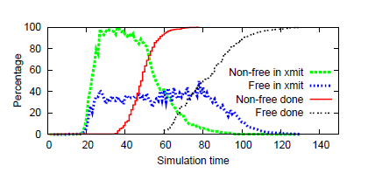
Simulation Analysis - II

Slide 47
Simulation Analysis - II
Contributing upstream capacity improves user’s performance
Non free loaders download chunks faster than free loaders

Slide 48
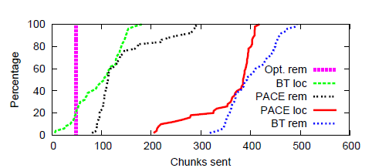
Simulation Analysis - III

Slide 49
Simulation Analysis - III
Local transmissions are preferred over remote in PACE
Bit torrent makes poor use of locality

Slide 50
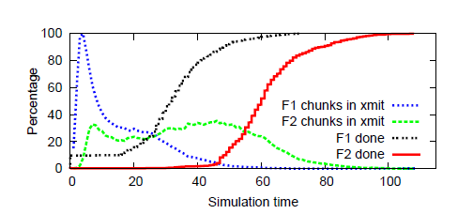
Simulation Analysis - IV

Slide 51
Conclusions
Simple pricing mechanisms are sufficient for efficient allocations
PACE is a system for currency-backed system exchange
PACE’s algorithmic mechanism
Hides complexity from users
Provides robustness
Incorporates network friendliness
Prevents cheating

Slide 52
Future Work
Long term money management
Role of prices in server provisioning

Slide 53
THANK YOU!

