Slide 1
Secure Routing for structured peer to peer overlay networks Miguel Castro1, Peter Druschel2, Ayalvadi Ganesh1, Antony Rowstron1 and Dan S. Wallach2

Slide 2
Introduction
Structured peer to peer overlay networks are resilient – but not secure.
Even a small fraction of malicious nodes may result in failure of correct message delivery.
Assumption that none of the participating nodes is malicious is unrealistic.
Notes:
Assumption that none of the participating nodes is malicious is unrealistic because generally a p2p system allows an open environment where mutually distrusting parties may participate

Slide 3
What this paper is about
An analysis of security issues in structured p2p overlay networks.
A study of attacks aimed at preventing correct message delivery in structured peer-to-peer overlays and present defenses to these attacks.
An evaluation of techniques that allow nodes to join the overlay, to maintain routing state, and to forward messages securely in the presence of malicious nodes.

Slide 4
Need for secure routing
Structured P2P overlay networks are prone to various security attacks.
malicious nodes that mis-route , corrupt or drop messages and routing information.
Malicious nodes that may attempt to assume the identity of other nodes and corrupt the objects.

Slide 5
Requirements of secure routing
A secure assignment of node identifiers
secure routing table maintenance
secure message forwarding

Slide 6
An Abstract Routing Overlay Model
Participating nodes are assigned uniform random identifiers called nodeIds from a large Id space.
App. Specific objects are assigned unique keys
Each key is mapped by the overlay to a unique live node the key’s root
Each node maintains a routing table with nodeIds of other nodes and their as­sociated IP addresses
neighbor set, consisting of some number of nodes with nodeIds near the current node in the id space
application objects are stored at more than one node in the overlay
A replica function maps an object’s key to a set of replica keys, such that the set of replica roots associated with the replica keys represents a random sample of participating nodes in the overlay

Slide 7
NodeId distribution
2¹²⁸-1
O
128 bit circular id space
nodeIDs (uniform random)
objIDs (uniform random)
Invariant: node with numerically closest nodeID maintains object
Key
Node ids

Slide 8
NodeId distribution
2¹²⁸-1
O
128 bit circular id space
nodeIDs (uniform random)
objIDs (uniform random)
Invariant: node with numerically closest nodeID maintains object
Key
Node ids

Slide 9
Node10233102 ^{(2),} (b = 2, l = 8)
0 | 1 | 2 | 3
02212102 |  | 22301203 | 31203203
 | 11301233 | 12230203 | 13021022
10031203 | 10132102 |  | 10323302
10200230 | 10211302 | 1022302
10230322 | 10231000 | 10232121
10233001 |  | 10233232
 |  | 10233120

Slide 10
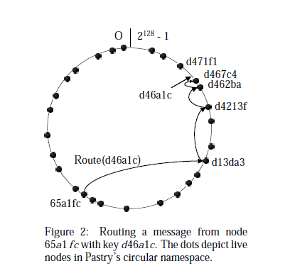
Routing Example

Slide 11
The system model
N nodes that run on an overlay network
Assume a bound f ( 0<= f <= 1) on fraction of faulty nodes
Faulty nodes grouped into independent coalitions with size bound cN ( 1/N <= c <= f)
Major damage when c = f

Slide 12
Secure routing primitive
Ensures that
the message is eventually delivered, despite nodes that may corrupt, drop or misroute the message
the message is delivered to all legitimate replica roots for the key, despite nodes that may attempt to impersonate a replica root
Need solution for
Node assignment
Secure routing table maintenance
Secure message forwarding

Slide 13
Node Id assignment - Attacks
An attacker who can ‘choose’ a node id can
Target a particular victim node whose routing table entries are made to point to a hostile node
choose the closest nodeIds to all replica keys for a particular target object, thus controlling all replica roots
Sybil attacks
Attacks are possible even when an attacker cannot choose the node id but if can get a large number of legitimate node ids

Slide 14
Node Id assignment - Solution
Certified node ids - set of central trusted certification authorities ensure that nodeIds are chosen randomly from the id space , and prevent nodes from forging nodeIds
A certificate binds a nodeId to a public key and its IP.
attacker cannot swap IDs between his nodes
Not a good idea when the IPs change dynamically
Solution for Sybil attacks
Charging money for node id s
Bind nodeIds to real world entities

Slide 15
Secure routing table Maintenance - Attacks
Attackers may fake proximity to increase the fraction of bad routing table entries
Bad routing updates
Hard to determine whether the routing updates are legitimate
This attack causes the value of f move towards 1 easily as the bad routing updates are propogated

Slide 16
Secure routing table Maintenance - Solution
Constrained routing table
impose strong constraints on the set of nodeIds that can fill each slot in a routing table
For node i – at row l and column d , an entry that
shares a prefix of length l with I
has d as its (l+1) st digit
closest nodeID to the point p: p satisfies above properties and has remaining digits same as i
Approach uses two routing tables
one that exploits network proximity information for efficient routing
one that constrains routing table entries

Slide 17
Secure message forwarding
certified nodeIds and secure routing table maintenance ensure that each constrained routing table (and neighbor set) has an average fraction of only f random entries that point to nodes controlled by the attacker.
Attacks are still possible
attacker can reduce the probability of successful delivery by simply not forwarding messages according to the algorithm

Slide 18
Secure Message forwarding - Attacks
the probability of routing successfully between two correct nodes when a fraction f of the nodes is faulty is only: (1-f )^{h-1} where h is the average no of routing hops
Probability of routing correctly to a non-faulty replica root is (1-f)^{h}
Fewer hops increase the probability of routing correctly
number of hops can be decreased by increasing the value of b.
But increasing b also increases the cost of routing table maintenance

Slide 19
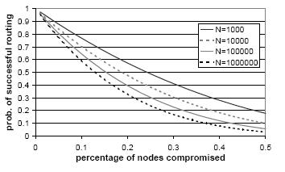
Probability of routing to a correct replica b=4

Slide 20
Secure Message forwarding - Solution
ensures that with very high probability at least one copy of the message reaches each correct replica root for the key.
Route message to the key
Root node returns prospective set of replica roots
apply failure test on all replica roots
If the test results are negative , accept the replica roots
If the test results are positive , apply redundant routing

Slide 21
Routing failure test
Route the message to root of destination key
Collect the set of prospective replica roots
Apply RFT on the set of prospective replca roots
-ve
RFT result
+ve
Accept the replica root set as the correct ones
Apply redundant routing

Slide 22
Routing failure test
Takes a key and the set of prospective replica roots
Returns negative if the set of roots is likely to be correct for the key; otherwise positive
If no set is returned within a time frame, returns positive
Works by comparing the density of nodeIDs in the sender’s neighborhood set with the density of nodeIDs close to the replica roots of the destination key – It is observed that the avg density of nodeIds per unit volume in the id space is greater than the avg density of faulty nodes.

Slide 23
Routing failure test - Attacks
Attacker can collect nodeId certificates of nodes that have left the overlay, and use them to increase the density of a prospective root neighbor set
Attacker can include both nodeIds of nodes it controls and nodeIds of correct nodes in a prospective root neighbor set

Slide 24
Routing failure test - Solution
the sender contacts all the prospective root neighbors to determine
if they are live and
if they have a nodeId certificate that was omitted from the prospective root neighbor set.
Prospective root returns to the sender a message with the list of
nodeId certificates
secure hashes of the neighbor sets reported by each of the
prospective root neighbors
set of nodeIds that are used to compute the hashes in the above list.
The sender checks that the hashes are consistent with the identifiers of the prospective root neighbors

Slide 25
Redundant routing
Invoked when routing failure test returns positive
Idea – route copies of the message over multiple routes toward each of the destination key’s replica roots
Issue – How to ensure that routes are diverse
Solution – neighbor set anycast
sends copies of the message toward the destinationkey until they reach a node with the key’s root in its neighbor set.
use the detailed knowledge that such a node has about the portion of the id space around the destination key to ensure that all correct replica roots receive a copy of the message.

Slide 26
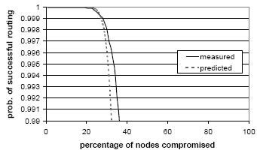
Performance of redundant routing

Slide 27
Overhead
Secure routing primitive adds significant overhead over the conventional routing
Overhead can be reduced by storing self-certifying data in the overlay
A client can go for a secure routing primitve only when the integrity check of the object fails.

Slide 28
Thank you!

